Slide 1
Characterization of boron irradiated by laser-driven protons in high-repetition-rate petawatt-range experiments by laser induced breakdown spectroscopy
V. Lazic, S. Almaviva, M. Scisciò, M. Alonzo, B. Grau, M. R. D. Rodrigues, G. Petringa, A. Bonasera, R. Catalano, E. Domenicone, P. L. Andreoli, D. Batani, K. Batani, M. Cipriani, G. A. P. Cirrone, G. Cristofari, E. Di Ferdinando, D. Dubresson, L. Giuffrida, D. Margarone, M. Nocente, F. Schillaci, M. Tryus, C. Verona, and F. Consoli.
ENEA, Dept. NUC, Frascati (RM), Italy
11/09/2025, IWPBF

Slide 2
Content
LIBS fundamentals - briefly
Depth profiling by LIBS
Correlation studies in LIBS
LIBS on irradiated Boron sample
Conclusions and discussion

Slide 3
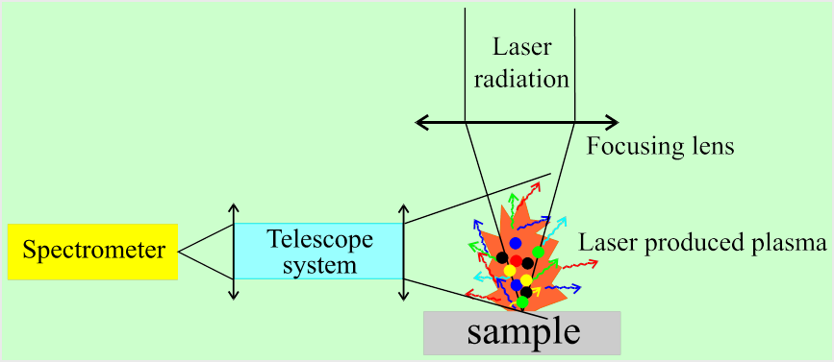
1. LIBS - fundamentals
Signal generation:
Plasma formation by short laser pulses (ns to fs) by breakdown of media or laser ablation
Hot plasma (T>10 000 K) contains elements initially present in the evaporated sample volume
Plasma expansion, cooling and re-combination
Multi-element detection by capturing the (delayed) plasma emission over wide spectral range
Characteristics:
Qualitative analyzis independent on the atomic weight
Relatively high detection sensitivity (ppb-ppm, pg-ng)
Micro-destructive and localized measurements inside laser spot (< 1mm)
Rapid measurements
Possibilities:
Measurements in any environment (gas, vacuum, water)
No sample preparation
Stand-off measurement (distance up to 100 m)
Depth profiling of solid samples
Element quantification through calibration or initially calibrated «calibration-free»

Slide 4
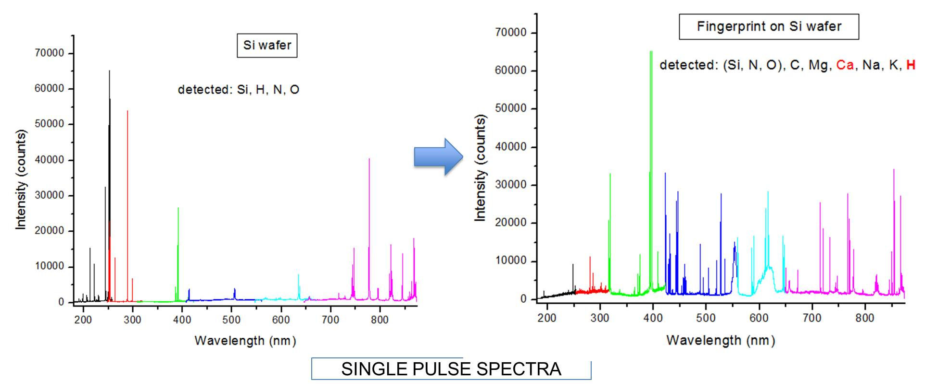
1. LIBS - fundamentals
By a single laser pulse it is possible to detece ALL elements inside the ablated layer (0.1-10 µm) if above the detection threshold
HIGHLY SENSIBLE FOR ANALYSIS OF TRACE SAMPLES (< 1 ng)

Slide 5
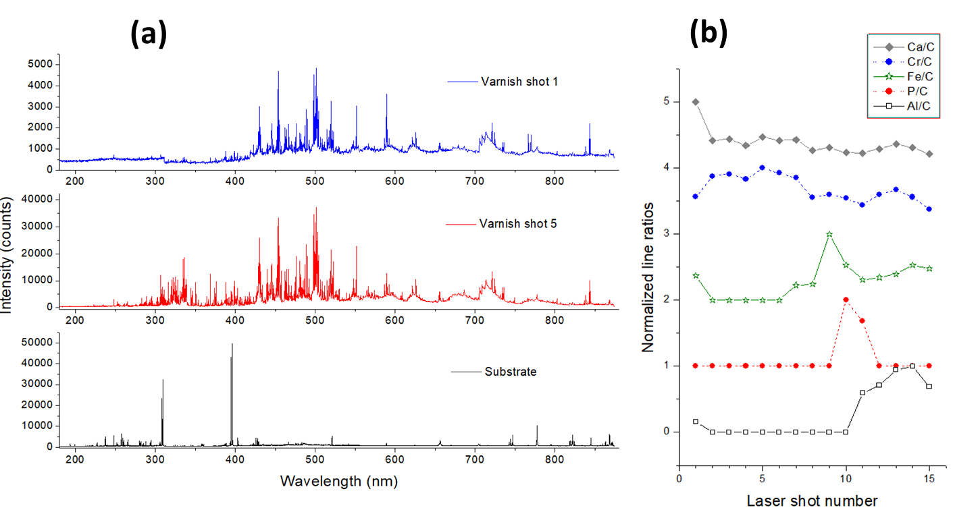
2. LIBS – depth profiling
LIBS depth profiling of solid samples: detection of spectra after each laser pulse (layer by layer ablation)
The depth profiling of car paint (white varnish) distinguished the chemical composition of all four sample layers.
A Novel LIBS Sensor for Sample Examinations on a Crime Scene, Sensors 2024, 24, 1469
(a) Single pulse LIBS spectra on white varnish topcoat (shot 1), basecoat (shot 5) and substrate of sample 8. (b) Normalized line intensity ratios as a function of the laser shot number.

Slide 6
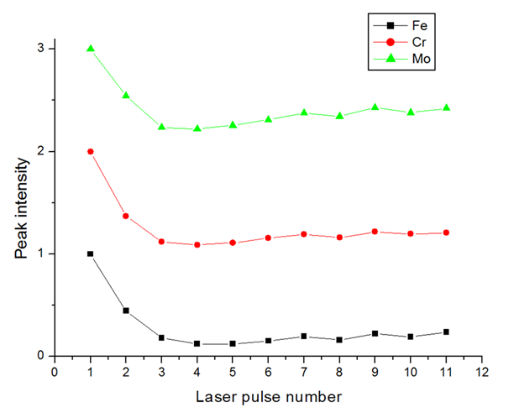
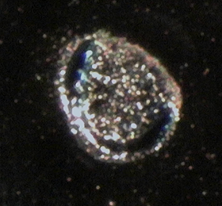
2. LIBS – depth profiling
To pay attention:
Possible metal polishing by laser pulses
Possible inclusions hard to ablate
Surface ripples and/or grains produced by material melting and successive solidification
Surface polishing: sample steal AISI 304, normalized peak intensities

Slide 7
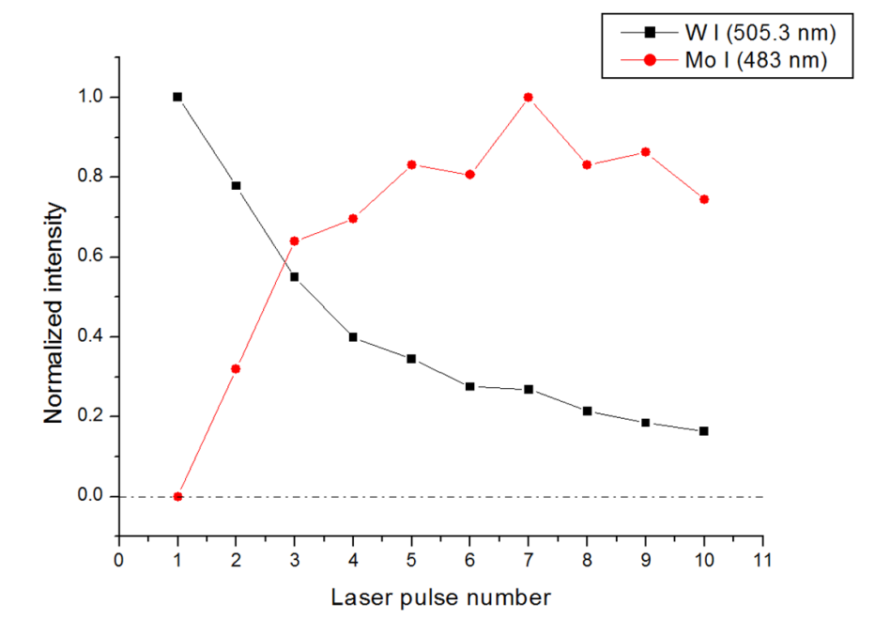
2. LIBS – depth profiling
To pay attention:
Crater enlargement (simultaneous ablation of top layers), present also when using a laser with a top-hat beam profile.
Partial re-deposition of the previously ablated material
Laser ablation of 1 µm thick tungsten layer (magneton sputtering in Ar) over molybdenum. Laser energy 40 mJ, spot diameter 0.30 mm, beam profile top-hat.
LIBS signal from the top layer remains present beyond the W-Mo interface!

Slide 8
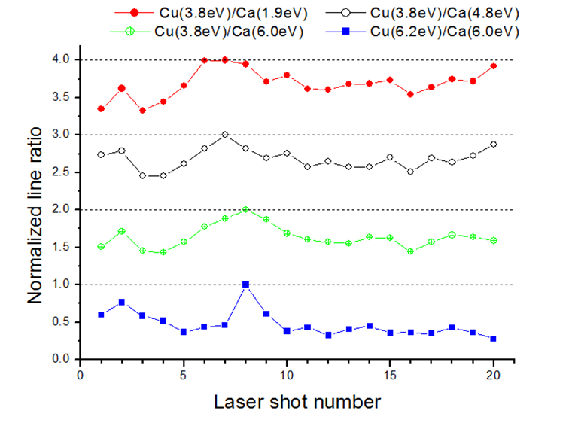
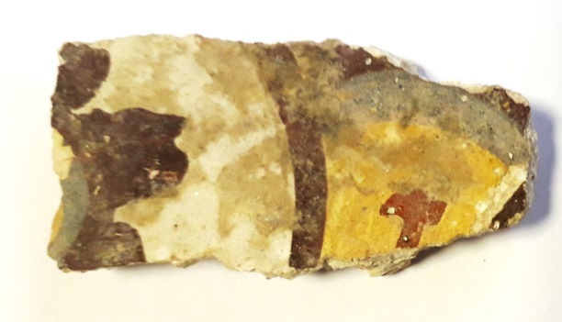
2. LIBS – depth profiling
To pay attention:
Change of the plasma parameters across layers of different chemical and physical properties (matrix effect)
Increase in the plasma temperature and electron density due to the plume confinement inside the developing crater.
Cu rich pigment layer was observed only after normalization on the Ca I line with similar Ek
Stratigraphic characterization of ancient Roman frescos by laser induced breakdown spectroscopy and importance of a proper choice of the normalizing lines, Spectrochimica Acta Part B 168 (2020) 105853
Fragment of a Roman fresco:
ablation rate ~ 1 µm

Slide 9
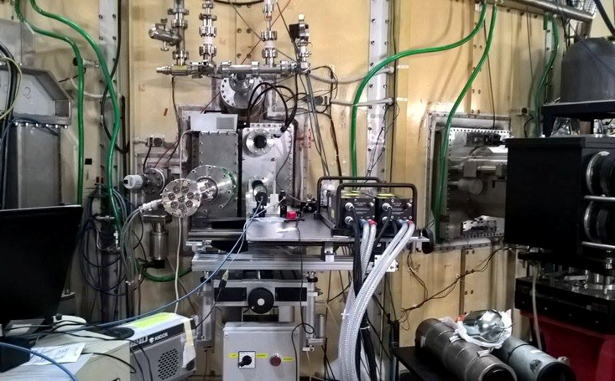
2. LIBS – depth profiling
Example – stand-off LIBS measurements on FTU wall
- Toroidal limiter was covered by TZM tiles (Ti 0.40–0.55t%, Zn 0.06–0.12t%, max 0.06 % max of other metals in Mo matrix).
LIBS measurements in vacuum, through saphire window of diameter 50 mm.
Working distance adjustable 2.0 – 2.5 m.
Previously: the plasma walls passed boronization using diborane (B2D6)

Slide 10
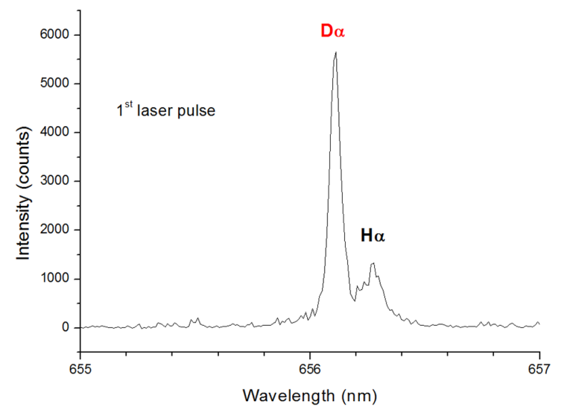
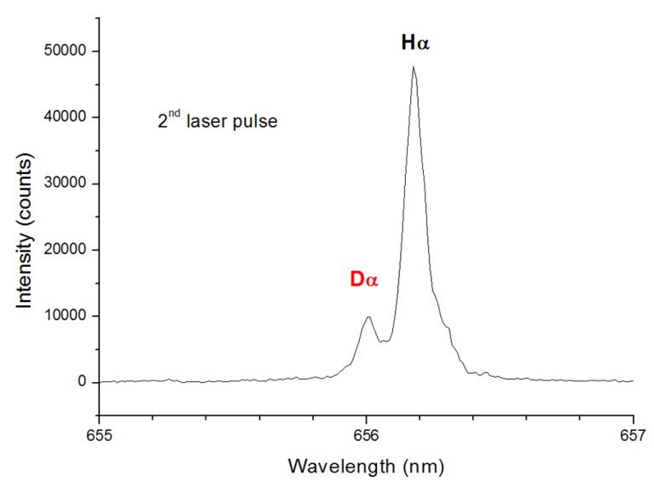
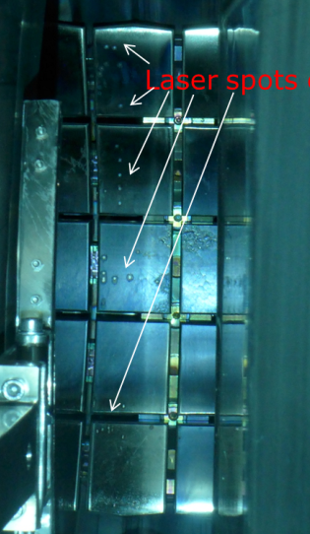
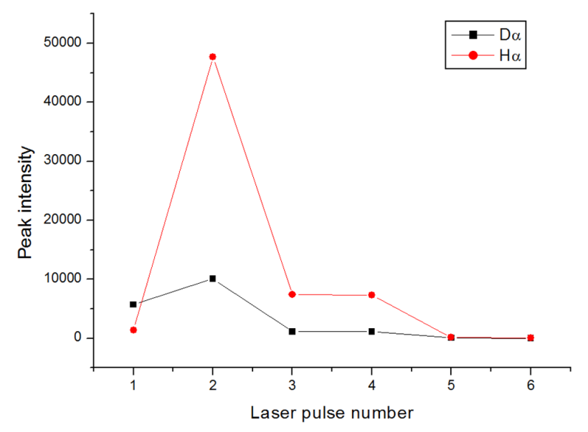
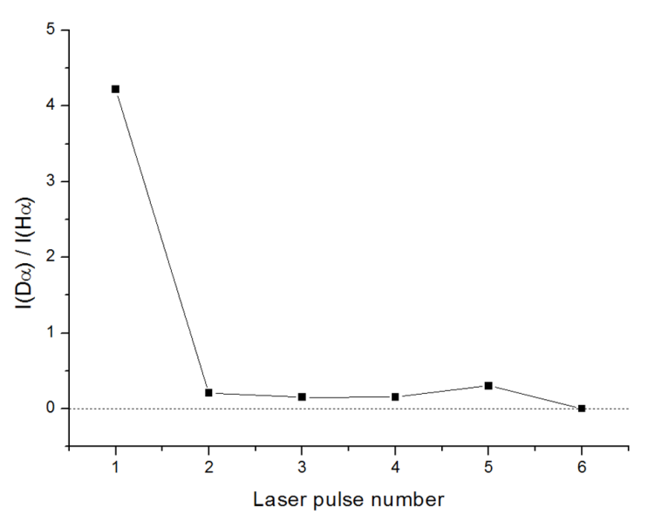
2. LIBS – depth profiling
Example – stand-off LIBS measurements on FTU wall
.
“Detection by LIBS of the deuterium retained in the FTU toroidal limiter, Nuclear Materials and Energy 18 (2019) 208–211.
Deuterium (plus hydrogen) was detected for the first five pulses. The highest D/H ratio is at the wall surface

Slide 11
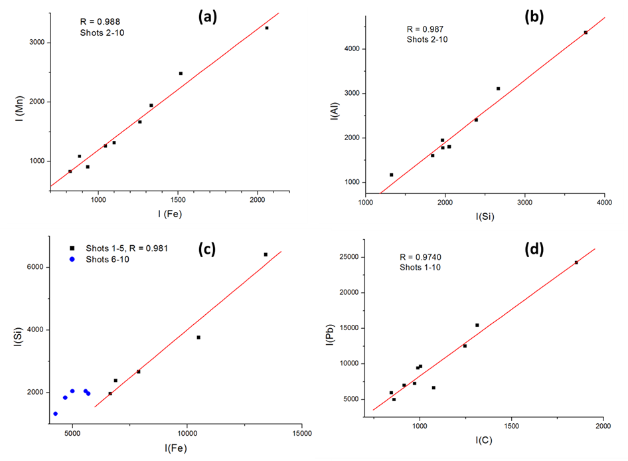
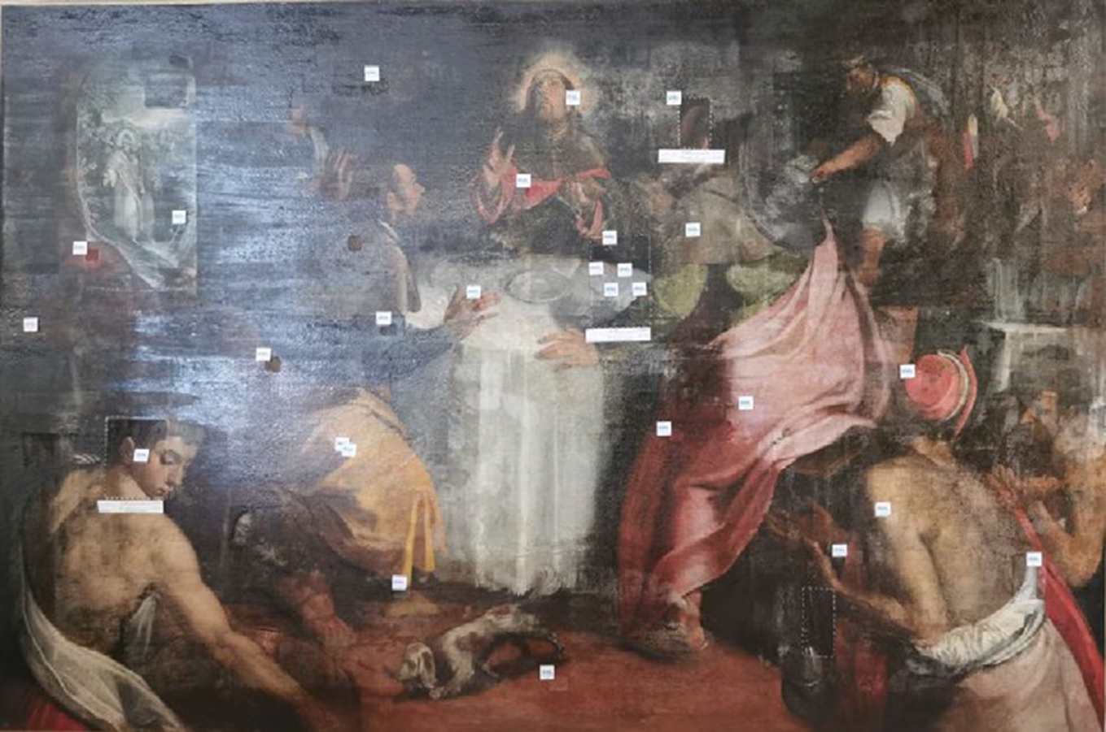

3. LIBS – correlation studies
Correlation studies between the elements in one or more layers: helps to identify material or origin of the elements
Fragment of oil paint “Emmaus Dinner” by F. Bellini, XVII century :
Correlation Si-Al means the use of kaolinite (Al2O3•2SiO2•2H2O)
Correlation Pb-C means the use of Lead White pigment (2PbCO3Pb(OH)2),
Identification of materials in oil paintings through studies of correlations and ratios between the element line intensities during LIBS stratigraphy, Spectrochim. Acta Part B 201 (2023) 106601

Slide 12
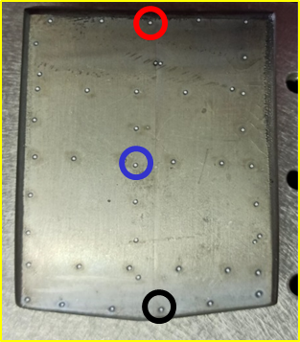
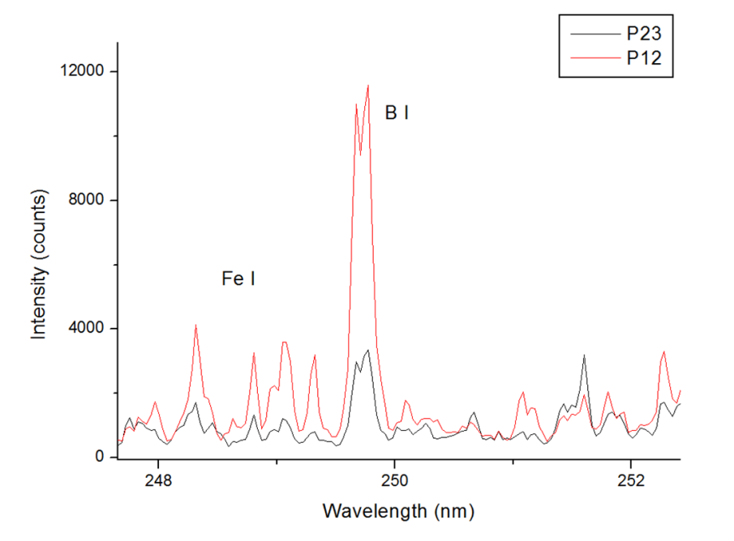
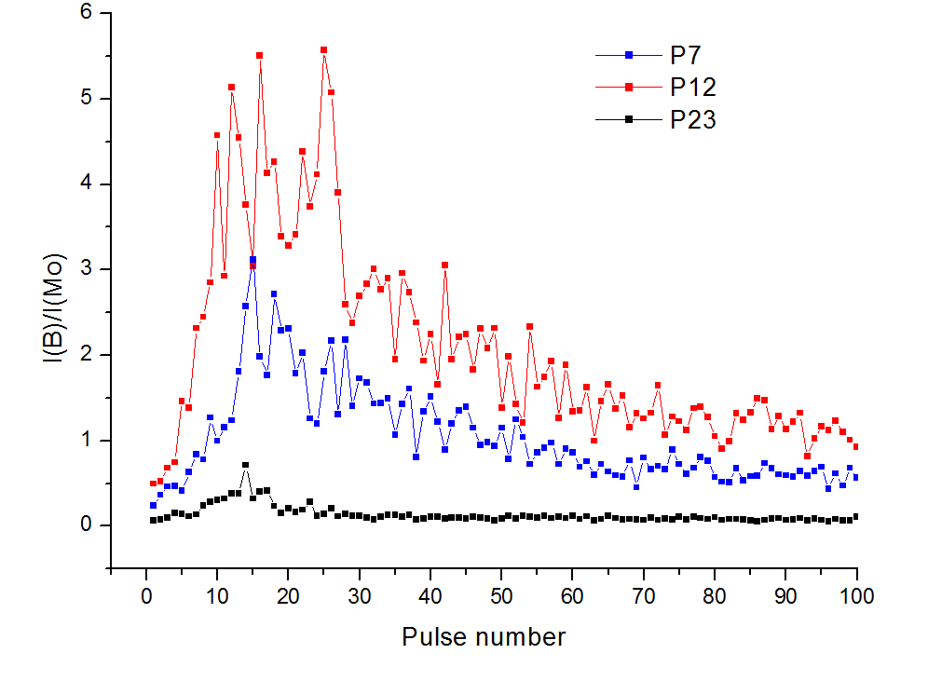
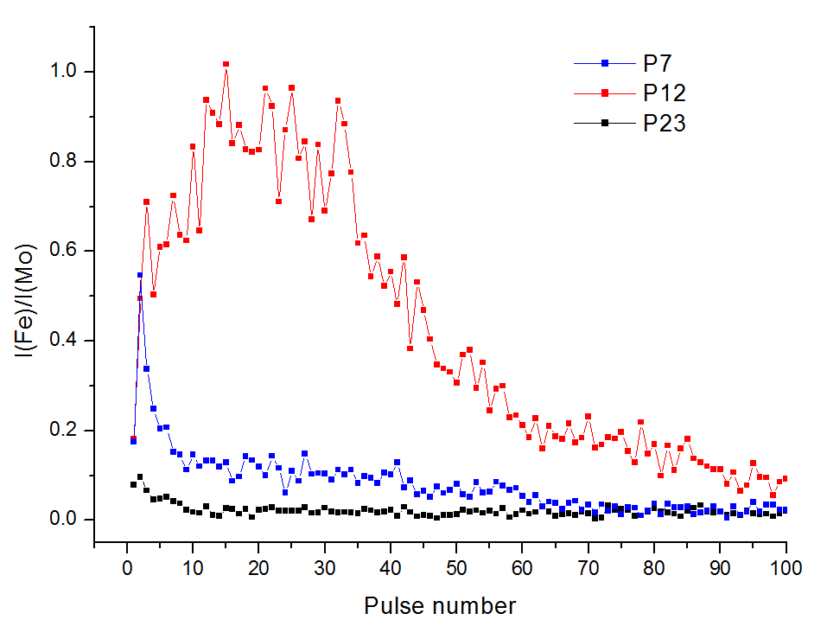
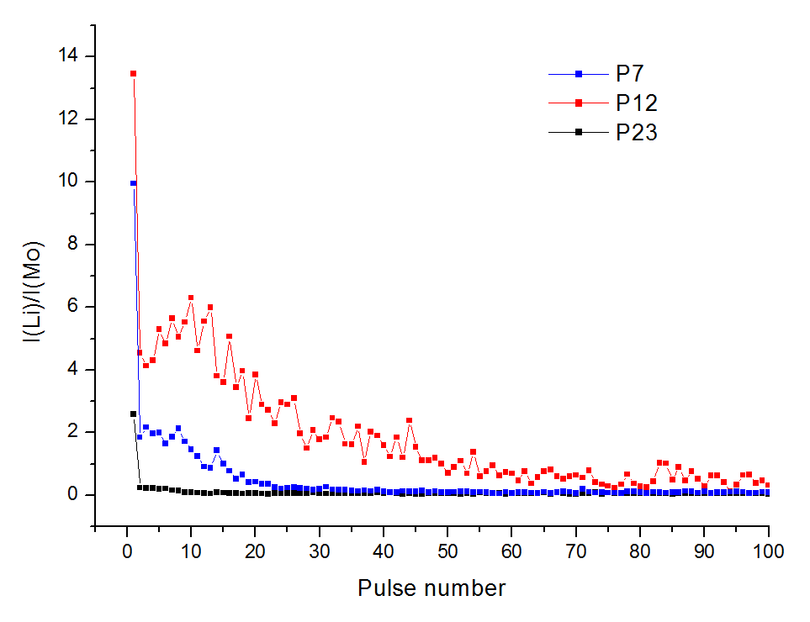
3. LIBS – correlation studies
Tile extracted from the FTU tokamak: LIBS depth profiling at 40 different positions to study the element distributions in 2D and in depth.
Boron (B)
Iron (Fe)
Litium (Li)

Slide 13
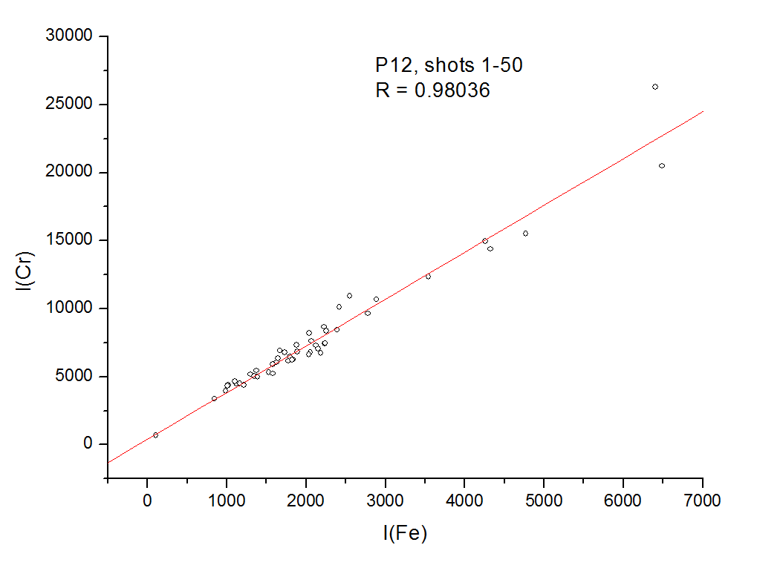
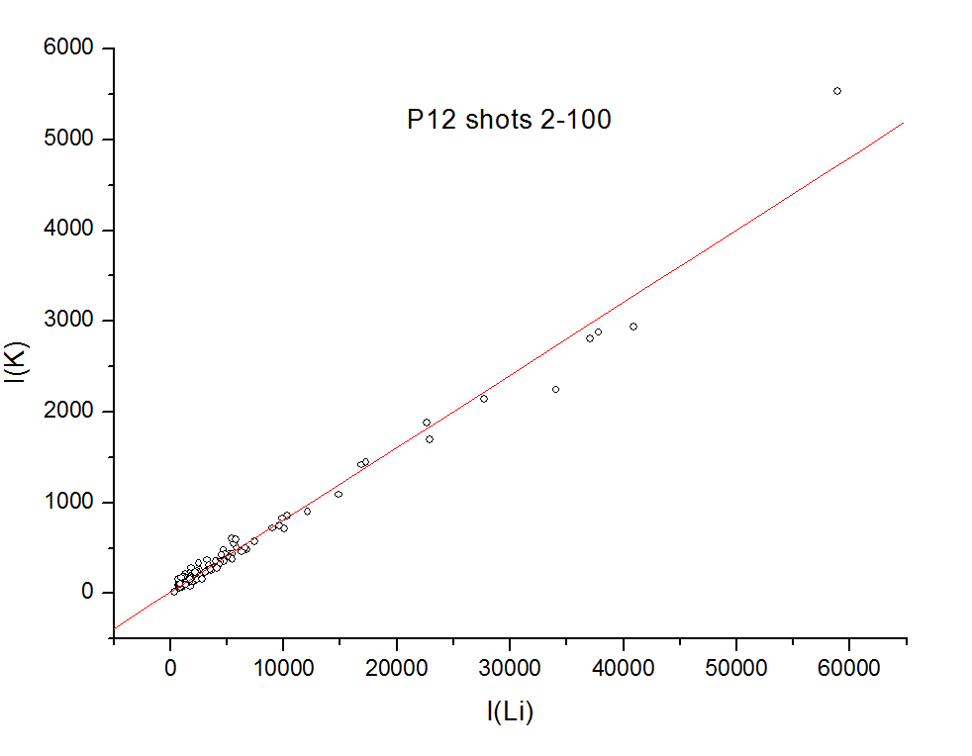
3. LIBS – correlation studies
Tile extracted from the FTU tokamak:
Boron and other impurities from external sources preferentially accumulate farther from the FTU equatorial.
Correlation Cr-Fe
Correlation Li-K
Correlation found between Fe-Cr indicate the contamination (sputtering) from stainless steal reactor’s structure.
Correlation found between Li-K indicate the contamination from the same source.

Slide 14
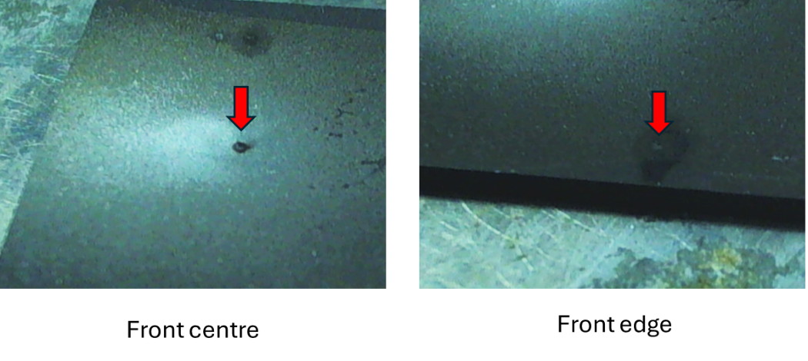
4. LIBS on irradiated Boron target
Experimental:
Sample: B sample irradiated in a pitcher-catcher experiment of H-11B conducted at ELIMAIA-L3 in ELI-Beamlines (4 J, 30 fs, 3×1019 W/cm2).
LIBS measurements: by applying 1000 laser pulses with ns duration and energy of 160 mJ; the laser spot diameter on sample was of 0.3 mm.
The depth profiling by LIBS was performed in four sample areas: at the front and back side, both at the sample’s center and its edge.

Slide 15
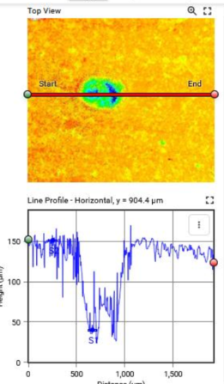
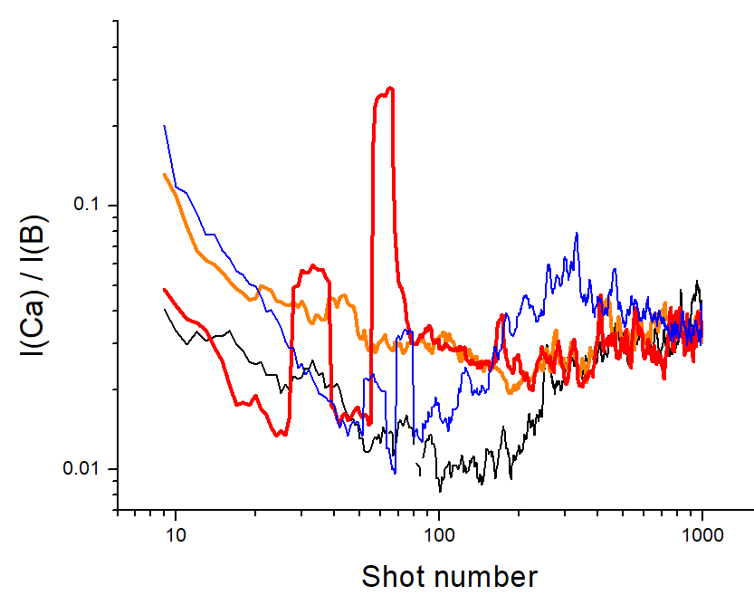
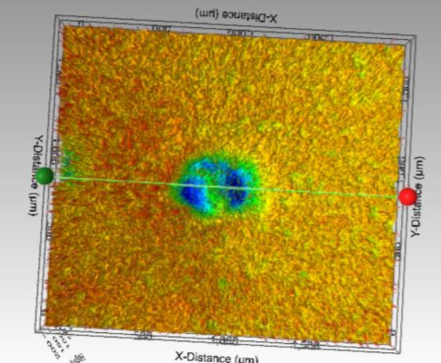
4. LIBS on irradiated Boron target
The average ablation rate was of about 0.1 µm/pulse.
Some inclusion or resolidified material hard to ablate, are present.
By LIBS, we found some inclusions rich in Ca

Slide 16
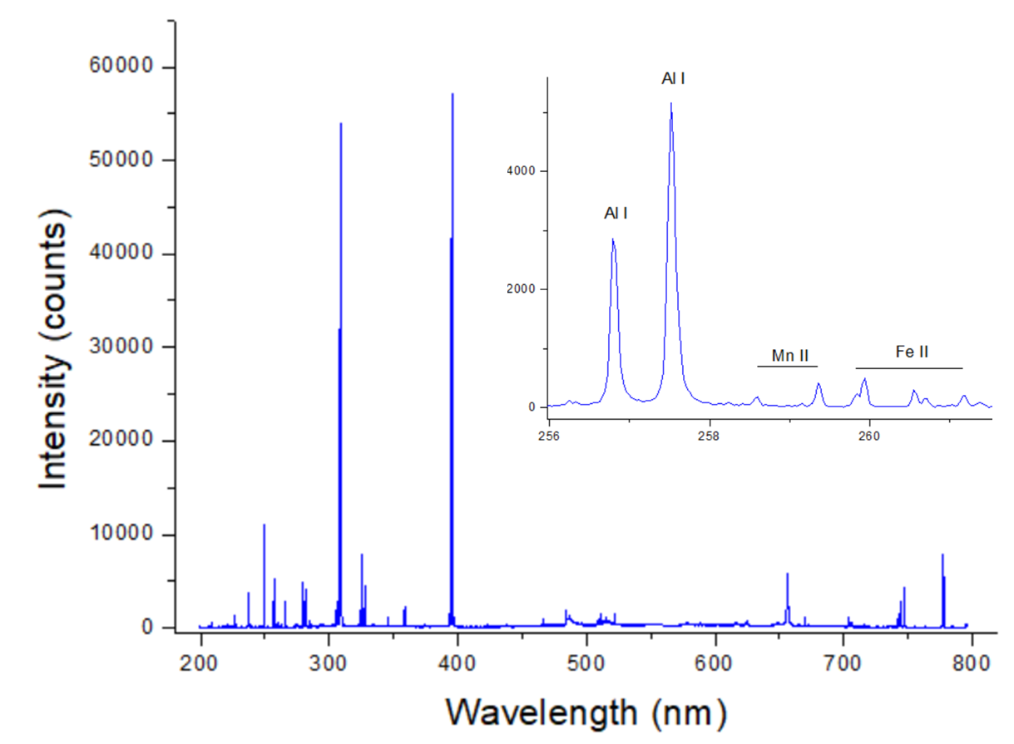
4. LIBS on irradiated Boron target
Data processing: To achieve good signal-to-noise ratio (SNR) from some trace elements, successively the spectra were averaged over 11 measurements after discarding the first two laser shots, here considered as cleaning shots.
An example of the full LIBS spectrum and some its details, obtained for the 100th laser pulse on the front center of the boron target

Slide 17
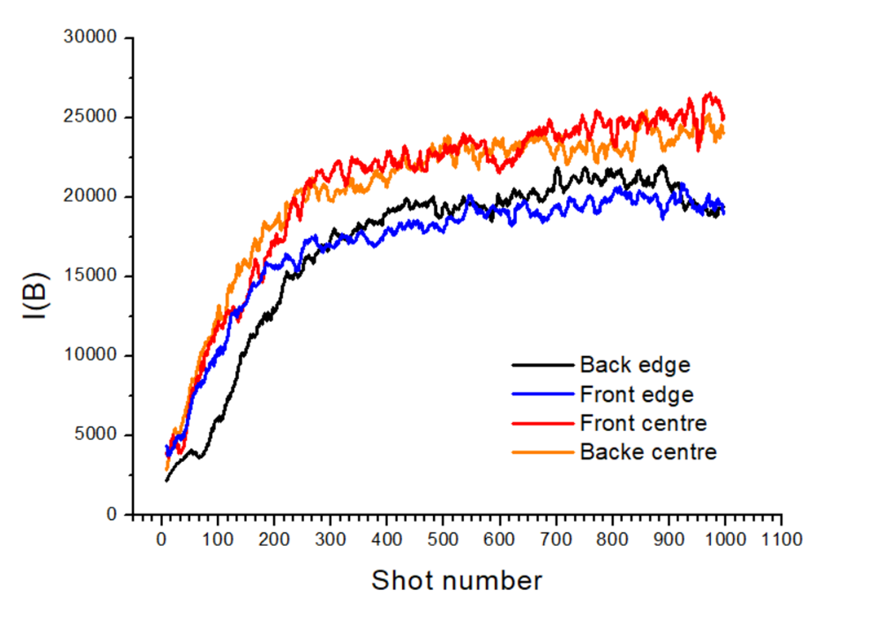
4. LIBS on irradiated Boron target
For the first ≈200 laser pulses, the overall plasma intensity progressively grows up due to the crater development and increase of the plasma temperature.
Peak line intensity from B I as a function of the laser pulse number for different measuring points

Slide 18
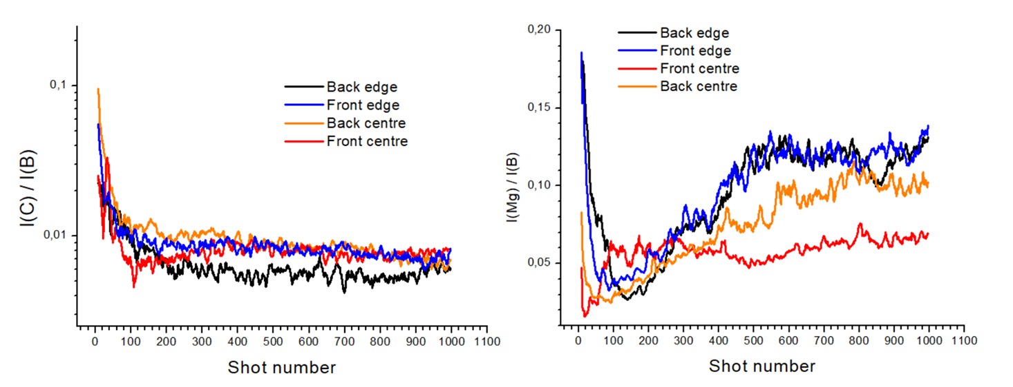
4. LIBS on irradiated Boron target
Top layer: first ≈100 pulses, equivalent to ≈10 µm:
This layer is rich in C, Ca and Mg; it contains also Si and Cr, plus traces of Cr, Li, K, Na. In some points, also Pb was detected.
In depth distribution of C and Mg from their atomic line intensities normalized on B line;

Slide 19
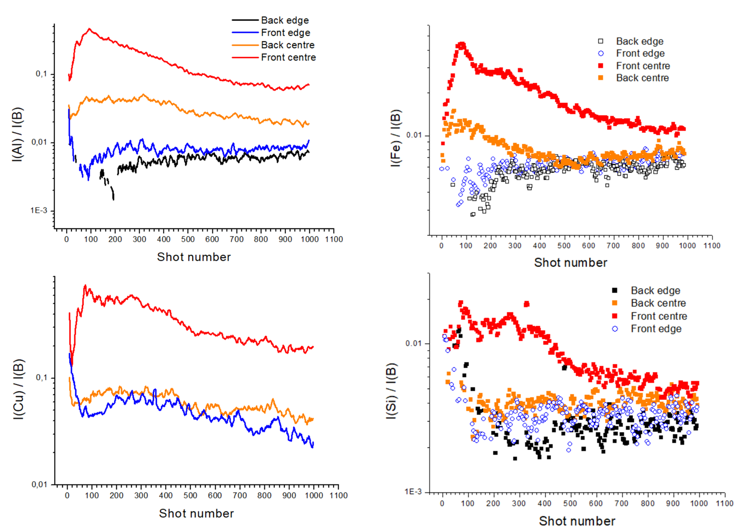
4. LIBS on irradiated Boron target
Deep layers: >100 pulses, depth 10-100 µm:
The central frontal part shows a huge increase in Al, Cu, Fe, Si and Mn (not shown) compared to the measurements performed at edges of the target.
The back central part of the target also has higher values of these elements than the peripheric points. Note: Cu was not detected at the edge of the target’s back.
In depth distribution of Al, Cu, Fe and Si from their atomic line intensities normalized on B line.

Slide 20
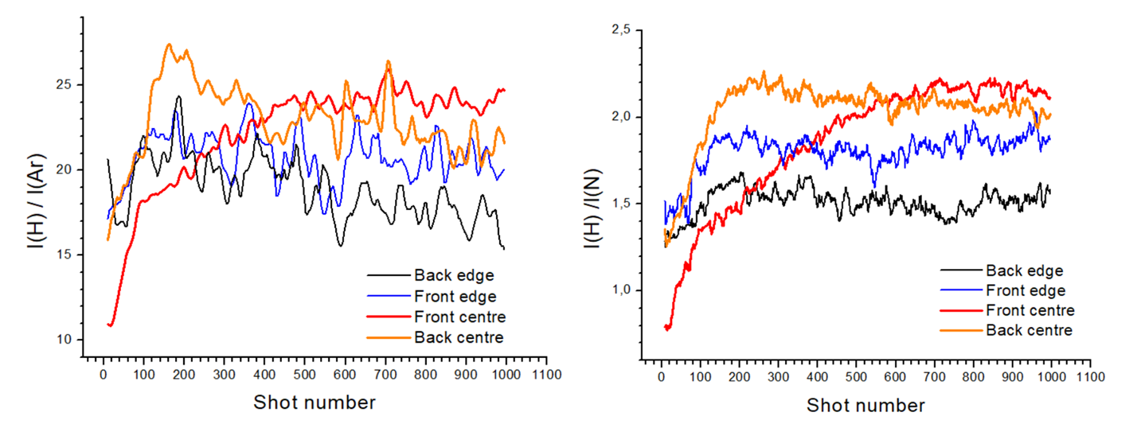
4. LIBS on irradiated Boron target
Hydrogen distribution:
considering that this element is also present in air (N, O, H and Ar), we performed the normalizations both on Ar (low signal) and N lines, obtaining similar results.
In depth, the presence of H is the highest at the central part of the target except for the top layers on the front side.
In depth distributions of H normalized on Ar (left) or N line (right).

Slide 21
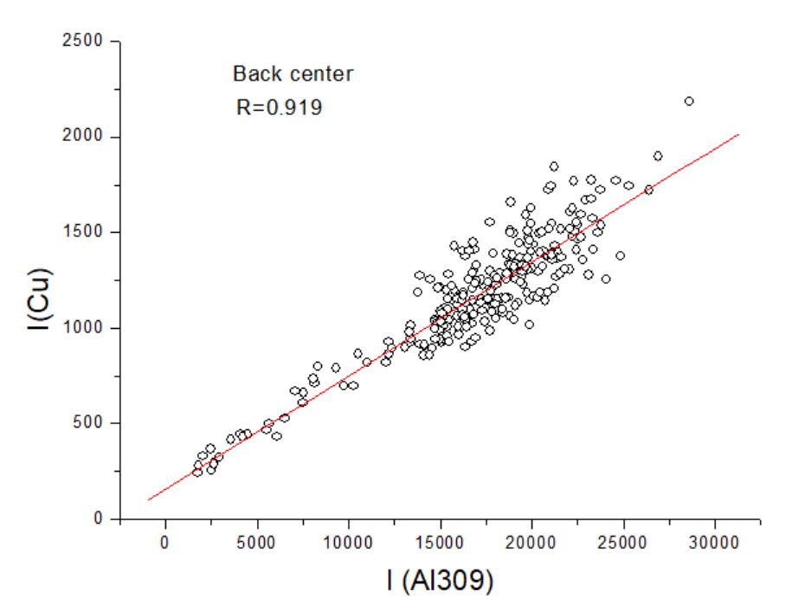
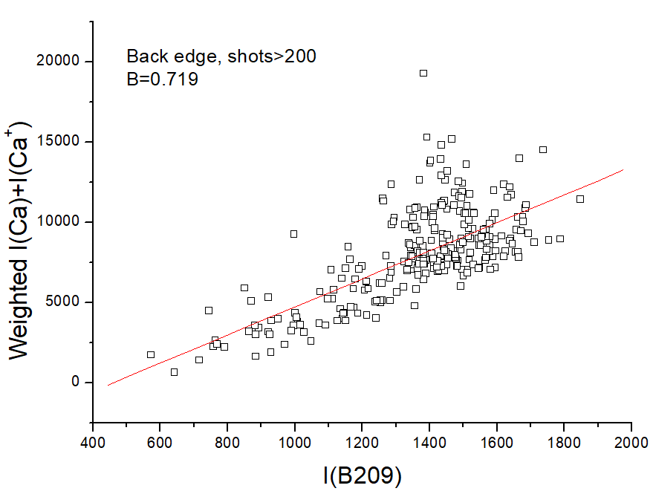
4. LIBS on irradiated Boron target
Correlations:
Copper is associated with the Al target.
Calcium is associated with B target: presence of Ca inclusions.

Slide 22
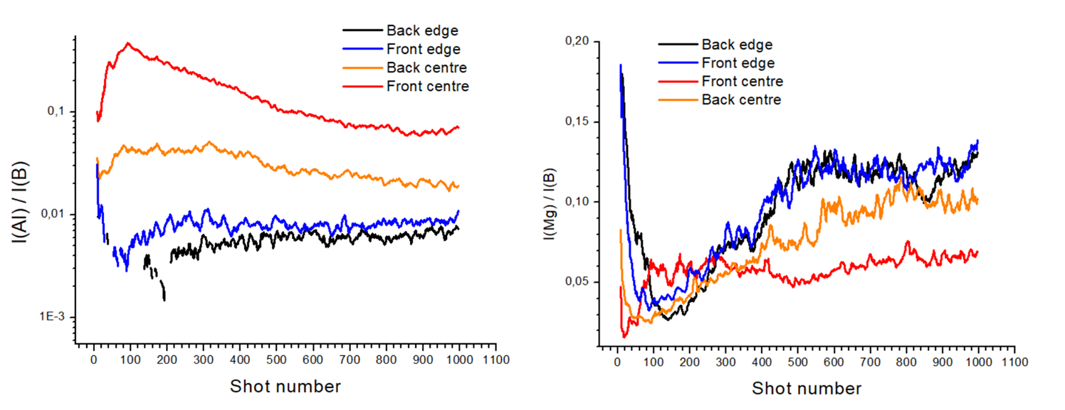
4. LIBS on irradiated Boron target
Comparative Al and Mg distribution:
in the central part of the target, a larger presence of Al (Z=13) in deep layers occurs simultaneously with a reduction of Mg (Z=12).
Note: 26Al is a long living isotope.
To investigate further

Slide 23
5. Conclusions
By LIBS depth-profiling we reached depth of about 100 µm on B target. Further ablation increases the plasma trapping inside the laser induced crater.
Surface layer on B target was clearly detected. Bulk material contains Mg and Ca (inclusions present).
Presence of Al and the correlated impurities (Cu, Fe, Si) is for two orders of magnitude higher in the central irradiated part than at the target edges.
The detected Hydrogen is the highest in the central bulk volume, but it is very low in the front irradiated surface layers.
High presence of Al (Z=13) is associated with reduction of Mg (Z=12) that is a structural element of the B target.

Slide 24
Thank you for the attention!
Violeta.lazic@enea.it

