Slide 1
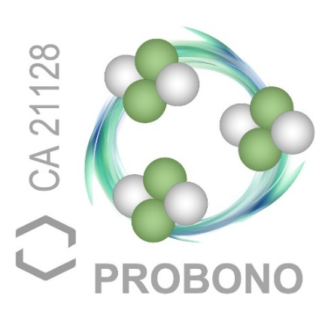

Cavity Pressure Acceleration in laser-induced, mixed-fuel fusion reactions
Przemysław Tchórz^{1*}, Tomasz Chodukowski¹, Stefan Borodziuk¹, Marcin Rosinski¹, Mattia Cipriani², Zofia Rusiniak¹, Roman Dudzak^{3,4}, Michal Krupka^{3,4,5}, Jakub Cikhardt^{4,6}, Tomas Burian³, Sushil Singh^{3,4}, Maciej Szymanski¹, Anna Marchenko^{1,7}, Michal Kustosz¹, Shubham Agarwal^{3,8}, Josef Krasa³, Robert Swierczynski⁹, Janina Pokorska¹, Tadeusz Pisarczyk¹, Daniel Klir⁶, Jiri Skala^{3,4}, Jan Dostal^{3,4}, Miroslav Krus⁴ and Libor Juha³
¹ Institute of Plasma Physics and Laser Microfusion, Poland
² ENEA, Fusion and Technologies for Nuclear Safety Department, Italy
³ Institute of Physics, AS CR, Prague, Czech Republic
⁴ Institute of Plasma Physics, AS CR, Czech Republic
⁵ Faculty of Nuclear Sciences and Physical Engineering, Czech Technical University in Prague, Czech Republic
⁶ Faculty of Electrical Engineering, Czech Technical University in Prague, Czech Republic
⁷ National Science Center, Kharkiv Institute of Physics and Technology, Ukraine
⁸ Faculty of Mathematics and Physics, Charles University in Prague, Prague, Czech Republic
⁹ Military University of Technology, Poland
Przemysław Tchórz (IPPLM)
5th International Workshop on Proton-Boron Fusion, Belgrade, 08.09.2025 – 11.09.2025

Slide 2
Outline
Introduction
Cavity Pressure Acceleration – overview
Latest experimental results – products of DD reaction by means of CPA method on PALS laser system (Prague, Czech Republic)
Simulations – proton boron reaction using CPA proton beam and optimization of cavity design for DD reaction with kJ, ns-class laser pulses
MC simulations of proton boron reaction basing on experimental results
Radiative-hydrodynamic simulations – PALS experiment
Radiative-hydrodynamic simulations – upcoming experiment at ELI Beamlines
Experimental design - proton-boron fusion in pitcher-catcher configuration at ELI Beamlines L4n laser system

Slide 3
Cavity Pressure Acceleration – overview
Przemysław Tchórz (IPPLM) 5th International Workshop on Proton-Boron Fusion, Belgrade, 08.09.2025 – 11.09.2025

Slide 4
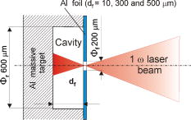
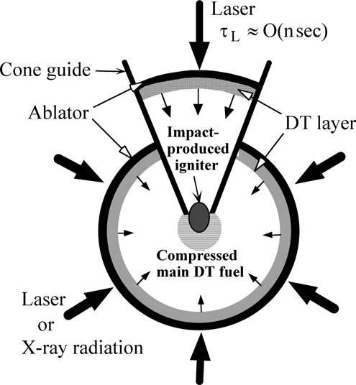
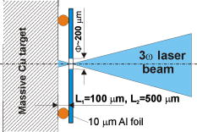
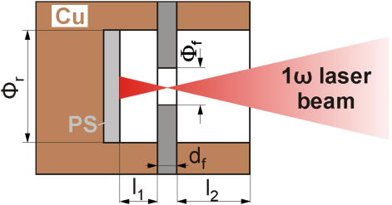
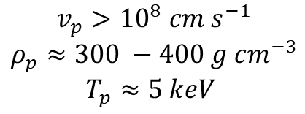
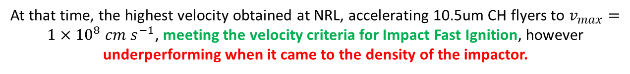
1. Introduction: Cavity Pressure Acceleration – overview
Requirements for the ablated impactor shell:
Historically, Cavity Pressure Acceleration (CPA) was proposed as an alternative driver for direct-drive Impact Fast Ignition (Murakami et al 2005 Plasma Phys. Control. Fusion 47 B815).
$$v_{p}>{10}^{8} cm s^{−1}$$
$$ρ_{p}≈300 −400 g cm^{−3}$$
$T_{p}≈5 keV$
Borodziuk et al. Appl. Phys. Lett. 93, 101502 (2008)
Borodziuk et al. Appl. Phys. Lett. 95, 231501 (2009)
Borodziuk et al. Appl. Phys. Lett. 99, 231501 (2011)
$v_{max}>7×{10}^{7} cm s^{−1}$ for both 10um Al ($≈2.7g/cm^{3}$) and 20um PS ($≈1g/cm^{3}$) foils
At that time, the highest velocity obtained at NRL, accelerating 10.5um CH flyers to $v_{max}=1×{10}^{8} cm s^{−1}$, meeting the velocity criteria for Impact Fast Ignition, however underperforming when it came to the density of the impactor.
Murakami et al 2005 Plasma Phys. Control. Fusion 47 B815
Przemysław Tchórz (IPPLM) 5th International Workshop on Proton-Boron Fusion, Belgrade, 08.09.2025 – 11.09.2025

Slide 5
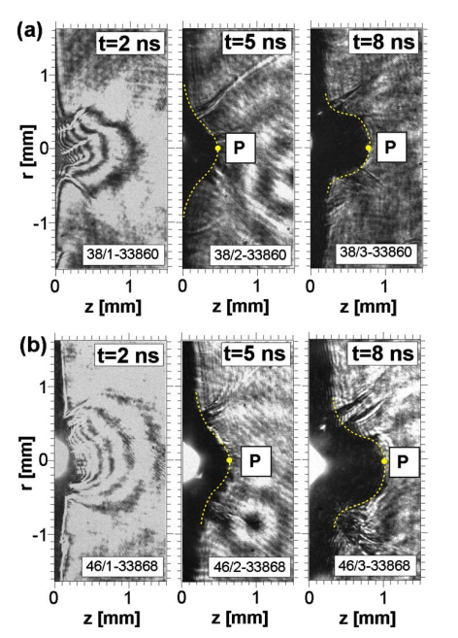
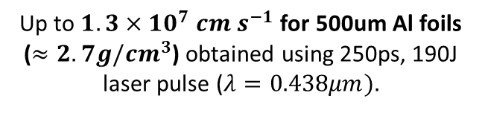
1. Introduction: Cavity Pressure Acceleration – overview
Up to $1.3×{10}^{7} cm s^{−1}$ for 500um Al foils ($≈2.7g/cm^{3}$) obtained using 250ps, 190J laser pulse ($λ=0.438μm).$
Historically, Cavity Pressure Acceleration (CPA) was proposed as an alternative driver for direct-drive Impact Fast Ignition (Murakami et al 2005 Plasma Phys. Control. Fusion 47 B815).
Borodziuk et al. Appl. Phys. Lett. 93, 101502 (2008)
Borodziuk et al. Appl. Phys. Lett. 95, 231501 (2009)
Borodziuk et al. Appl. Phys. Lett. 99, 231501 (2011)
$v_{max}>7×{10}^{7} cm s^{−1}$ for both 10um Al ($≈2.7g/cm^{3}$) and 20um PS ($≈1g/cm^{3}$) foils
At that time, the highest velocity obtained at NRL, accelerating 10.5um CH flyers to $v_{max}=1×{10}^{8} cm s^{−1}$, meeting the velocity criteria for Impact Fast Ignition, however underperforming when it came to the density of the impactor.
Borodziuk et al. Appl. Phys. Lett. 93, 101502 (2008)
Przemysław Tchórz (IPPLM) 5th International Workshop on Proton-Boron Fusion, Belgrade, 08.09.2025 – 11.09.2025

Slide 6
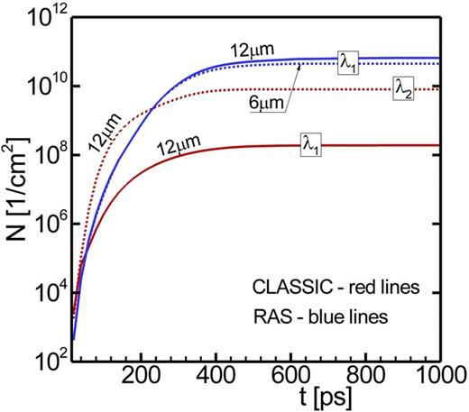
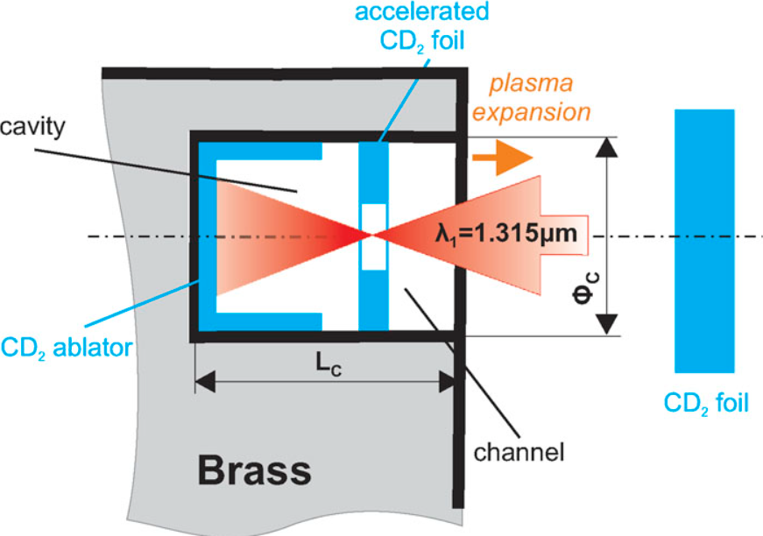
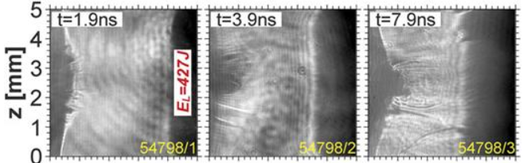

1. Introduction: Cavity Pressure Acceleration – overview
In 2020, roughly 10 years after last experimental activities regarding CPA scheme, the idea was revisited with slightly different setup. Instead of metallic flyers, deuterated polyethylene was used.
$v_{max}>4×{10}^{7} cm s^{−1}$ for $CD_{2}$ foil, while producing $≈3×10^{6}$ neutrons per shot
DD reaction has two possible channels:
${}_{1}^{2}{D+{}_{1}^{2}D → {}_{2}^{3}{He +}n (2.45 MeV)}$ (50%)
${}_{1}^{2}{D+{}_{1}^{2}D → {}_{1}^{3}{T +}p^{+} (3.02 MeV)}$ (50%)
Chodukowski et al. AIP Advances 10, 085206 (2020)
Przemysław Tchórz (IPPLM) 5th International Workshop on Proton-Boron Fusion, Belgrade, 08.09.2025 – 11.09.2025

Slide 7
Latest experimental results – products of DD reaction by means of CPA method on PALS laser system (Prague, Czech Republic)

Slide 8
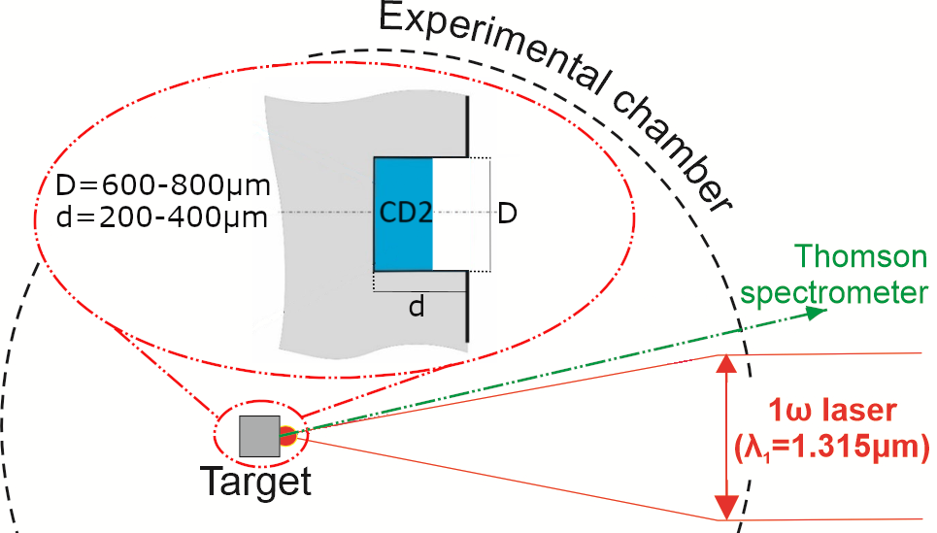
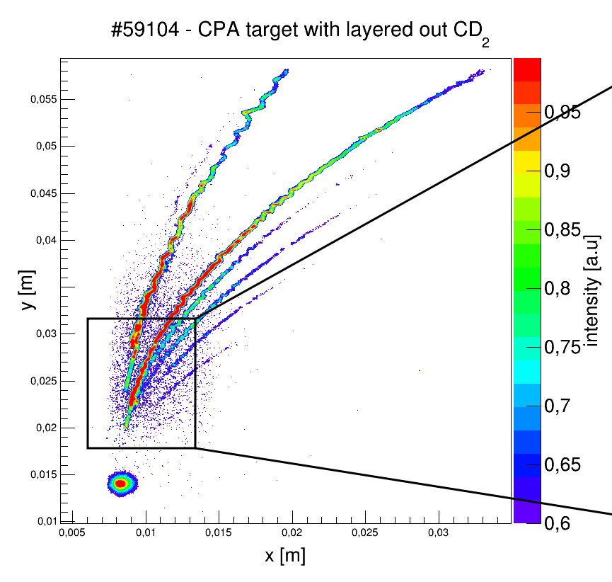
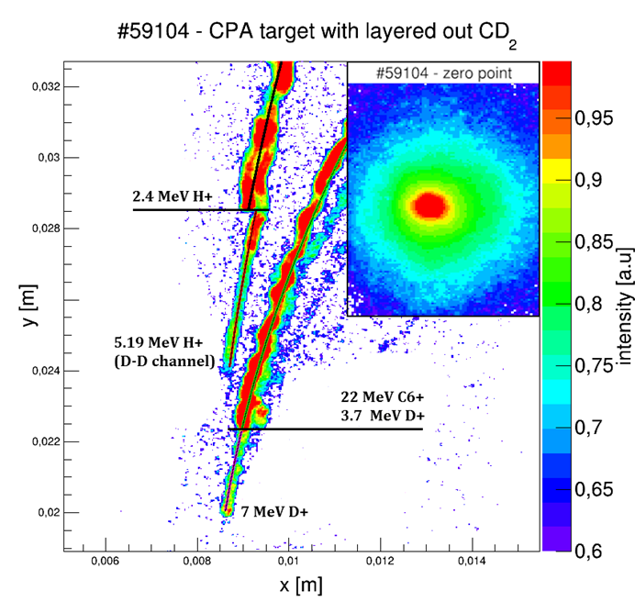
Introduction: Latest experimental results – products of DD reaction by means of CPA method on PALS laser system
(Prague, Czech Republic)
Additional acceleration occurs, which causes the DD protons to gain additional energy, up to 5.2 MeV. In several shots (example: green spectrum), strong peak around 3.7 MeV visible, but at lower maximum energy: the additional accelerating force was weaker.
Most likely, the additional accelerating force is attributed to strong electrical fields arising inside the cavity – has to be investigated in following experimental campaigns.
30⁰ in respect to the target normal
Tchórz et al. Phys. Plasmas 31, 084503 (2024)

Slide 9
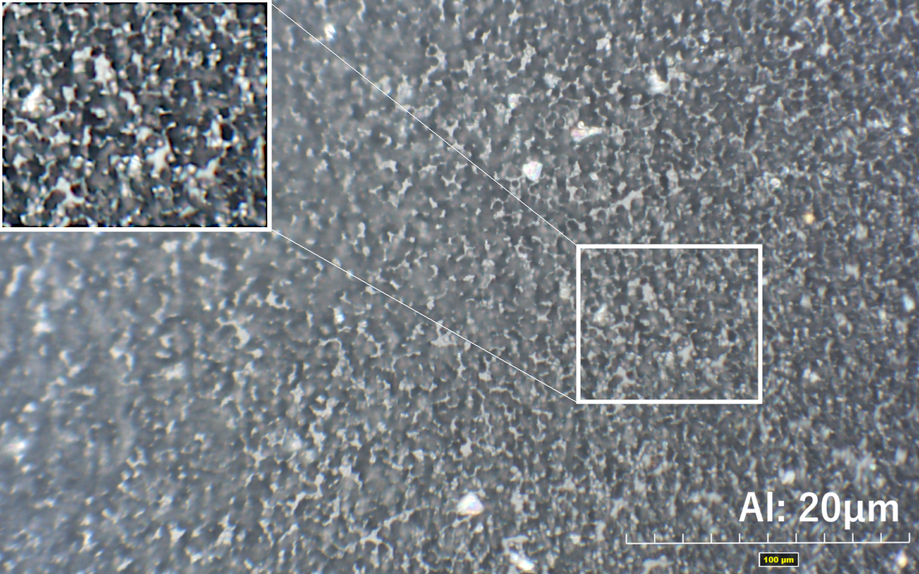
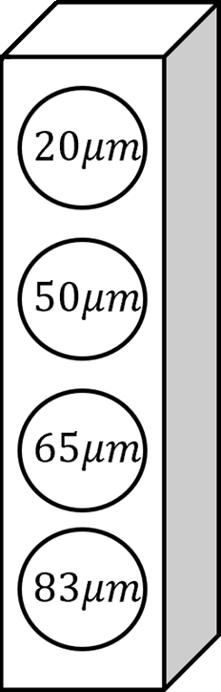

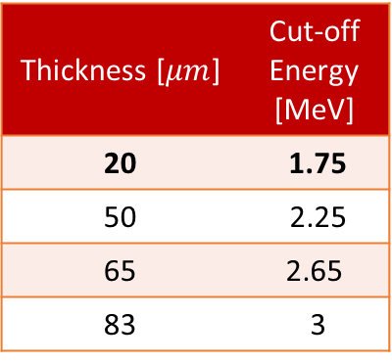
Introduction: Latest experimental results – products of DD reaction by means of CPA method on PALS laser system
(Prague, Czech Republic)
Thickness [$μm$] | Cut-off Energy [MeV]
20 | 1.75
50 | 2.25
65 | 2.65
83 | 3
$$20μm$$
CR 39 detector measurements 50 cm away from target, 30 deg (under TPS line of sight) – below 65𝜇𝑚 filter thickness strong saturation

Slide 10
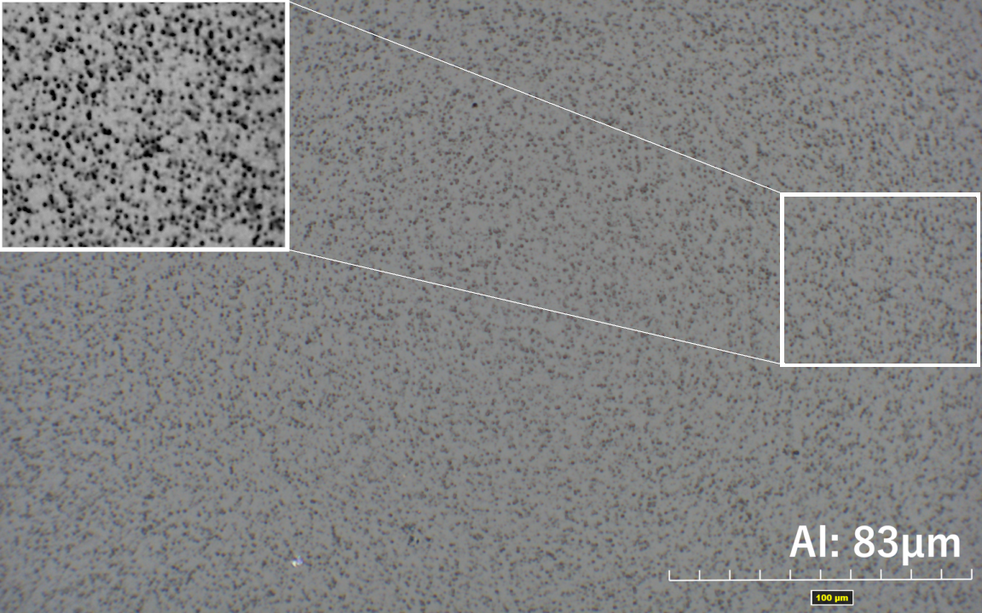
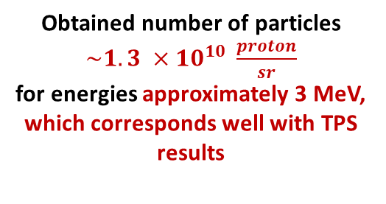

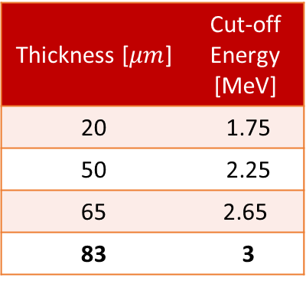
Introduction: Latest experimental results – products of DD reaction by means of CPA method on PALS laser system
(Prague, Czech Republic)
Thickness [$μm$] | Cut-off Energy [MeV]
20 | 1.75
50 | 2.25
65 | 2.65
83 | 3
$$83μm$$
Obtained number of particles $\sim 1.3 ×{10}^{10} \frac{proton}{sr}$ for energies approximately 3 MeV, which corresponds well with TPS results

Slide 11
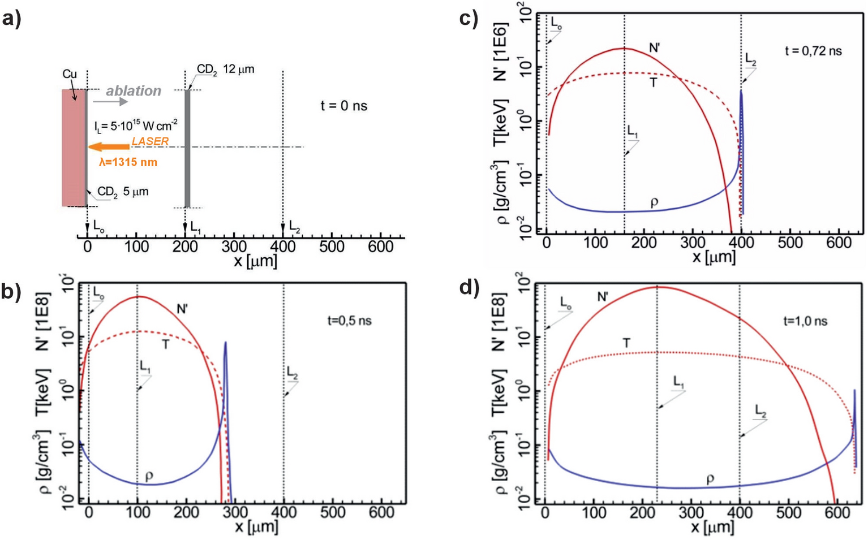
Introduction: Latest experimental results – products of DD reaction by means of CPA method on PALS laser system
(Prague, Czech Republic)
1D simulation – custom code (Jach et al. Computer Modelling of Dynamic Interaction of Bodies by Free Particle (PWN Method, 2001) (in polish)
80% of neutrons are produced before density peak leaves cavity channel, which means that the mechanism behind neutron production is not a beam-target type
Using powdered fuel instead of flyer-ablator geometry should give similar neutron yield with much simpler construction
Chodukowski, T., Borodziuk, S., Tchórz, P. et al. Sci Rep 15, 21863 (2025).

Slide 12
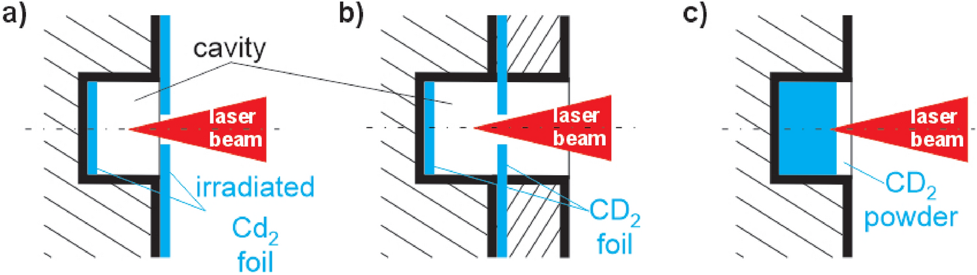
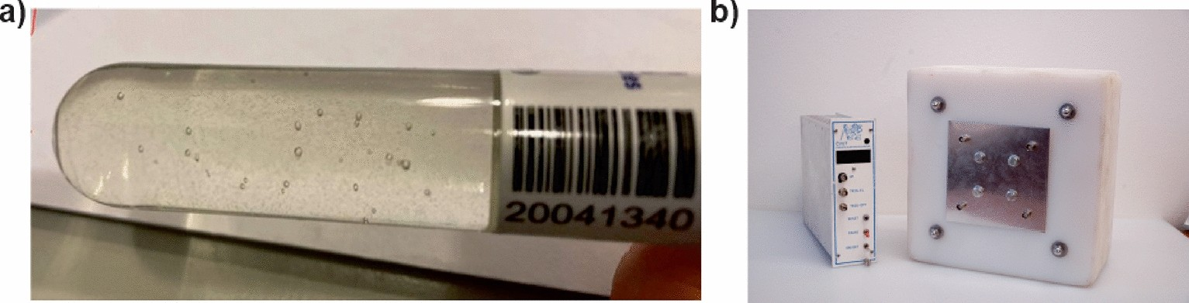
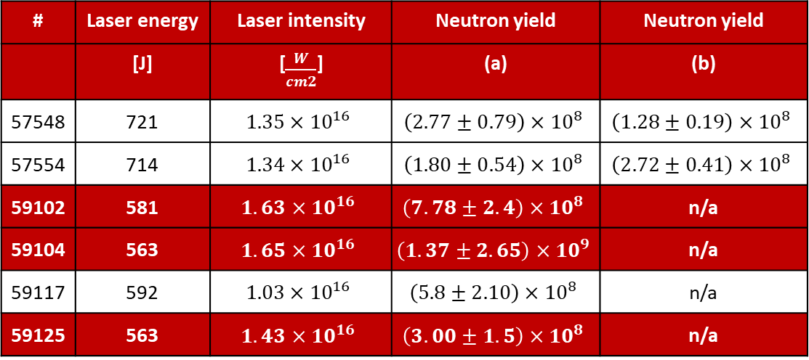
Introduction: Latest experimental results – products of DD reaction by means of CPA method on PALS laser system
(Prague, Czech Republic)
# | Laser energy | Laser intensity | Neutron yield | Neutron yield
 | [J] | [$\frac{W}{cm2}$] | (a) | (b)
57548 | 721 | $$1.35×{10}^{16}$$ | $$\left(2.77±0.79\right)×{10}^{8}$$ | $$\left(1.28±0.19\right)×{10}^{8}$$
57554 | 714 | $$1.34×{10}^{16}$$ | $$\left(1.80±0.54\right)×{10}^{8}$$ | $$\left(2.72±0.41\right)×{10}^{8}$$
59102 | 581 | $$1.63×{10}^{16}$$ | $$\left(7.78±2.4\right)×{10}^{8}$$ | n/a
59104 | 563 | $$1.65×{10}^{16}$$ | $$\left(1.37±2.65\right)×{10}^{9}$$ | n/a
59117 | 592 | $$1.03×{10}^{16}$$ | $$\left(5.8±2.10\right)×{10}^{8}$$ | n/a
59125 | 563 | $$1.43×{10}^{16}$$ | $$\left(3.00±1.5\right)×{10}^{8}$$ | n/a
Chodukowski, Borodziuk, Tchórz et al. Sci Rep 15, 21863 (2025).
Notes:
Neutron production independent from used geometry

Slide 13
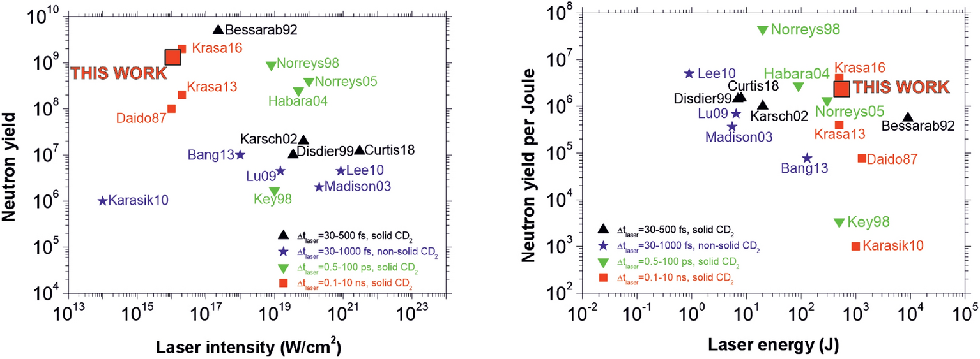
Introduction: Latest experimental results – products of DD reaction by means of CPA method on PALS laser system
(Prague, Czech Republic)
Chodukowski, T., Borodziuk, S., Tchórz, P. et al. Sci Rep 15, 21863 (2025).

Slide 14
Simulations – proton boron reaction using CPA proton beam and optimization of cavity design for DD reaction with kJ, ns-class laser pulses

Slide 15
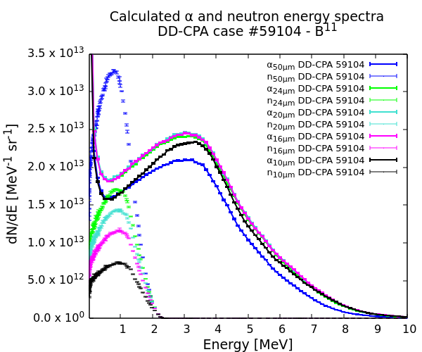
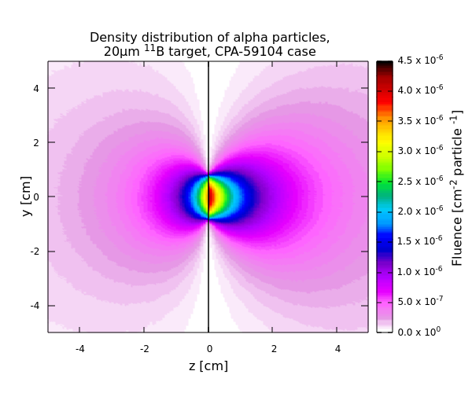
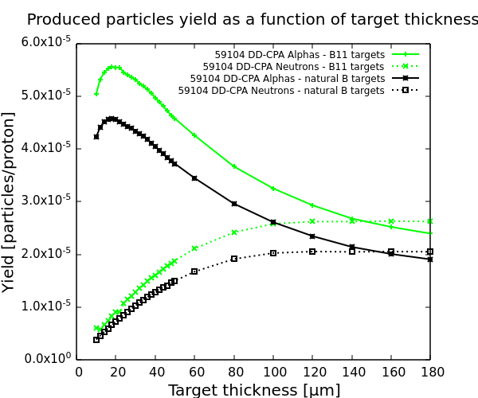
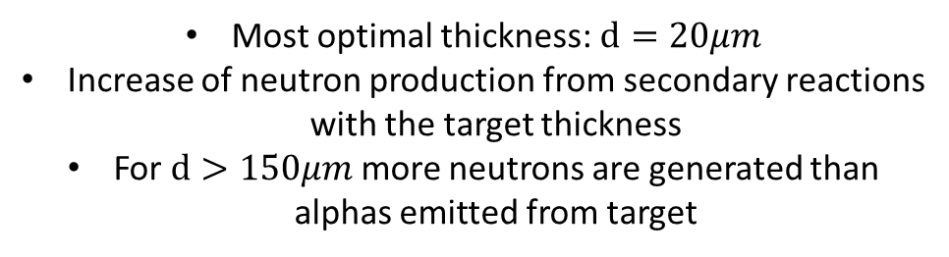
2. Simulations: MC simulations of proton boron reaction basing on experimental results
Monte Carlo simulations using FLUKA code (INFN, ver. FLUKA 2023.3.4)
Experimentally measured proton energy spectrum used as input
Most optimal thickness:$d=20μm$
Increase of neutron production from secondary reactions with the target thickness
For $d>150μm$ more neutrons are generated than alphas emitted from target

Slide 16
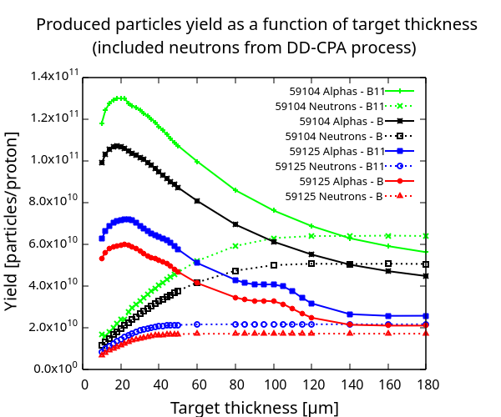
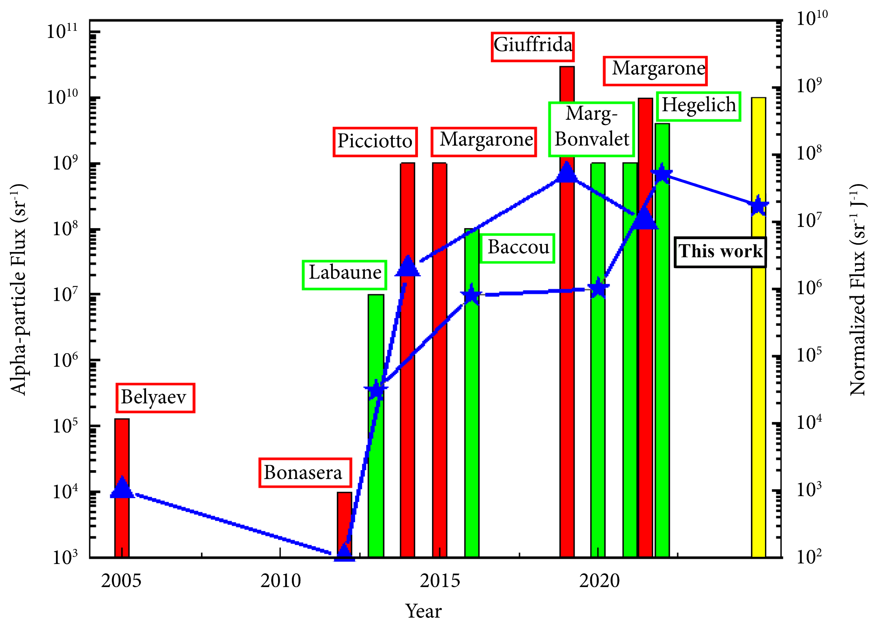
2. Simulations: MC simulations of proton boron reaction basing on experimental results
Monte Carlo simulations using FLUKA code (INFN, ver. FLUKA 2023.3.4)
Experimentally measured proton energy spectrum used as input
Notes:
Secondary reactions:
11B(p,n)11C,
11B(p,n)14N ->>>>> 14N(alpha,n)17F

Slide 17
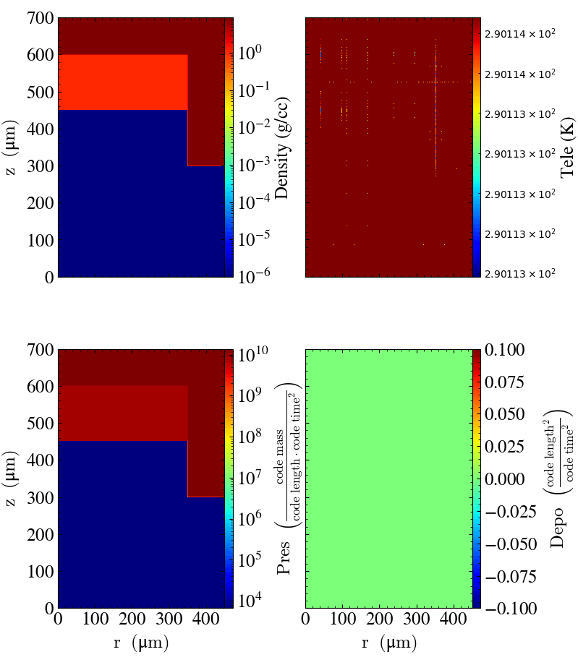
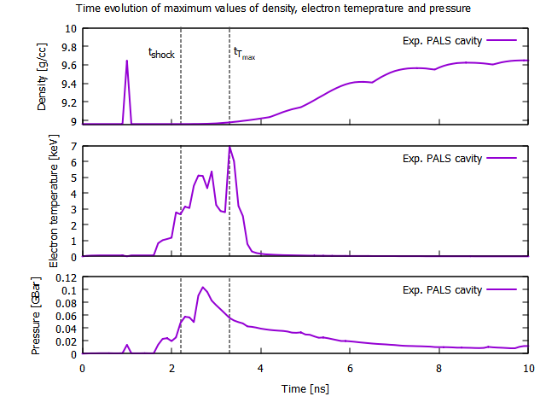

2. Simulations: Radiative-hydrodynamic simulations – PALS experiment
350ps FWHM, 600J, $λ=1315 nm$ (PALS) Simulation length: 10 ns, 100ps step
$$d=700 μm, D=300 μm,{ L}_{CD}=150μm$$

Slide 18
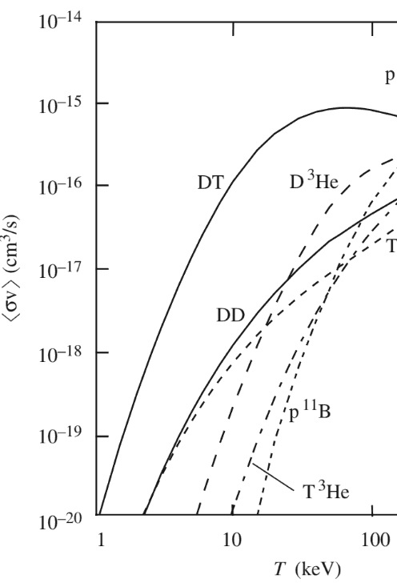
2. Simulations: Radiative-hydrodynamic simulations – PALS experiment
Cavity used during PALS experiment was too wide, resulting in low efficiency of heating and pressurizing the plasma, yet still allowed sufficient $T_{e}$ for DD reaction

Slide 19
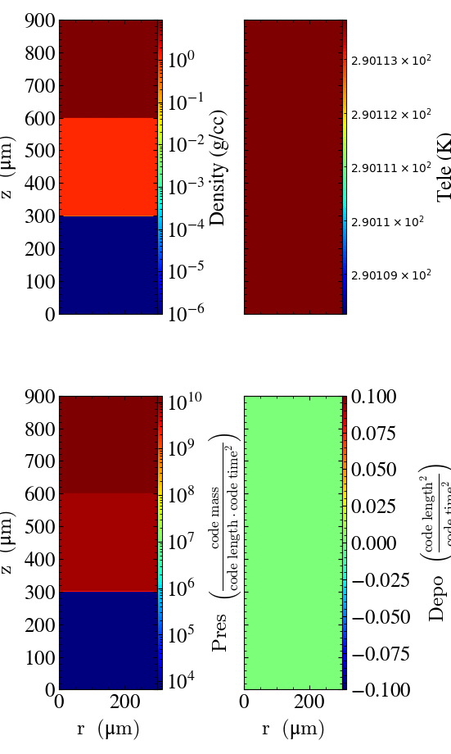
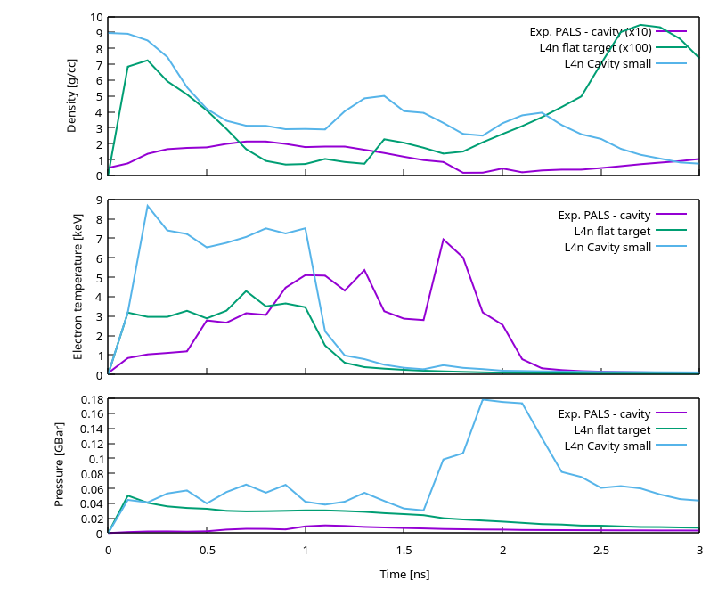
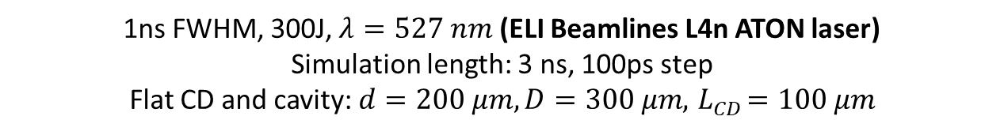
2. Simulations: Radiative-hydrodynamic simulations – upcoming experiment at ELI Beamlines
1ns FWHM, 300J, $λ=527 nm$ (ELI Beamlines L4n ATON laser) Simulation length: 3 ns, 100ps step
Flat CD and cavity: $d=200 μm, D=300 μm, { L}_{CD}=100 μm$

Slide 20
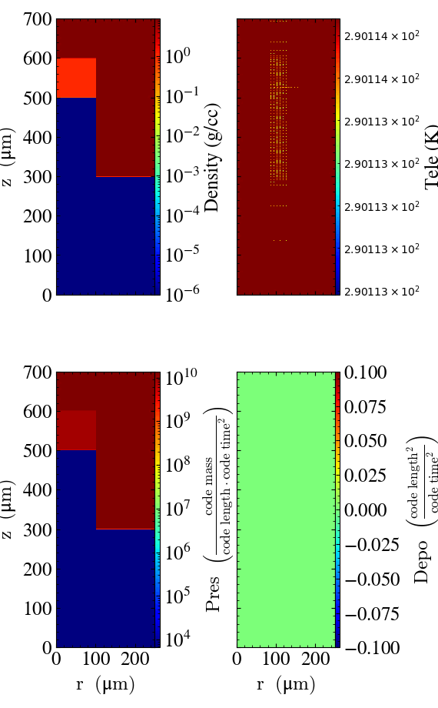
2. Simulations: Radiative-hydrodynamic simulations – upcoming experiment at ELI Beamlines
1ns FWHM, 300J, $λ=527 nm$ (ELI Beamlines L4n ATON laser) Simulation length: 3 ns, 100ps step
Flat CD and cavity: $d=200 μm, D=300 μm, { L}_{CD}=100 μm$

Slide 21
2. Simulations: Radiative-hydrodynamic simulations – upcoming experiment at ELI Beamlines
Density – 100x higher comparing to flat target, 10x comparing to PALS (at exit)
Electron temperature – similar level to max from PALS, but for longer duration
Pressure – 20x higher during plasma release time
Notes:
Order of magnitude lower laser intensity : ELI vs PALS, still comparable temperatures obtainable

Slide 22
Experimental design - proton-boron fusion in pitcher-catcher configuration at ELI Beamlines L4n laser system

Slide 23

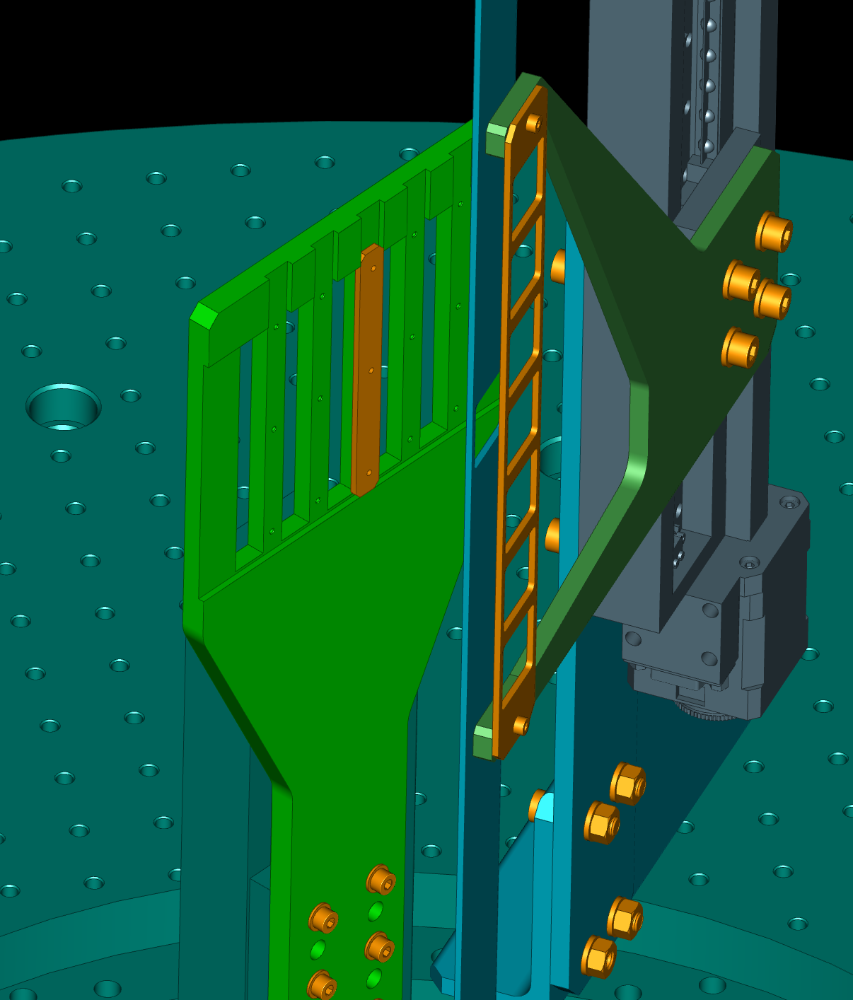
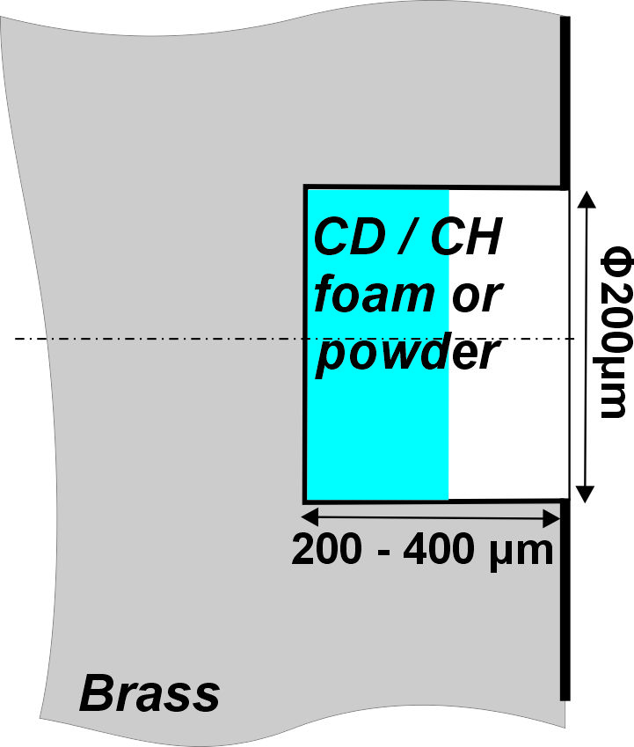
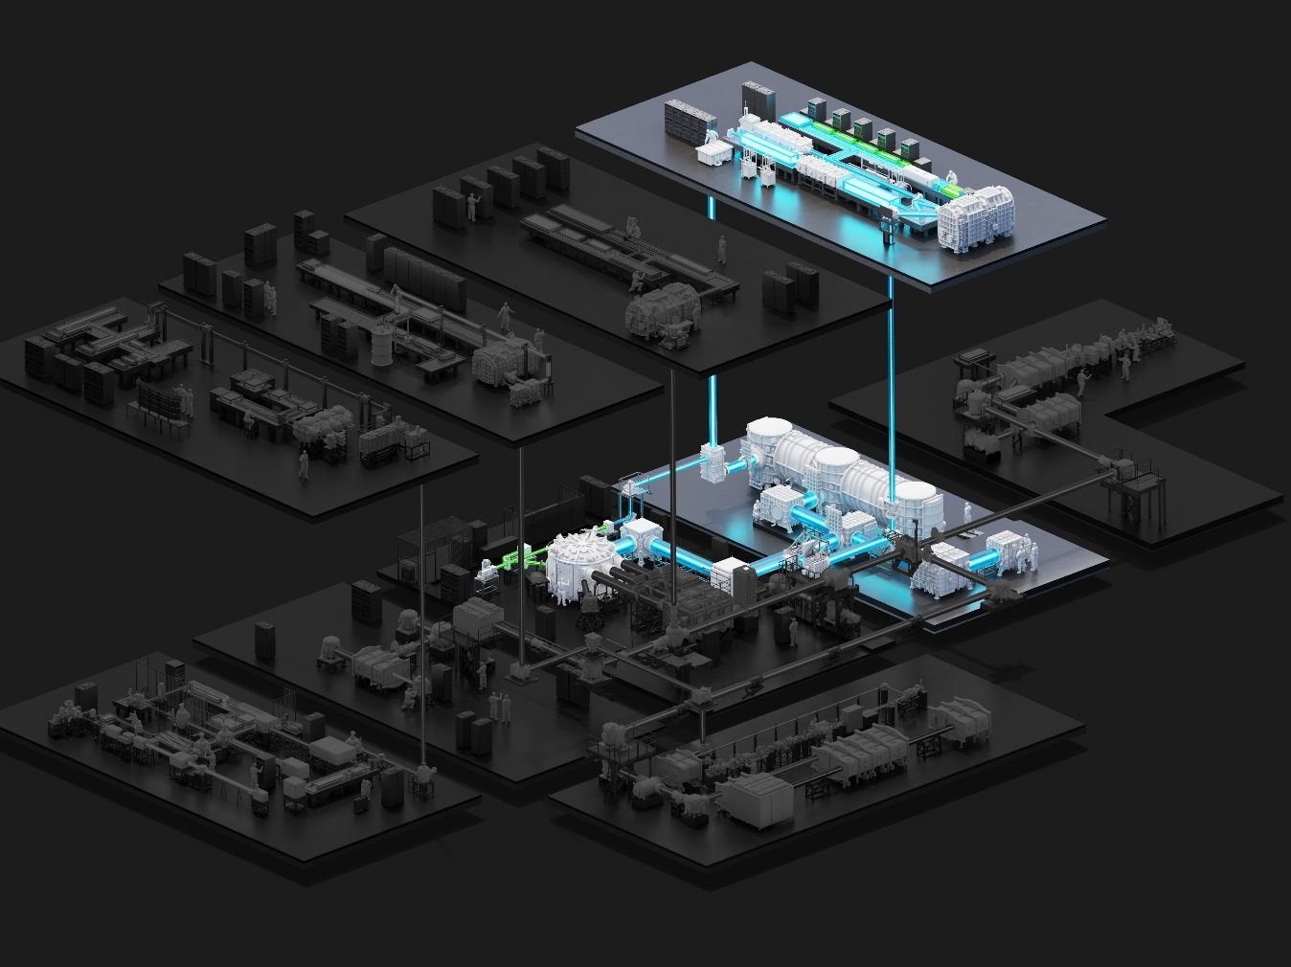
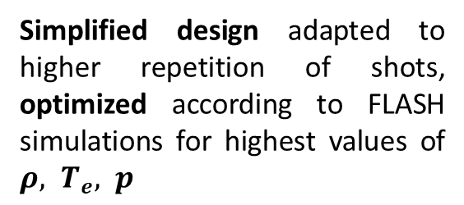
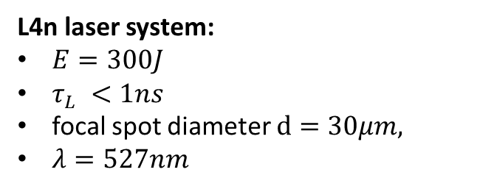
3. Experimental design - proton-boron fusion in pitcher-catcher configuration at ELI Beamlines L4n laser system
Cavity Pressure Acceleration in pitcher-catcher-based proton-boron experiment
Simplified design adapted to higher repetition of shots, optimized according to FLASH simulations for highest values of $ρ, T_{e}, p$
L4n laser system:
$E=300J$
$τ_{L} <1ns$
focal spot diameter $d=30μm,$
$λ=527nm$

Slide 24
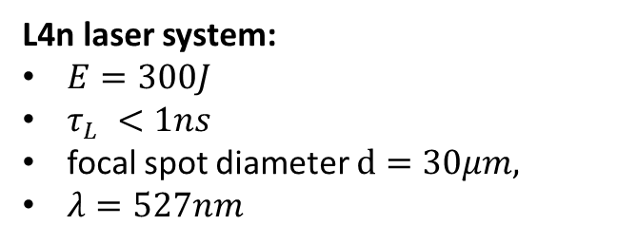
3. Experimental design - proton-boron fusion in pitcher-catcher configuration at ELI Beamlines L4n laser system
Cavity Pressure Acceleration in pitcher-catcher-based proton-boron experiment
New kind of fuel - nano-particle „foam” ppC:H/D of desired thickness
(Tosca et al. Materials Today Sustainability 30 (2025))
L4n laser system:
$E=300J$
$τ_{L} <1ns$
focal spot diameter $d=30μm,$
$λ=527nm$

Slide 25
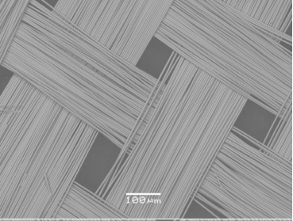
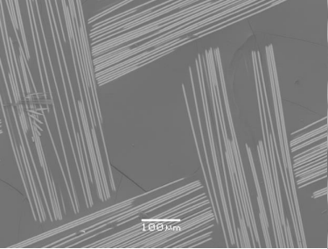
3. Experimental design - proton-boron fusion in pitcher-catcher configuration at ELI Beamlines L4n laser system
Cavity Pressure Acceleration in pitcher-catcher-based proton-boron experiment
New kind of catcher materials – e.g „fiber cloth” suitable for high-rep experiments
L4n laser system:
$E=300J$
$τ_{L} <1ns$
focal spot diameter $d=30μm,$
$λ=527nm$

Slide 26
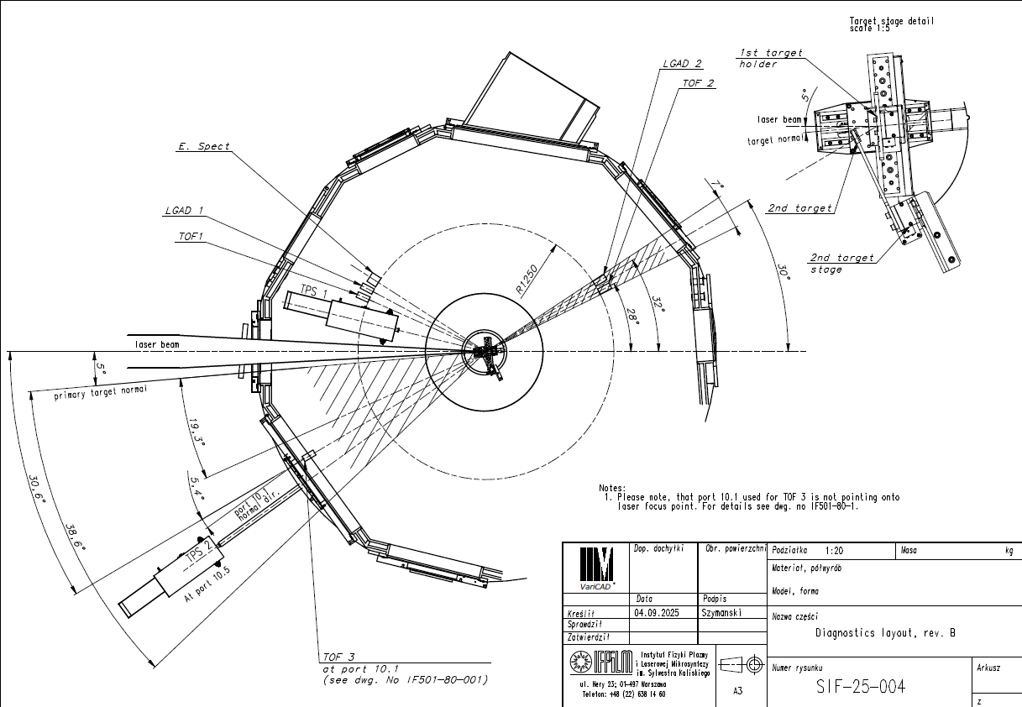
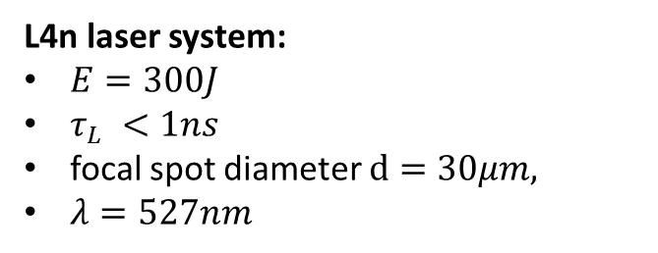
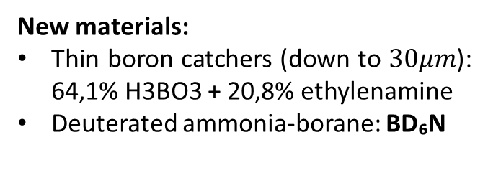
3. Experimental design - proton-boron fusion in pitcher-catcher configuration at ELI Beamlines L4n laser system
L4n laser system:
$E=300J$
$τ_{L} <1ns$
focal spot diameter $d=30μm,$
$λ=527nm$
Additional diagnostics:
Electron spectrometer
Second TPS unit
Neutron time-of-flight
Advanced ion time-of-flight detectors
HPGe
X-ray detectors
New materials:
Thin boron catchers (down to $30μm$): 64,1% H3BO3 + 20,8% ethylenamine
Deuterated ammonia-borane: BD₆N

Slide 27
3. Experimental design - proton-boron fusion in pitcher-catcher configuration at ELI Beamlines L4n laser system
L4n laser system:
$E=300J$
$τ_{L} <1ns$
focal spot diameter $d=30μm,$
$λ=527nm$
Additional diagnostics:
Electron spectrometer
Second TPS unit
Neutron time-of-flight
Advanced ion time-of-flight detectors
HPGe
X-ray detectors
New materials:
Thin boron catchers (down to $30μm$): 64,1% H3BO3 + 20,8% ethylenamine
Deuterated ammonia-borane: BD₆N

Slide 28
3. Experimental design - proton-boron fusion in pitcher-catcher configuration at ELI Beamlines L4n laser system
L4n laser system:
$E=300J$
$τ_{L} <1ns$
focal spot diameter $d=30μm,$
$λ=527nm$
talks of:
M. Manojlovic
G. Lastovicka-Medin
Additional diagnostics:
Electron spectrometer
Second TPS unit
Neutron time-of-flight
Advanced ion time-of-flight detectors
HPGe
X-ray detectors
New materials:
Thin boron catchers (down to $30μm$): 64,1% H3BO3 + 20,8% ethylenamine
Deuterated ammonia-borane: BD₆N
Notes:
Deuterated ammonia borane – potentially more deuterium fuel than CD2

Slide 29
Thank you!
This work has been carried out within the framework of the EUROfusion Consortium, funded by the European Union via the Euratom Research and Training Program (Grant Agreement No. 101052200—EUROfusion). Views and opinions expressed are, however, those of the author(s) only and do not necessarily reflect those of the European Union or the European Commission. Neither the European Union nor the European Commission can be held responsible for them.
This scientific paper has been published as part of the international project called “PMW,” co-financed by the Polish Ministry of Science and Higher Education within the framework of the scientific financial resources for 2020 – 2022 under the Contract No. 5199/PALS/2021/0 and was partially funded by LASERLAB-EUROPE (Grant No. PALS002750). This research work was supported by the Ministry of Science and Higher
Education as part of the IPPLM statutory subsidy. This research work was supported by the Ministry of Youth and Sports of the Czech Republic (Project x Nos. LM2023068 and LM2018114 (PALS RI). This work was supported as well from the Czech Academy of Science’s project “Strategy AV21—Light at the service of society.”
The dissertation is based upon work from COST Action CA21128 “PROton BOron Nuclear fusion: from energy production to medical applications,” supported by COST (European Cooperation in Science and Technology —
www.cost.eu). The computing resources and the related technical support used for this work have been provided by CRESCO/ENEAGRID High Performance Computing infrastructure and its staff. CRESCO/ENEAGRID High Performance Computing infrastructure is funded by ENEA, the Italian National Agency for New Technologies, Energy and Sustainable Economic Development and by Italian and European research programmes.

Slide 30
Extra slide

