Slide 1





ELECTRON DRIVEN REACTIVE PROCESSES INVOLVING H₂⁺, BeH⁺ AND THEIR ISOTOPOLOGUES IN FUSION PLASMA
Nicolina Pop
nicolina.pop @upt.ro
5th IWPBF
8th September 2025
Belgrade

Slide 2

Outline
Theoretical considerations
Cross sections and rate coefficients for state-to-state ro-vibrational transitions of the H₂⁺, HD⁺ ions, induced by low-energy electron collisions.
Study includes the major electron-impact processes relevant for low-metallicity astrochemistry: inelastic and superelastic scattering, and dissociative recombination
Low&High energy collisions of electrons with BeH⁺ and isotopomers
5th IWPBF
8th September 2025
Belgrade

Slide 3
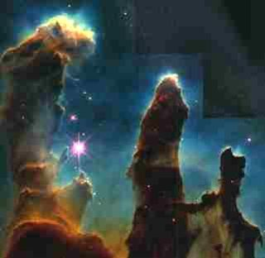

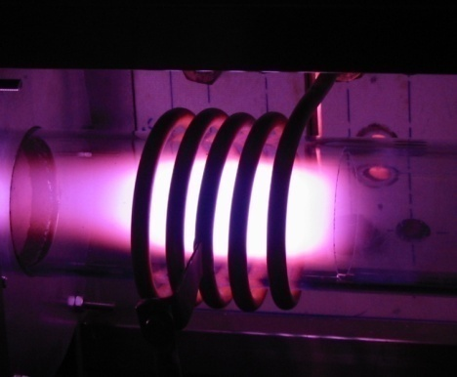
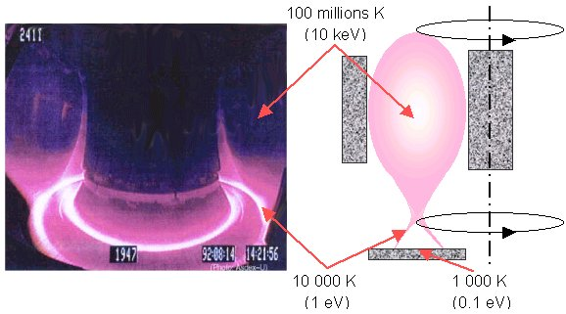
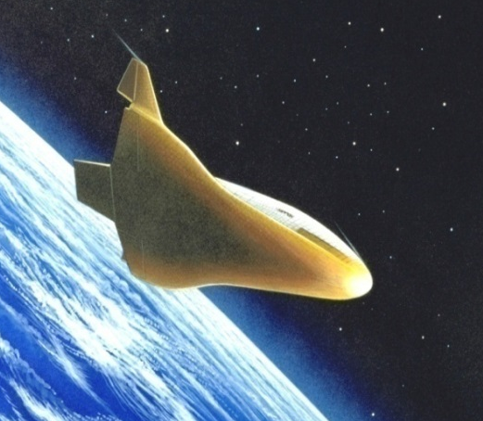

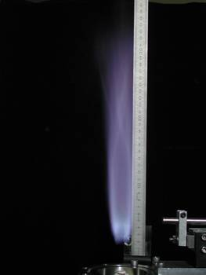
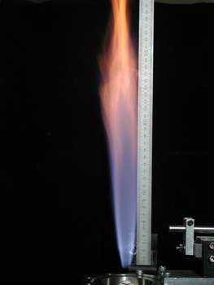
Electron/molecular cation reactive collisions
Important processes in the kinetics of ionized media
Interstellar molecular clouds
Planetary atmospheres
Cold laboratory plasmas
At the wall of the fusion devices (ITER) project
Hypersonic entry of spacecrafts
Plasma-assisted
depollution
Electric-field-assisted combustion
Plasma-assisted-combustion

Slide 4

AB⁺(v')+e⁻
v' < v
AB⁺ (v ) + e⁻
AB⁺(v')+e⁻
v' > v
(Ro)vibrational
de-excitation,
SUPERelastic collision
(Ro)vibrational
excitation,
Inelastic collision
Elastic collision
AB*, AB**
Photoabsorbtion
Dissociative excitation
Dissociative recombination
hν+AB
A⁺ + B + e⁻
A(n) + B(n')

Slide 5
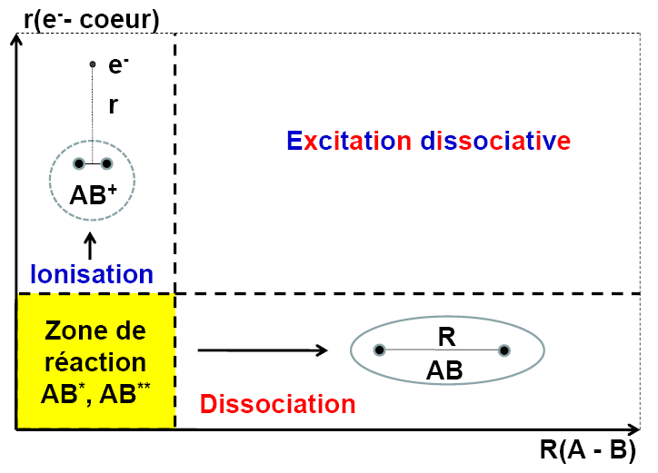
Main THEORETICAL approach: MQDT
Multichannel Quantum Defect Theory
Seaton (1958-1983), Fano, Jungen, Greene, Giusti -Suzor (1970-…),…
Quantum Interferences
CHANNEL interactions
Dissociative state
Dissociative excitation
Bound (Rydberg) state
Notes:
.

Slide 6
THEORETICAL CONSIDERATIONS
MQDT steps
5th IWPBF
8th September 2025
Belgrade

Slide 7

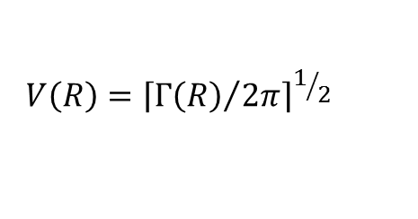



Slide 8


Slide 9
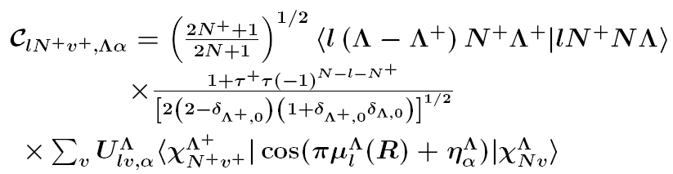

2011/11/24-27, TIM11

Slide 10

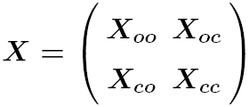

Slide 11


Slide 12

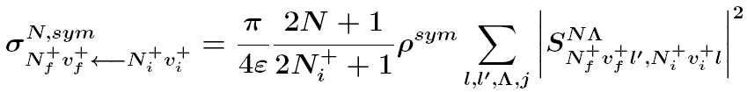

h. Rate coefficients

Slide 13
H₂⁺ + e⁻

Slide 14
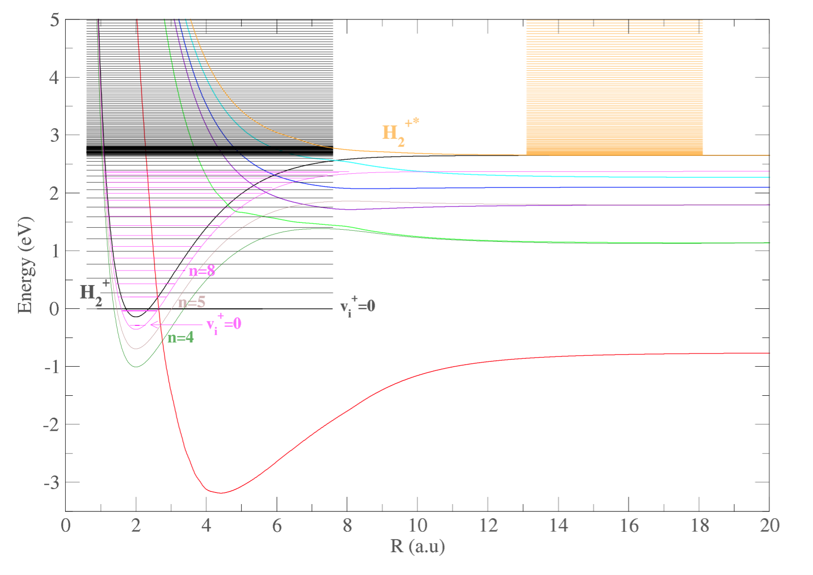
Vibrational CONTINUUM
H₂*
H₂**

Slide 15
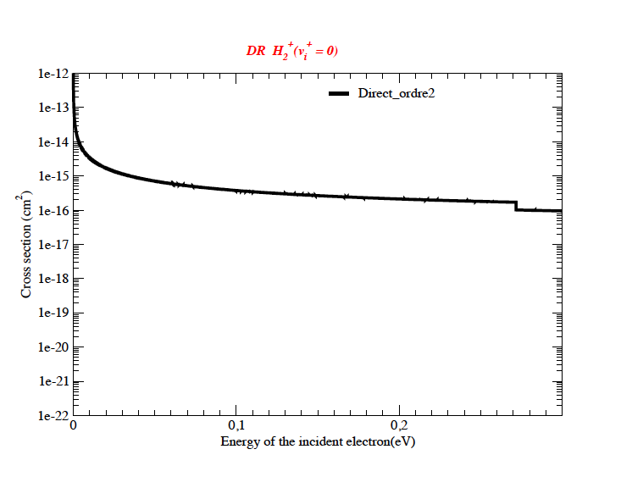
2014/11/22: TIM14

Slide 16
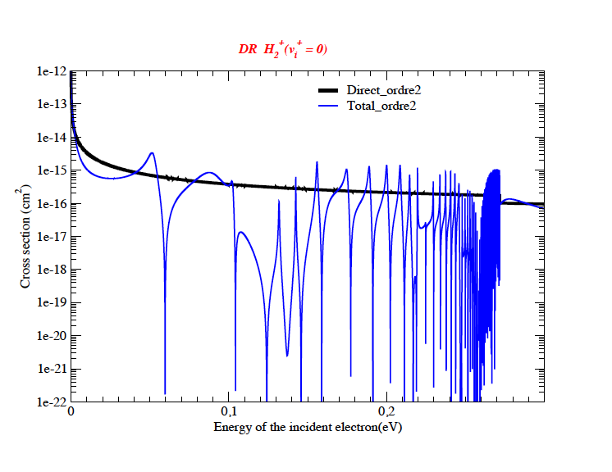
2014/11/22: TIM14

Slide 17
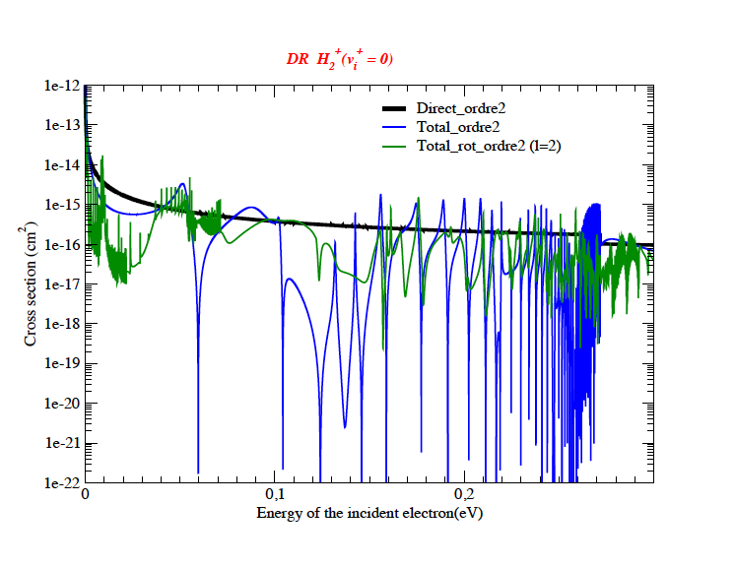
2014/11/22: TIM14

Slide 18
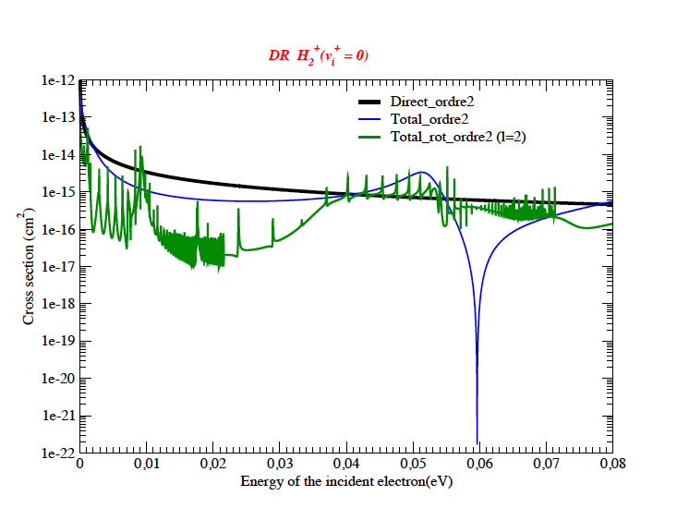
2014/11/22: TIM14

Slide 19
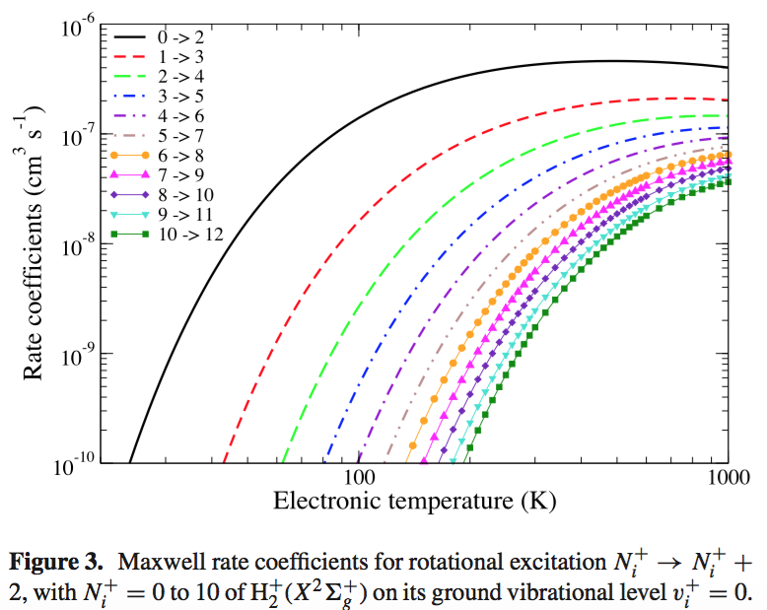
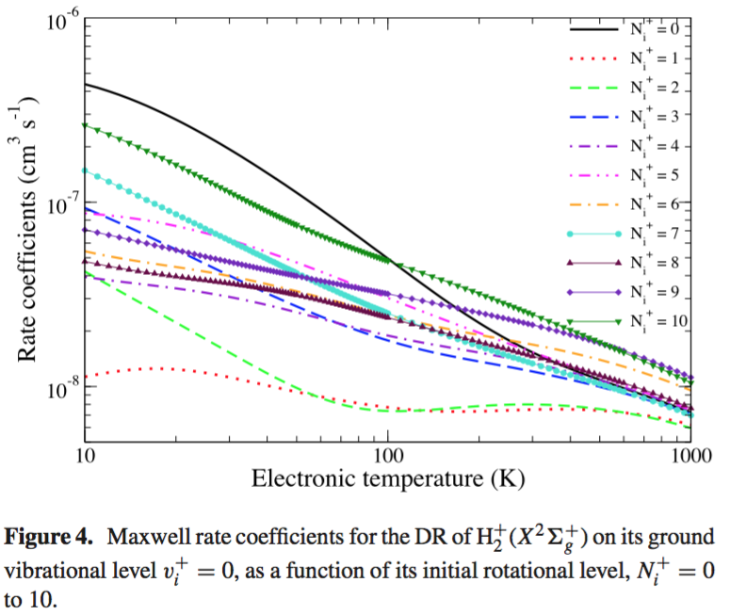

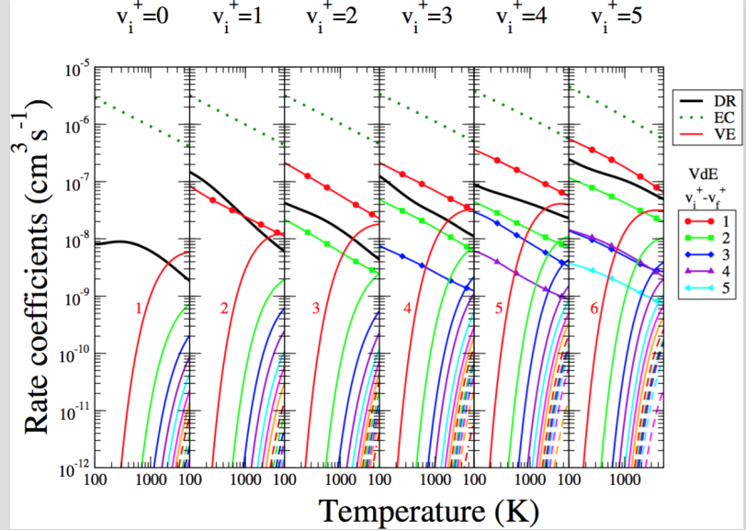
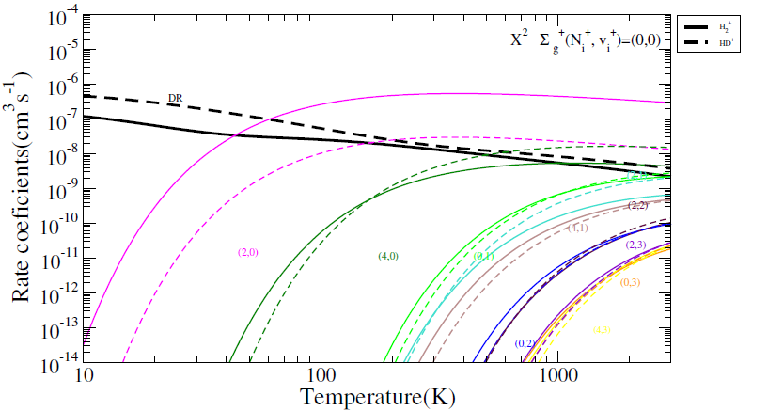
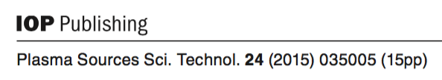
H₂⁺ + e⁻
Fig. 5 Electron-impact DR and RVT for HD⁺ and H₂⁺ .

Slide 20
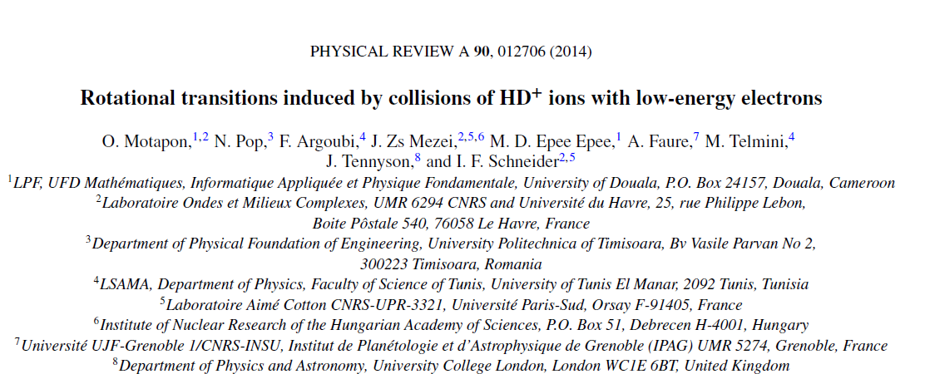
HD⁺ + e⁻

Slide 21
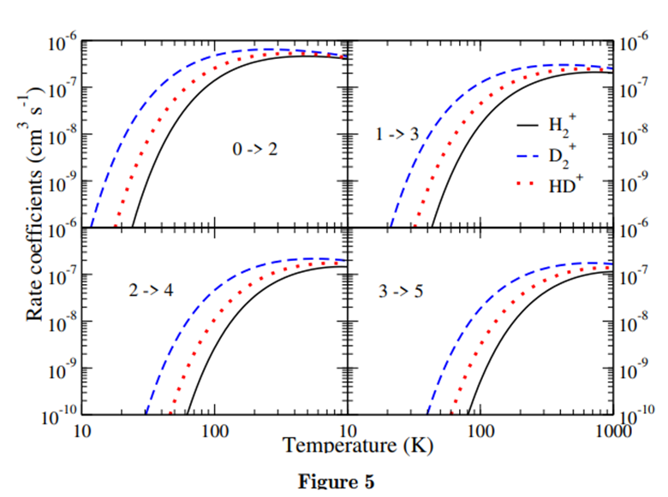
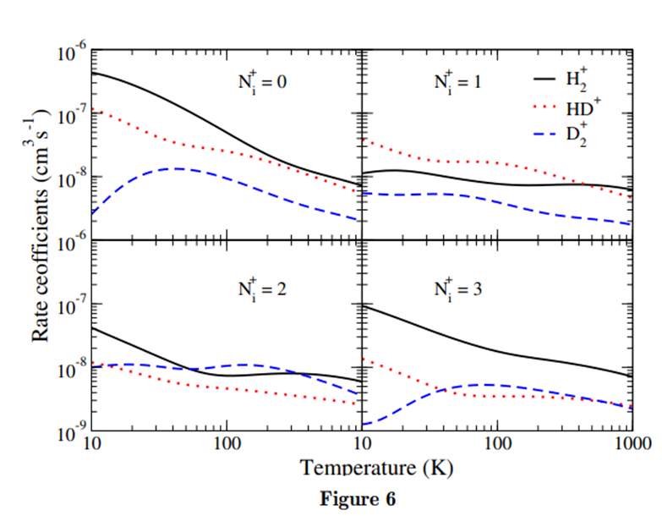
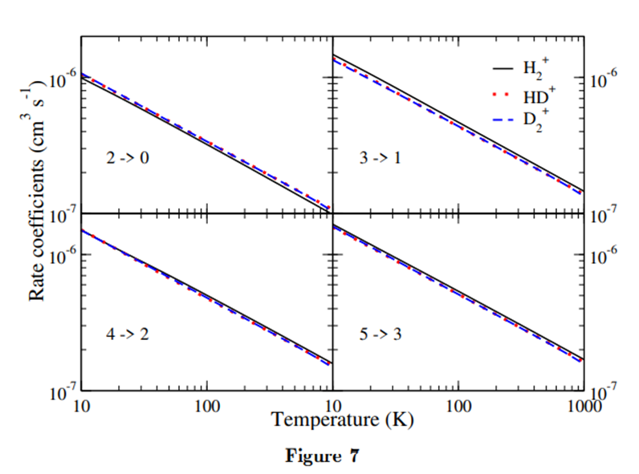

Slide 22
R. Haissane, N. Pop et al, submitted Astronomy and Astrophysics, (2025)

Slide 25
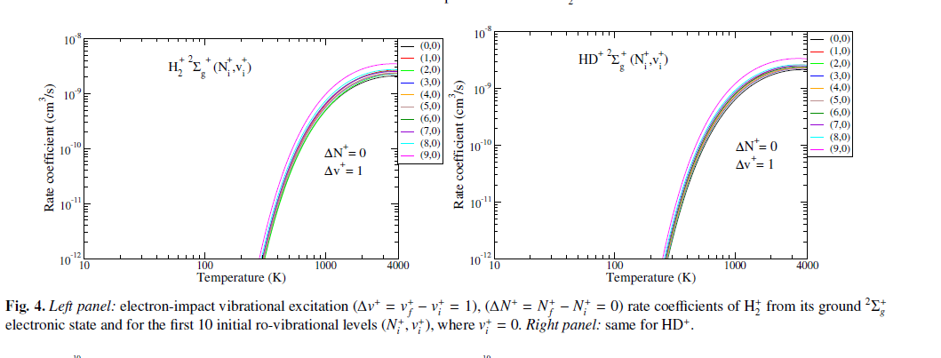

Slide 27
BeH⁺ + e⁻
BeH and its cation have been identified in stars including the sun, in sunspots, and in several comets. The accurate quantification of the relevant elementary processes involving these molecular species is of great importance for determining with the highest precision the physical and chemical conditions of these astrophysical media.
Beryllium was proposed as plasma-facing material for the International Thermonuclear Experimental Reactor (ITER). The interaction of the edge and divertor hydrogen plasma with the beryllium walls results in the formation and release of beryllium hydrides.

Slide 28
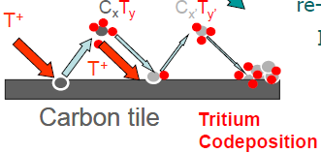
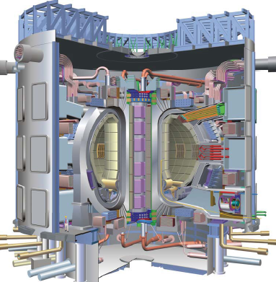
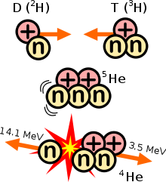
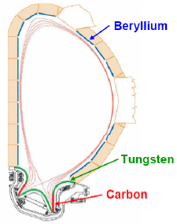
Thermonuclear fusion plasma (JET, ITER)
Fuels: H, D, T
Be: wall material in fusion devices.
Section ITER
BeH/BeH⁺, BeC/BeC⁺, CH/CH⁺, CH₄/CH₄⁺, CH₂ /CH₂⁺, H₂⁺, HeH⁺, isotopologi (H→D, H→T)

Slide 29
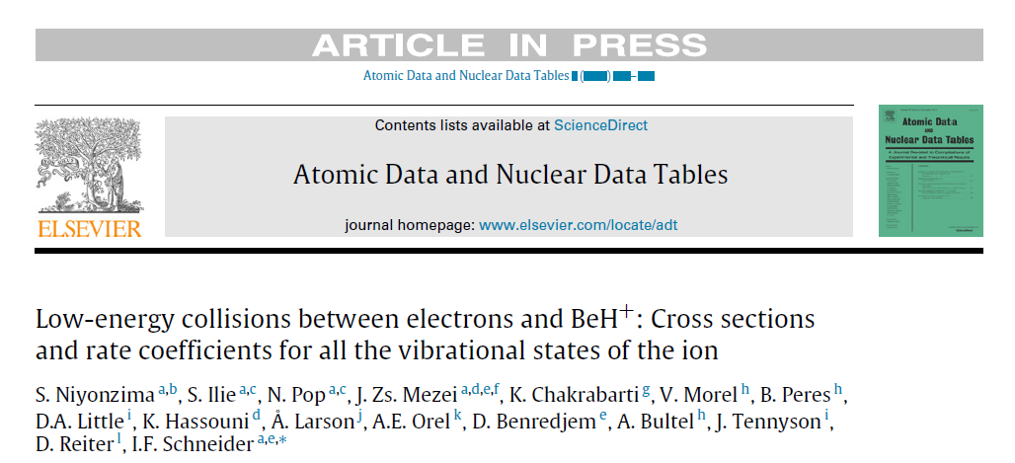
LOW-ENERGY COLLISIONS BETWEEN ELECTRONS AND BeH⁺
5th IWPBF
8th September 2025
Belgrade

Slide 30
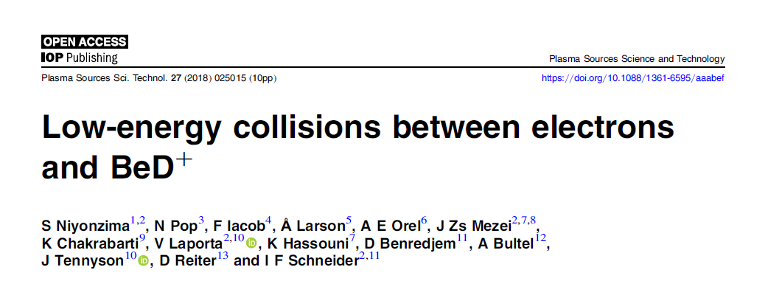
LOW-ENERGY COLLISIONS BETWEEN ELECTRONS AND BeD⁺
5th IWPBF
8th September 2025
Belgrade

Slide 31
LOW-ENERGY COLLISIONS BETWEEN ELECTRONS AND BeT⁺
5th IWPBF
8th September 2025
Belgrade

Slide 32

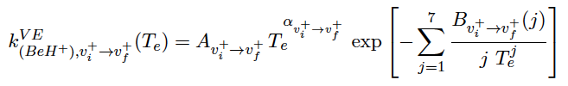
LOW-ENERGY COLLISIONS BETWEEN ELECTRONS AND BeH⁺
^{(rotational effects neglected)}
Arrhenius-type formulas are used in order to fit the rate coefficients as function of the electronic temperature.
The rate coefficients strongly depend on the initial vibrational level of the molecular ion.
5th IWPBF
8th September 2025
Belgrade

Slide 33
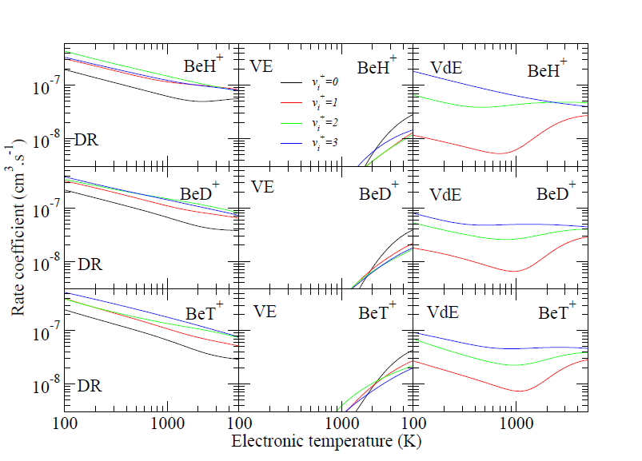
LOW-ENERGY COLLISIONS BETWEEN ELECTRONS AND BeH⁺ and its isotopomers
Maxwell rate coefficients for the DR and state-to-state VE, VdE of BeH+ , BeD+ and BeT+ ion .
2025/04/11
PROBONO WG Meeting, Prague

Slide 34
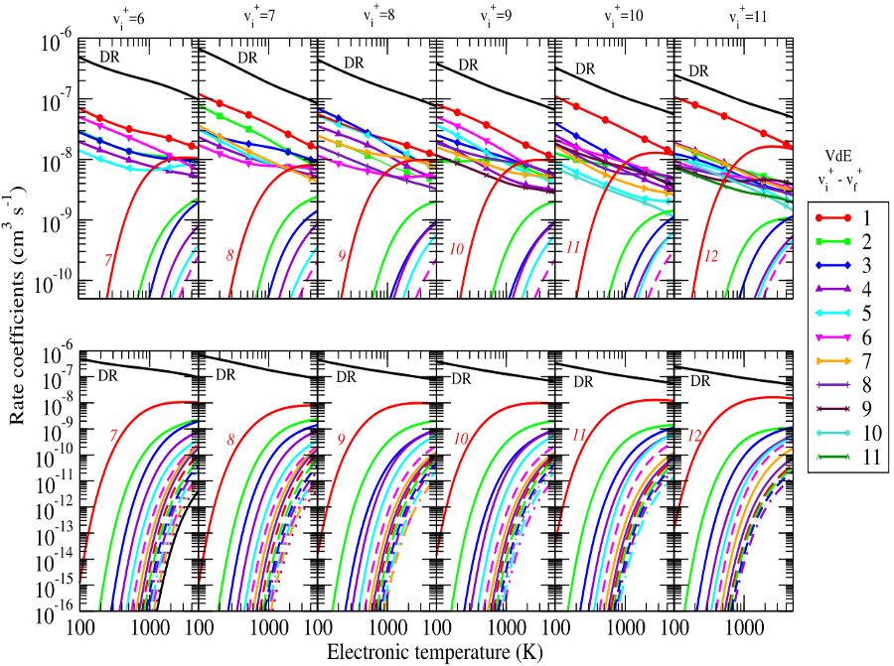
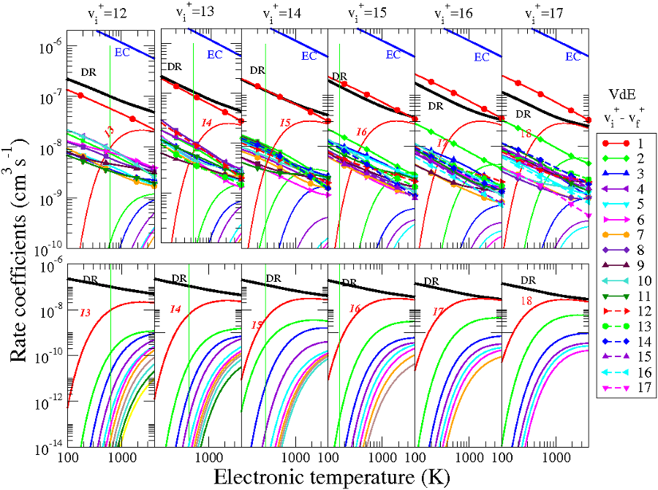
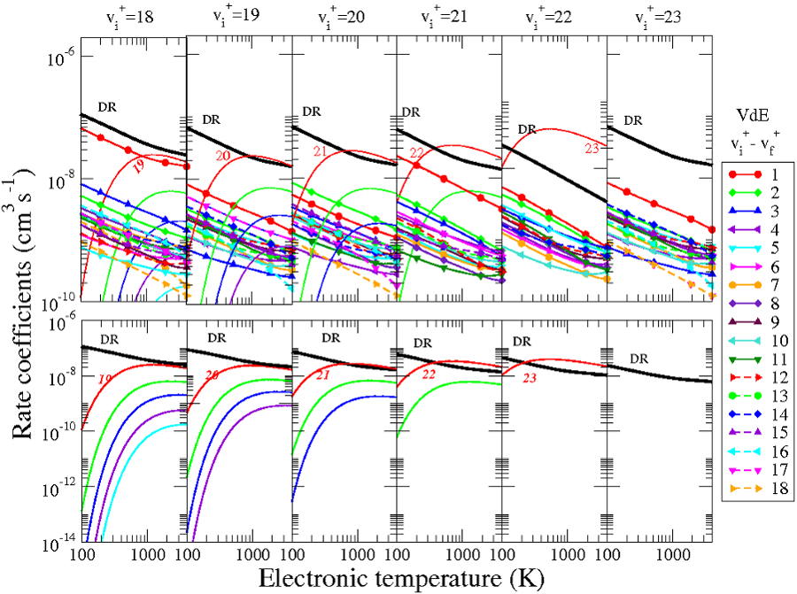
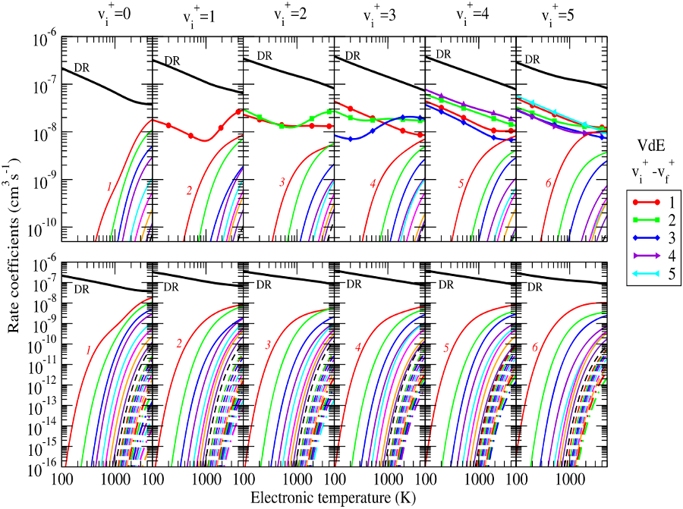
Rate coefficients of BeD⁺ (DR, VdE and VE processes) for the successive increase of the vibrational quantum number
N. Pop, et al. Plasma Sources Sci. Technol. 27 (2), 025015 (2018)

Slide 35
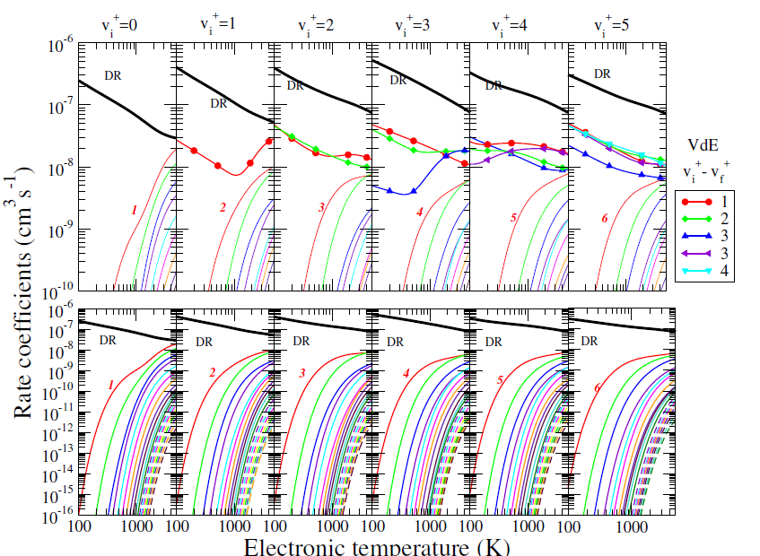
LOW-ENERGY COLLISIONS BETWEEN ELECTRONS AND BeT⁺
Reactive collisions between electrons and BeT + : Complete set of thermal rate coefficients up to 5000 K , N. POP et al, Atomic Data and Nuclear Data Tables (2021).
5th IWPBF
8th September 2025
Belgrade
2024/11/13
A&M Data

Slide 36
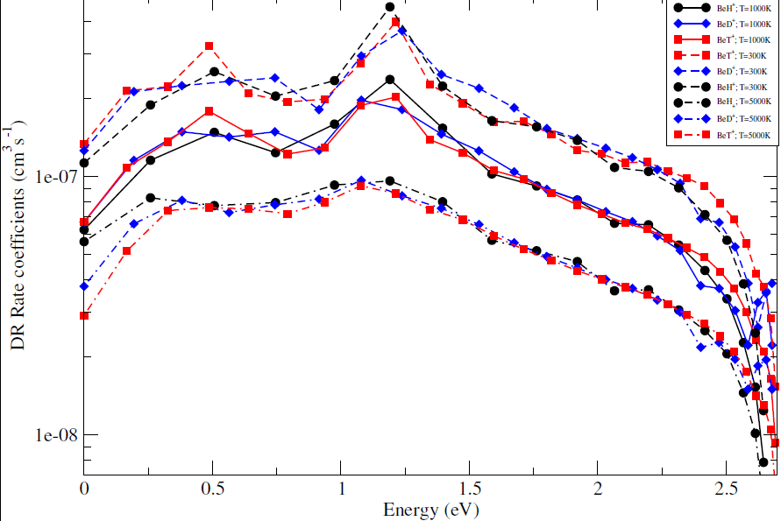
Isotopic effects: Dissociative recombination rate coefficient of the BeH^{+,} BeD⁺and BeT⁺
N. Pop et al, Atomic Data and Nuclear Data Tables, (2021).
DR rate coeffcient of the BeH+,BeD+and BeT+as function of the energy of the initial vibrational level of the target -relative to the ground vibrational level - for three electron temperatures.
.
5th IWPBF
8th September 2025
Belgrade

Slide 37
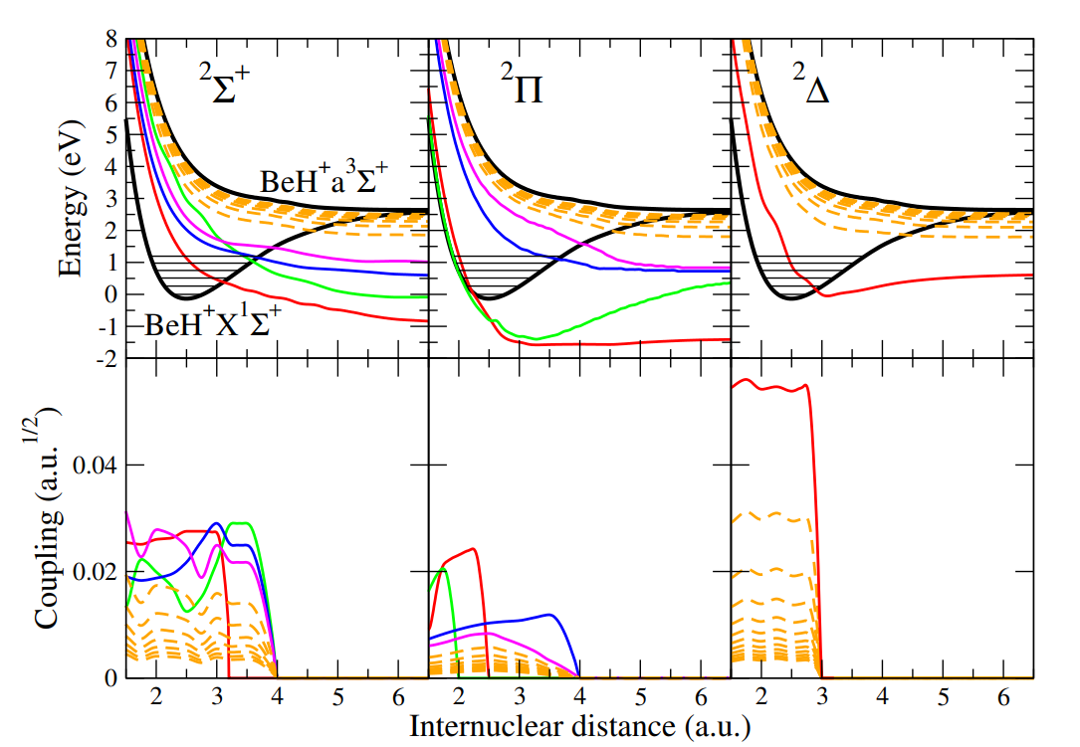
HIGH-ENERGY COLLISIONS BETWEEN ELECTRONS AND BeH⁺
Molecular data relevant for e − induced reactive processes. Upper row: Potential energy curves of BeH+ (thick black line) and dissociative states of BeH of 2Π, 2Σ +, and 2∆ symmetries. Low row: Electronic couplings between the dissociative states of BeH and the ionization continuum.

Slide 38
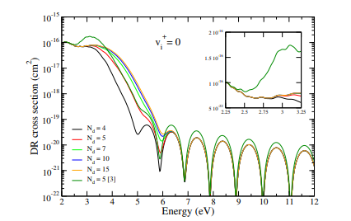
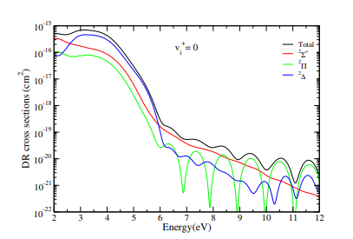
HIGH-ENERGY COLLISIONS BETWEEN ELECTRONS AND BeH⁺
Dissociative recombination (DR), vibrational excitation(VE), vibrational de-excitation (VdE), dissociative excitation (DE) cross sections (left side) and rate coefficients of BeH+ (right side) .

Slide 39
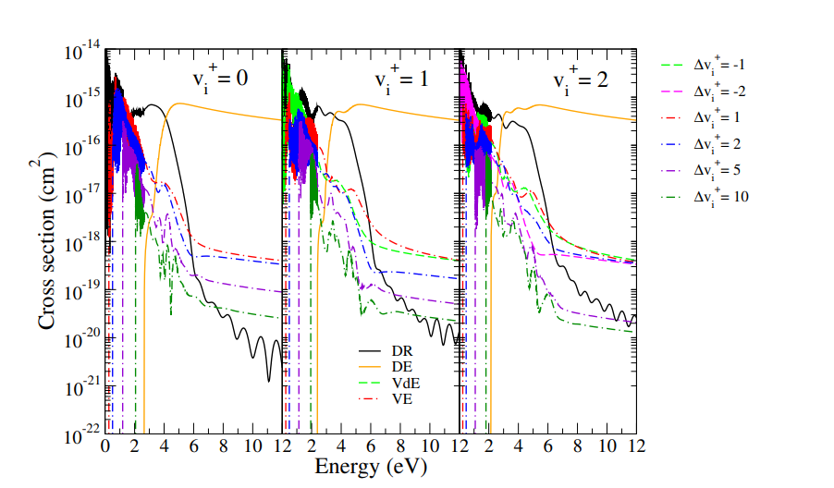
HIGH-ENERGY COLLISIONS BETWEEN ELECTRONS AND BeH⁺
E.Djuissi, J. Boffelli, R. Hassaine, N. Pop, V. Laporta, K. Chakrabarti, M. Ayouz, A. Bultel, Zs. Mezei, I. F. Schneider, PCCP (2024)
DOI: 10.1039/D4CP01736F
Dissociative recombination (DR), vibrational excitation(VE), vibrational de-excitation (VdE), dissociative excitation (DE) cross sections of BeH+ in its ground and lowest vibrational states.

Slide 40
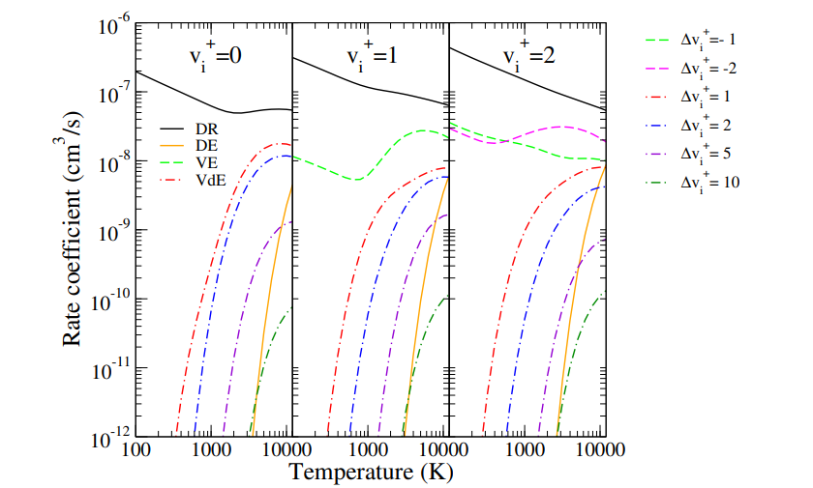

HIGH-ENERGY COLLISIONS BETWEEN ELECTRONS AND BeH⁺
Dissociative recombination (DR), vibrational excitation(VE), vibrational de-excitation VdE), dissociative excitation (DE) rate coefficients of BeH+ in its ground and lowest vibrational states.

Slide 41
Conclusions
Rotational effects in the DR for H₂⁺and HD⁺, are shown to be important below 1 eV only, in terms of energy, and below 2000 K in terms of rate coefficients.
State-to-state information of BeH⁺ (BeD⁺, BeT⁺) reactive collisions with electrons, illustrating the competition between the VT and DR was provided. By adding the generated dissociative states of BeH⁺ , cross sections and rate coefficients results are extended to collision energies above the dissociation threshold, taking into account the DE processes. These data are suitable for the modeling of the kinetics in fusion plasmas, in devices with beryllium based main chamber materials, such as ITER and JET.
Contributions to the Databases as IAEA or KIDA or VAMDC.
5th IWPBF
8th September 2025
Belgrade

Slide 42
Outcomes
Data provide updated and improved input for the modeling of hydrogen-rich plasmas in environments where a high abundance of free electrons is expected, such as planetary nebulae and the ionospheres of giant planets.
Dynamic calculations of DR și RVE, RVdE cross sections for H₂⁺ , HD⁺ , NH⁺ and BH⁺, will be computed to higher energy.
The state-to-state information of the isotopologues of BeH⁺ (BeD ⁺, BeT⁺) reactive collisions with electrons, illustrating the competition between the VT ,DR, DE above the dissociative threshold of the ion will be highlighted.
5th IWPBF
8th September 2025
Belgrade

Slide 43
Collaborators
^{I. F. Schneider, E Djuissi,} ^{J. Boffelli, R. Hassaine} (Université Le Havre Normandie )
Ch. Jungen (Université Paris-Sud, Orsay)
J. Zs. Mezei (Inst. of Nuclear Research Hungarian Acad. Sciences )
F. Argoubi, M.Telmini (Department of Physics , University of Tunis)
O. Motapon, M. Epee (University of Douala)
K. Chakrabarti (Scottish Church College, Calcutta)
J. Tennyson, D. Little (University College London)
V. Laporta (Lab Nanotec, CNR, Bari, Italy)
S. Niyonzima (Dépt de Physique, Université du Burundi)
2025/04/11
PROBONO WG Meeting, Prague

Slide 44

Thank you for your attention !
2025/04/11
PROBONO WG Meeting, Prague

