Slide 1
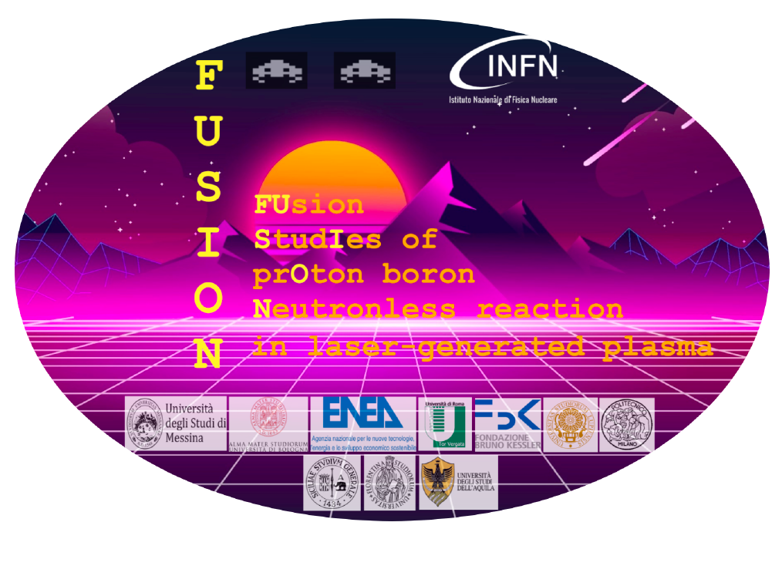
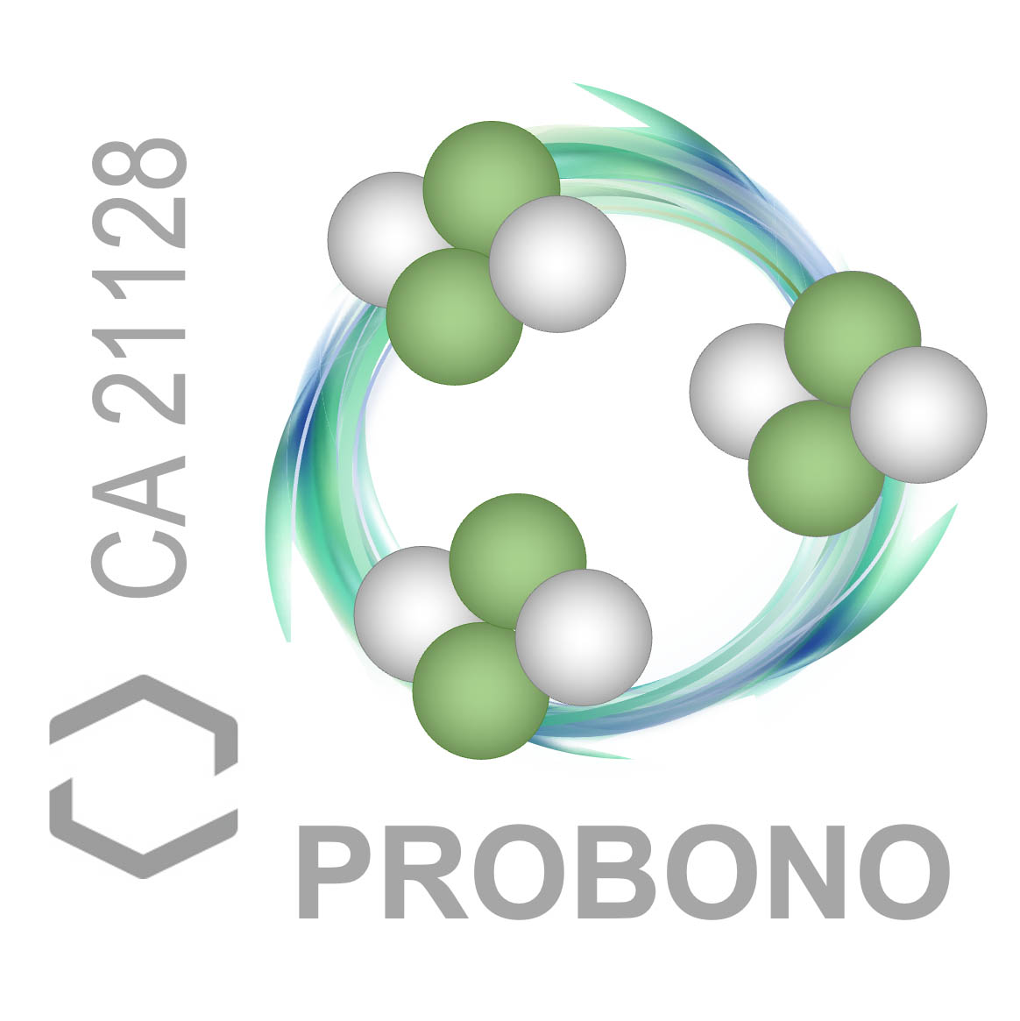



Investigation of Laser driven proton-boron reaction in Pitcher-Catcher configuration: CR39 and activation measurements with Monte Carlo validation
N. Macaluso, G. Petringa, F. Abubaker, L. Guardo, M. La Cognata, E. Pagano, G. Rapisarda, D. Santonocito, S. Agarwal, M. Alonzo, C. Altana, S. Arjmand, D. Bortot, G. Cantone, R. Catalano, M. Cervenak, C. Ciampi, M. Cipriani, G. A. P. Cirrone, F. Consoli, P. Devi, E. Domenicone, R. Dudzak, D. Ettel, P. Gajdos, B. Grau, L. Giuffrida, J. Krasa, M. Krupka, M. Krus, L. Juha, L. Malferrari, D. Margarone, G. Messina, S. Mirabella, G. Morello, A. D. Pappalardo, A. Picciotto, A.M. Raso, R. Rinaldi, M. Rosinski, M. Scisciò, A. Scandurra, S. Singh, P. Tchórz, A. Trifirò and C. Verona

Slide 2
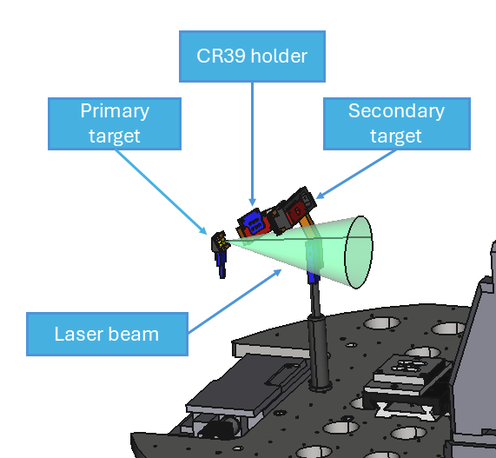
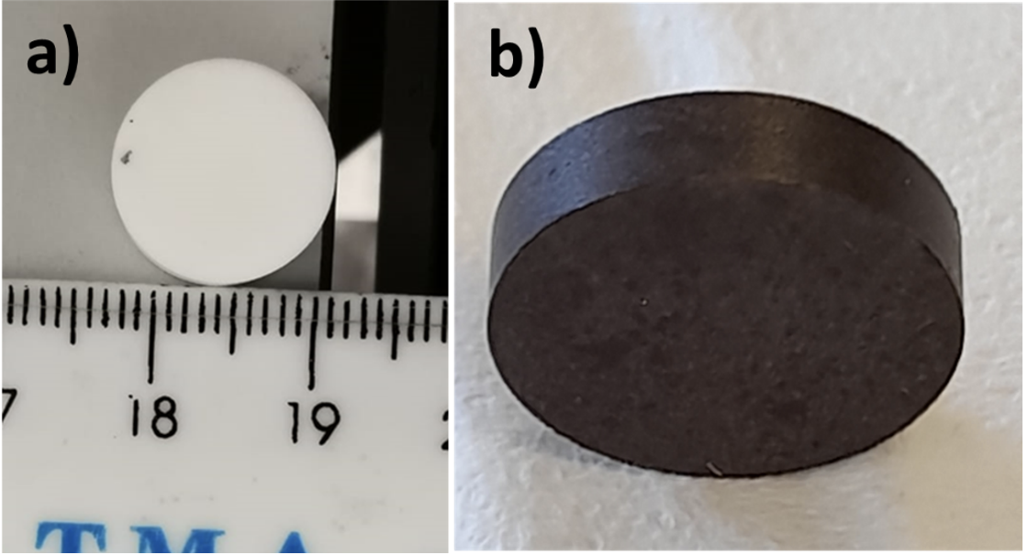
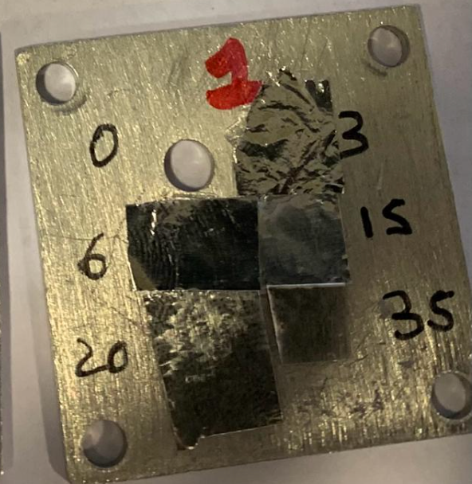
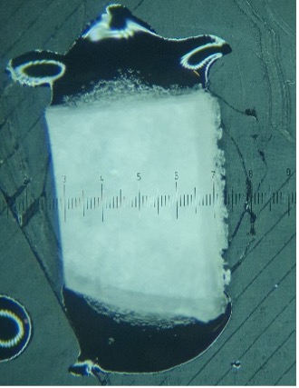
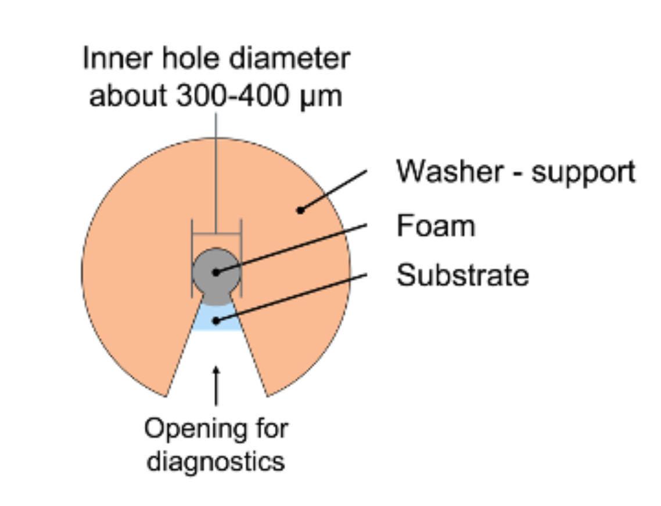
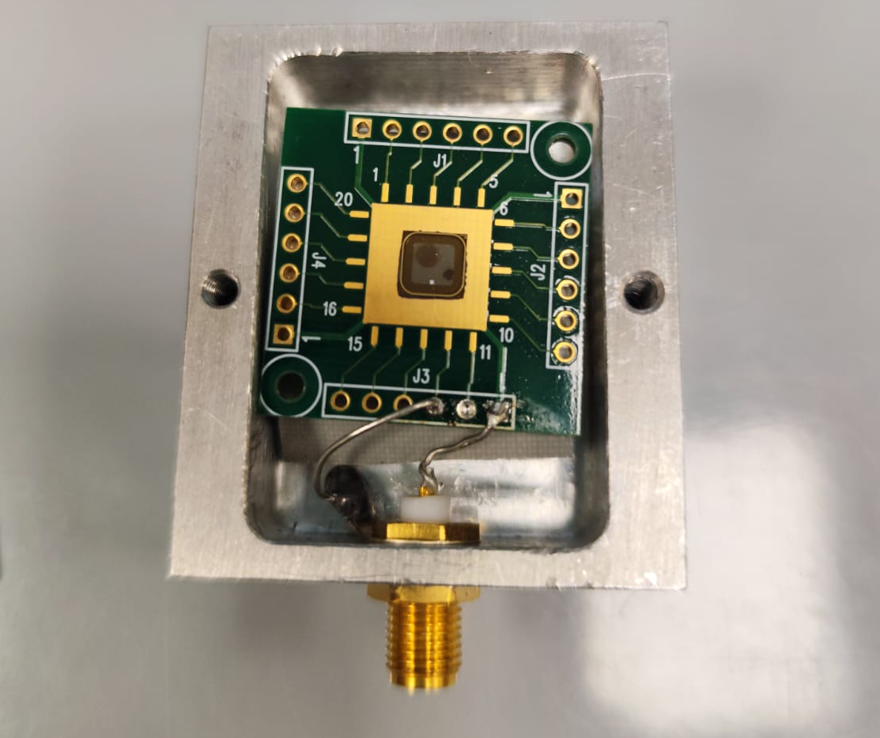
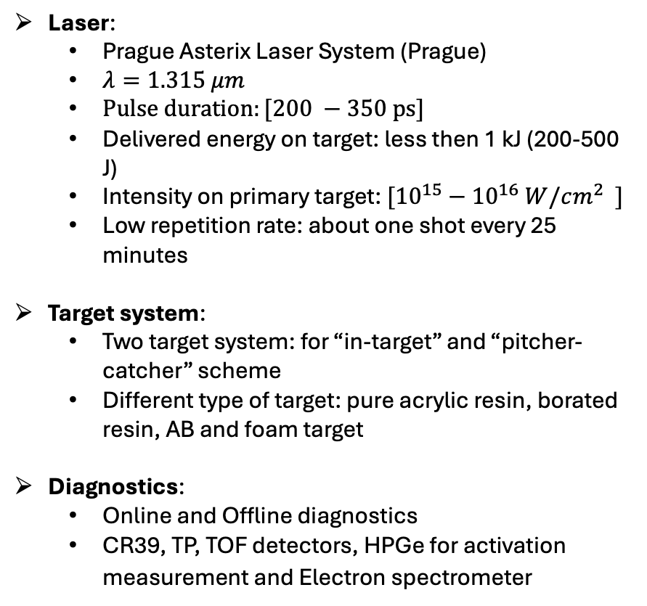
Experimental Setup:
Laser:
Prague Asterix Laser System (Prague)
$λ=1.315 μm$
$Pulse duration:[200 −350 ps]$
Delivered energy on target: less then 1 kJ (200-500 J)
Intensity on primary target: $[{10}^{15}−{10}^{16} W/cm^{2} ]$
Low repetition rate: about one shot every 25 minutes
Target system:
Two target system: for “in-target” and “pitcher-catcher” scheme
Different type of target: pure acrylic resin, borated resin, AB and foam target
Diagnostics:
Online and Offline diagnostics
CR39, TP, TOF detectors, HPGe for activation measurement and Electron spectrometer

Slide 3
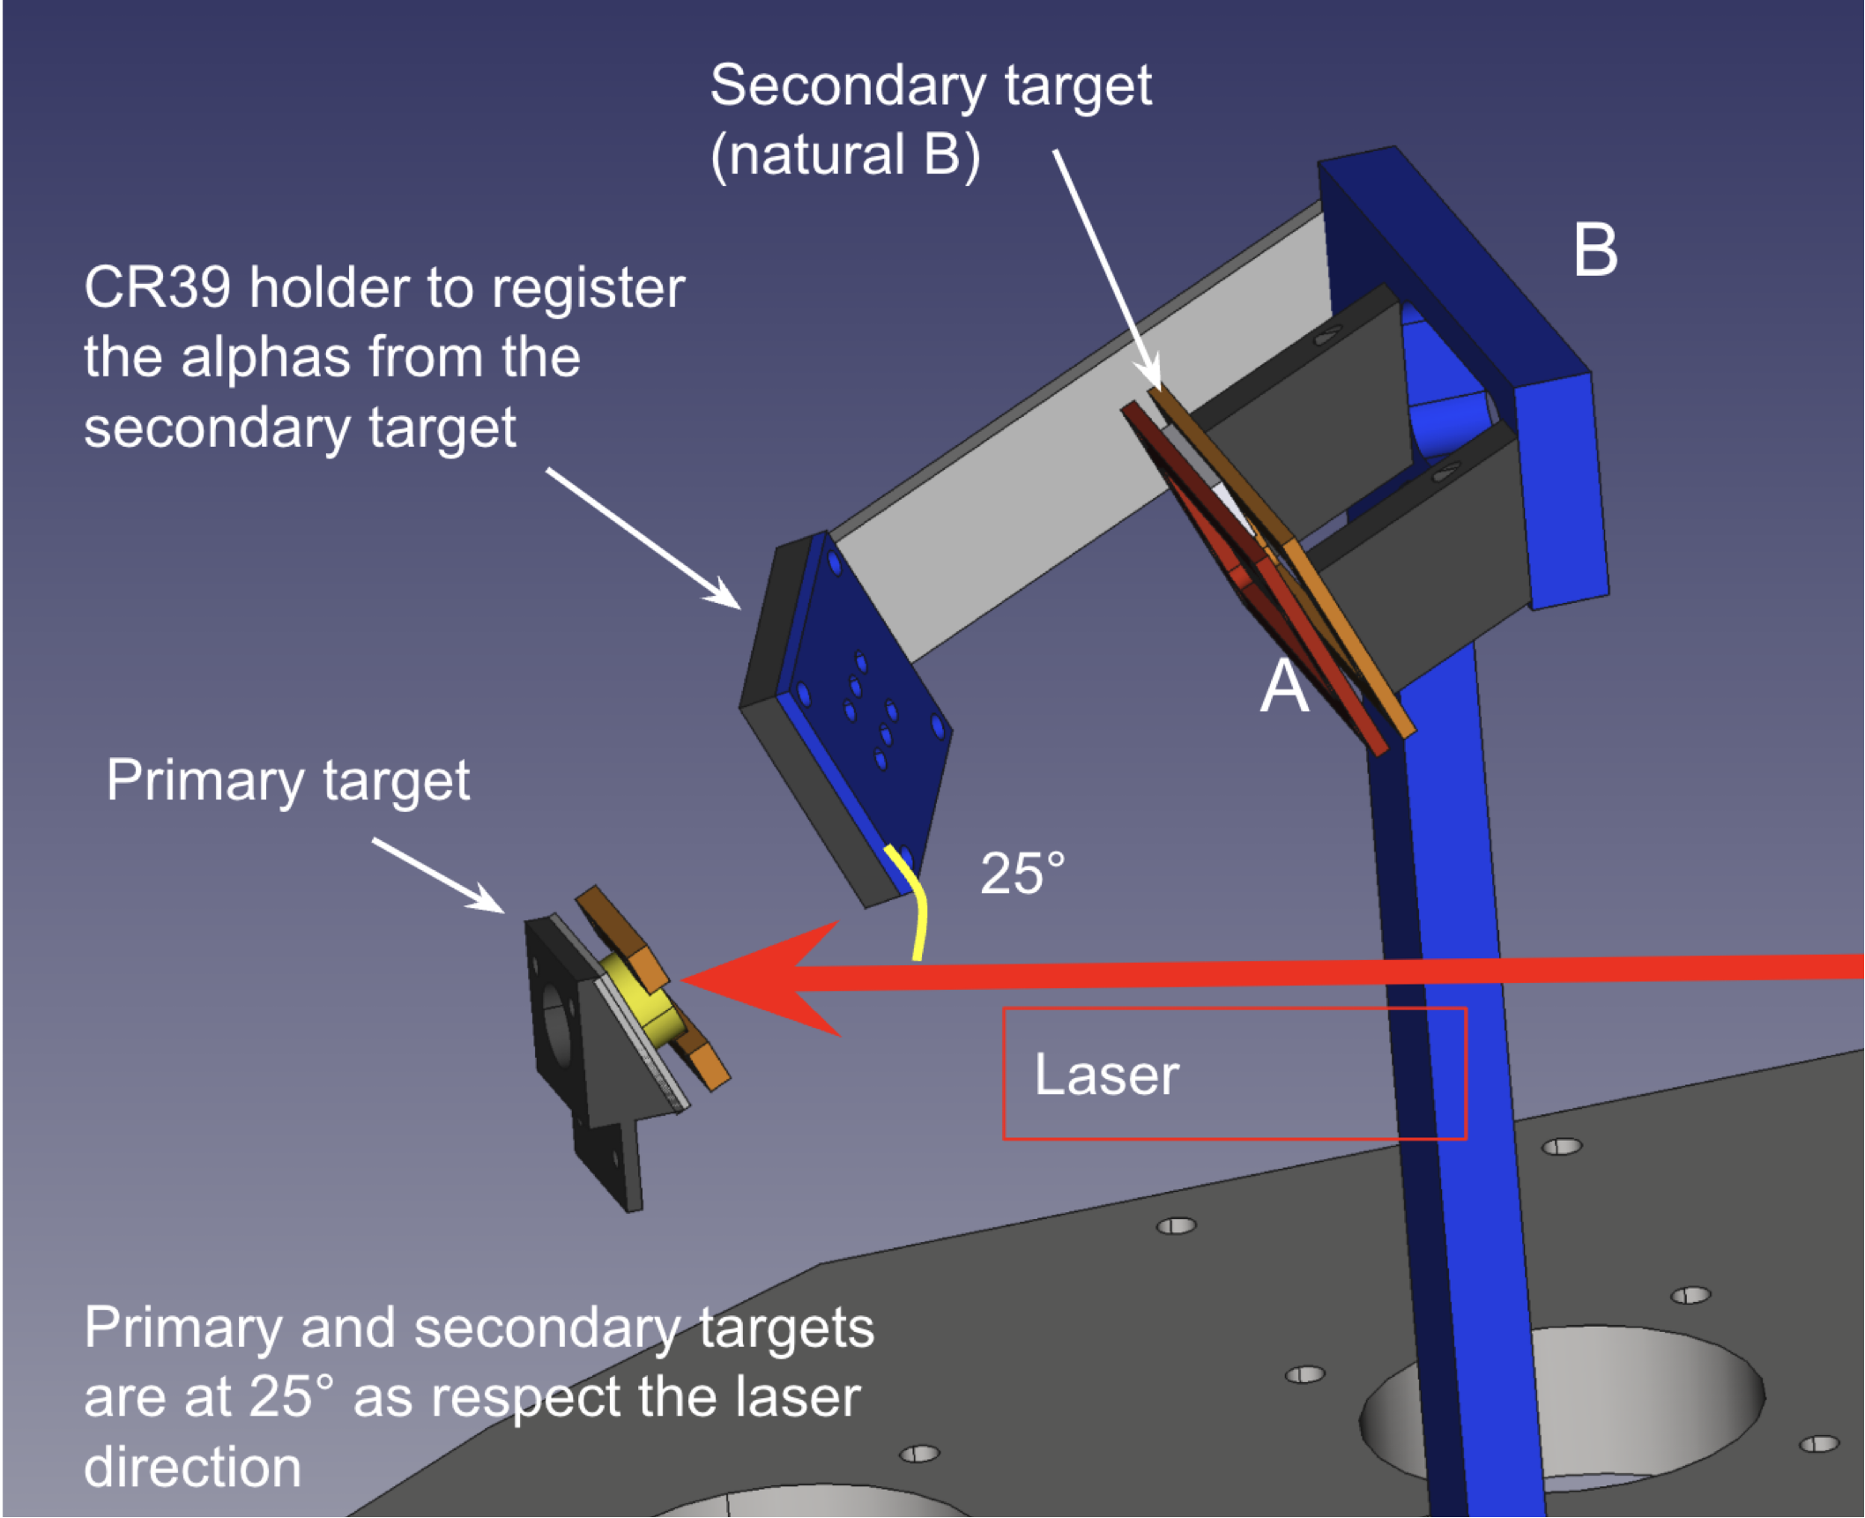
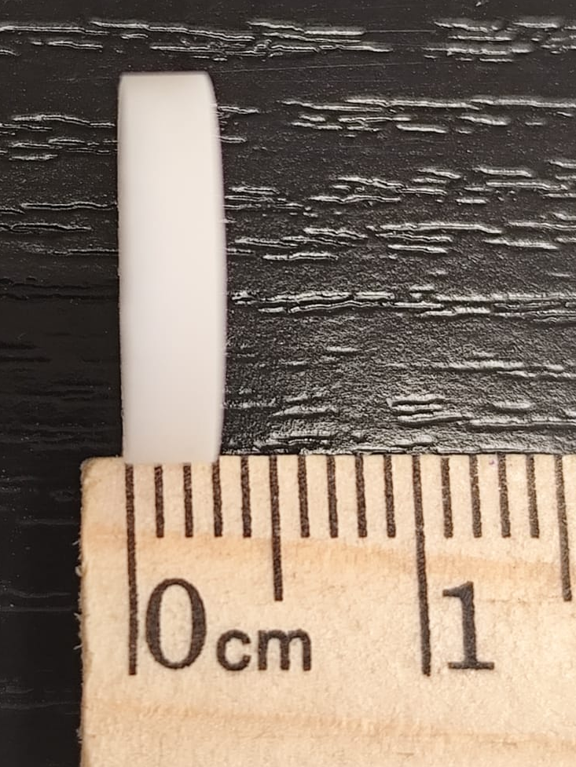
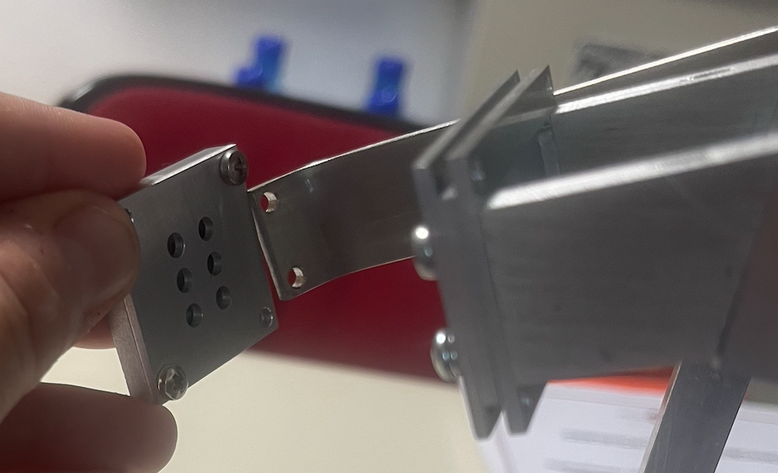
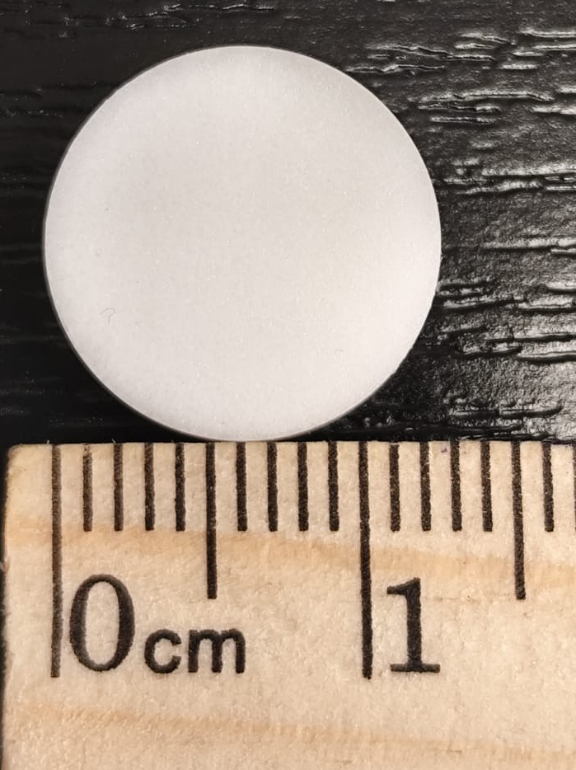
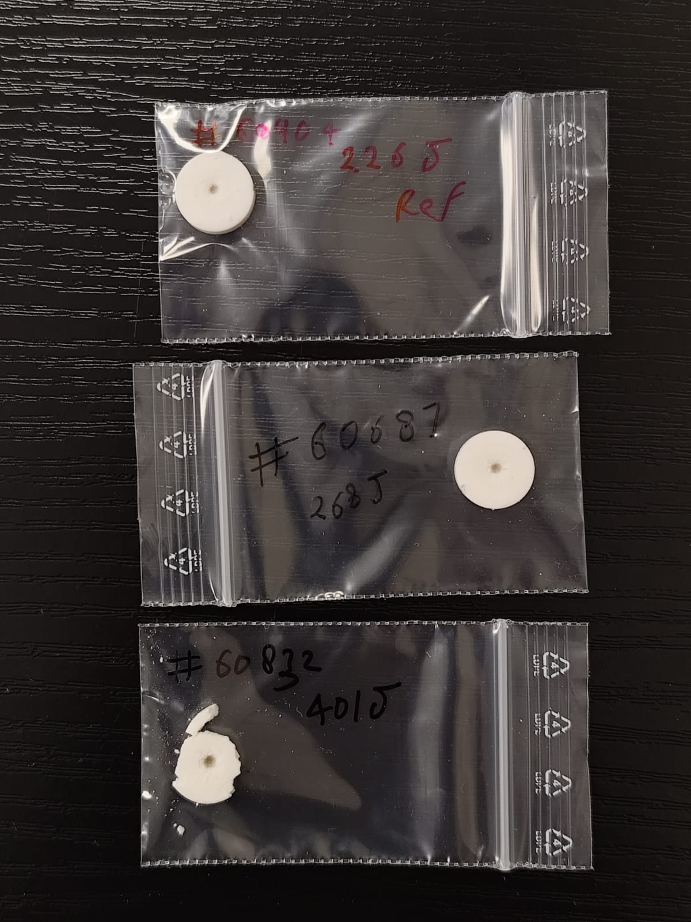
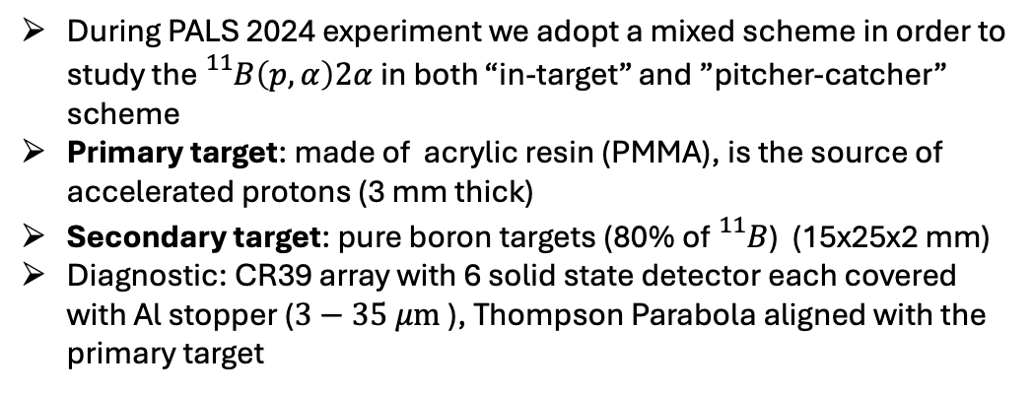
Pitcher-Catcher scheme:
During PALS 2024 experiment we adopt a mixed scheme in order to study the ${}_{}^{11}B\left(p,α\right)2α$in both “in-target” and ”pitcher-catcher” scheme
Primary target: made of acrylic resin (PMMA), is the source of accelerated protons (3 mm thick)
Secondary target: pure boron targets (80% of${}_{}^{11}B$) (15x25x2 mm)
Diagnostic: CR39 array with 6 solid state detector each covered with Al stopper ($3−35 μm$), Thompson Parabola aligned with the primary target

Slide 4
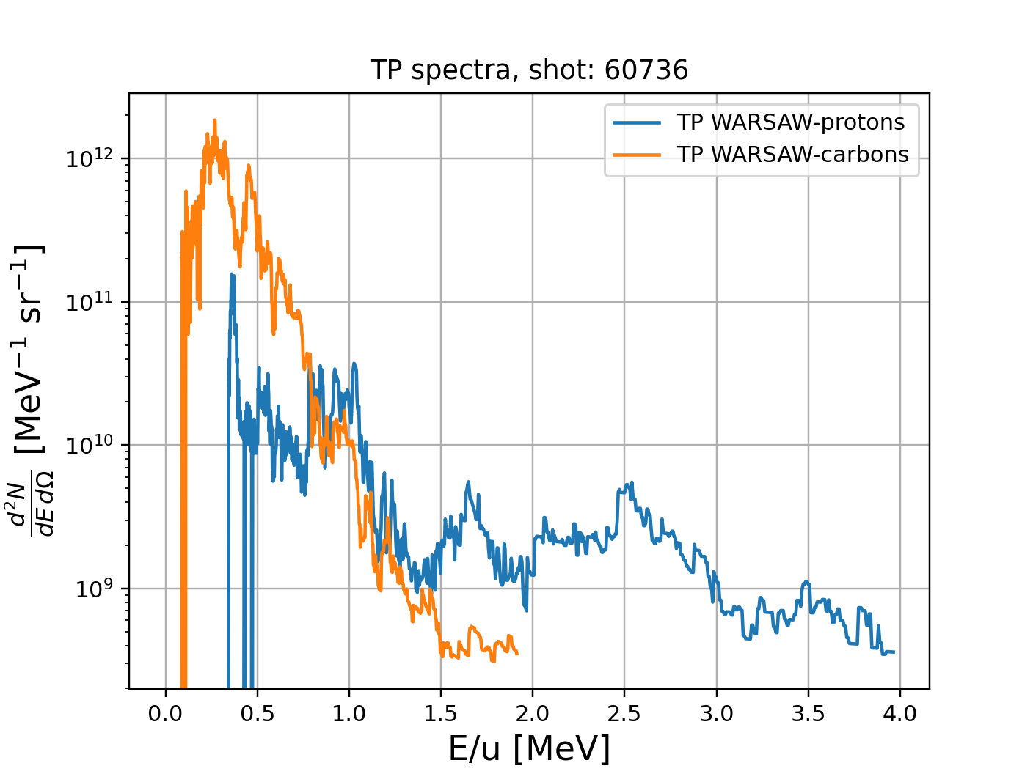
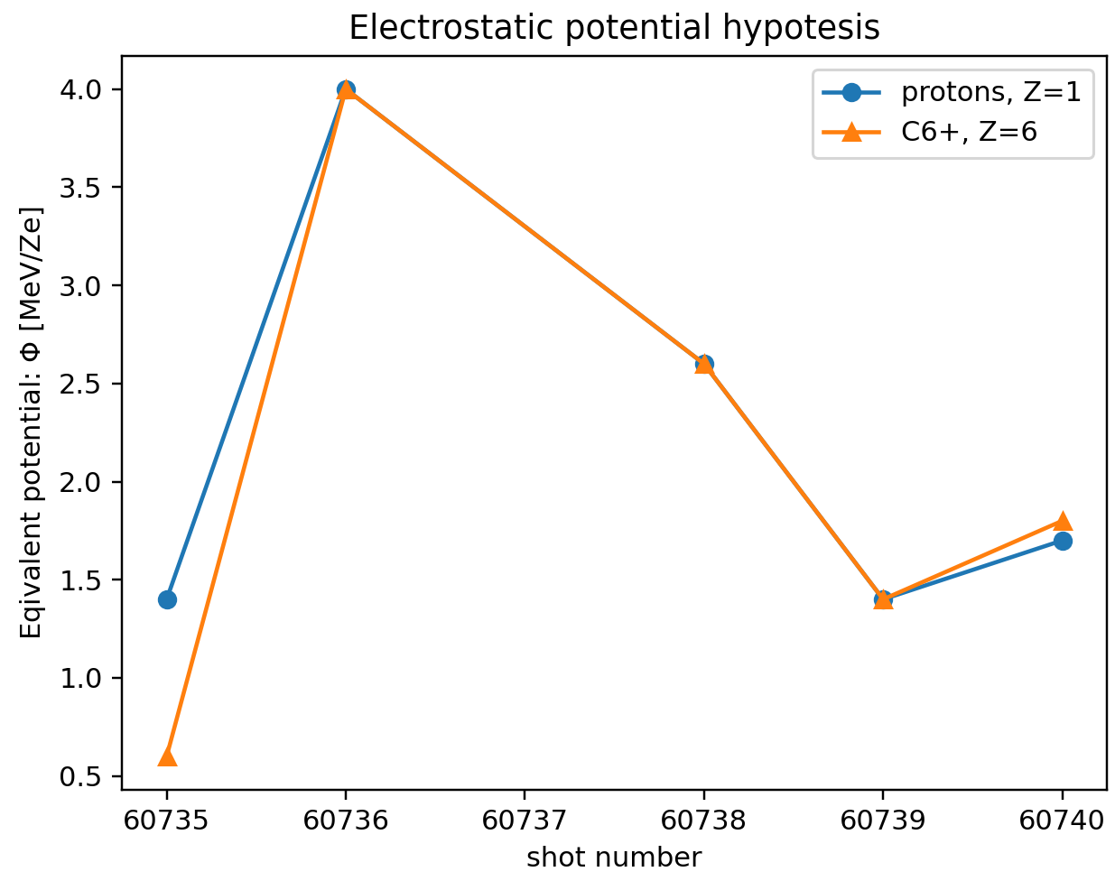
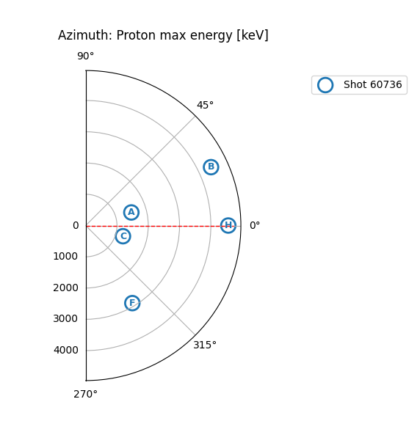
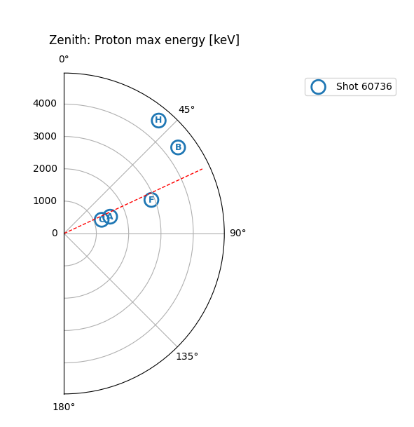
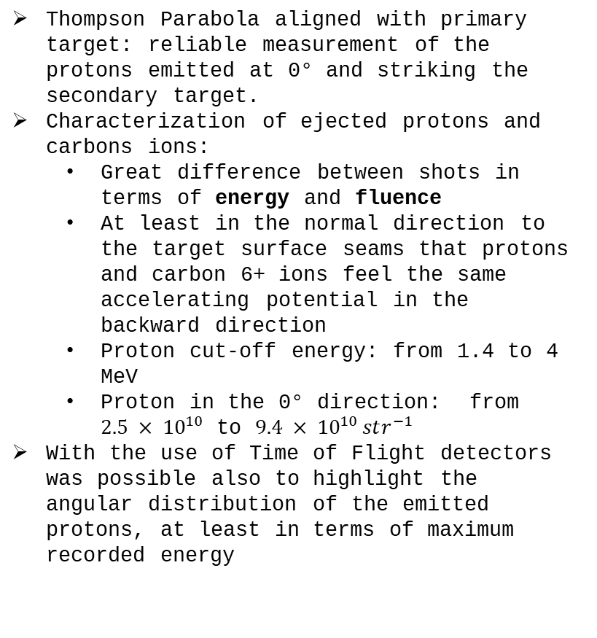
Proton source characterization:
Thompson Parabola aligned with primary target: reliable measurement of the protons emitted at 0° and striking the secondary target.
Characterization of ejected protons and carbons ions:
Great difference between shots in terms of energy and fluence
At least in the normal direction to the target surface seams that protons and carbon 6+ ions feel the same accelerating potential in the backward direction
Proton cut-off energy: from 1.4 to 4 MeV
Proton in the 0° direction: from $2.5 × {10}^{10}$ to $9.4 × {10}^{10 }str^{−1}$
With the use of Time of Flight detectors was possible also to highlight the angular distribution of the emitted protons, at least in terms of maximum recorded energy

Slide 5
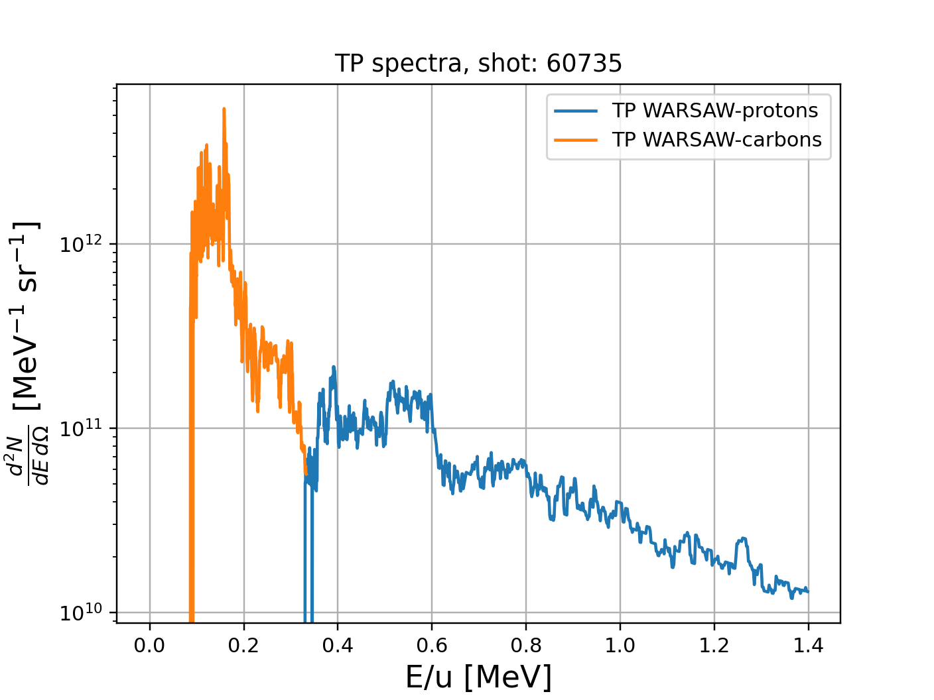
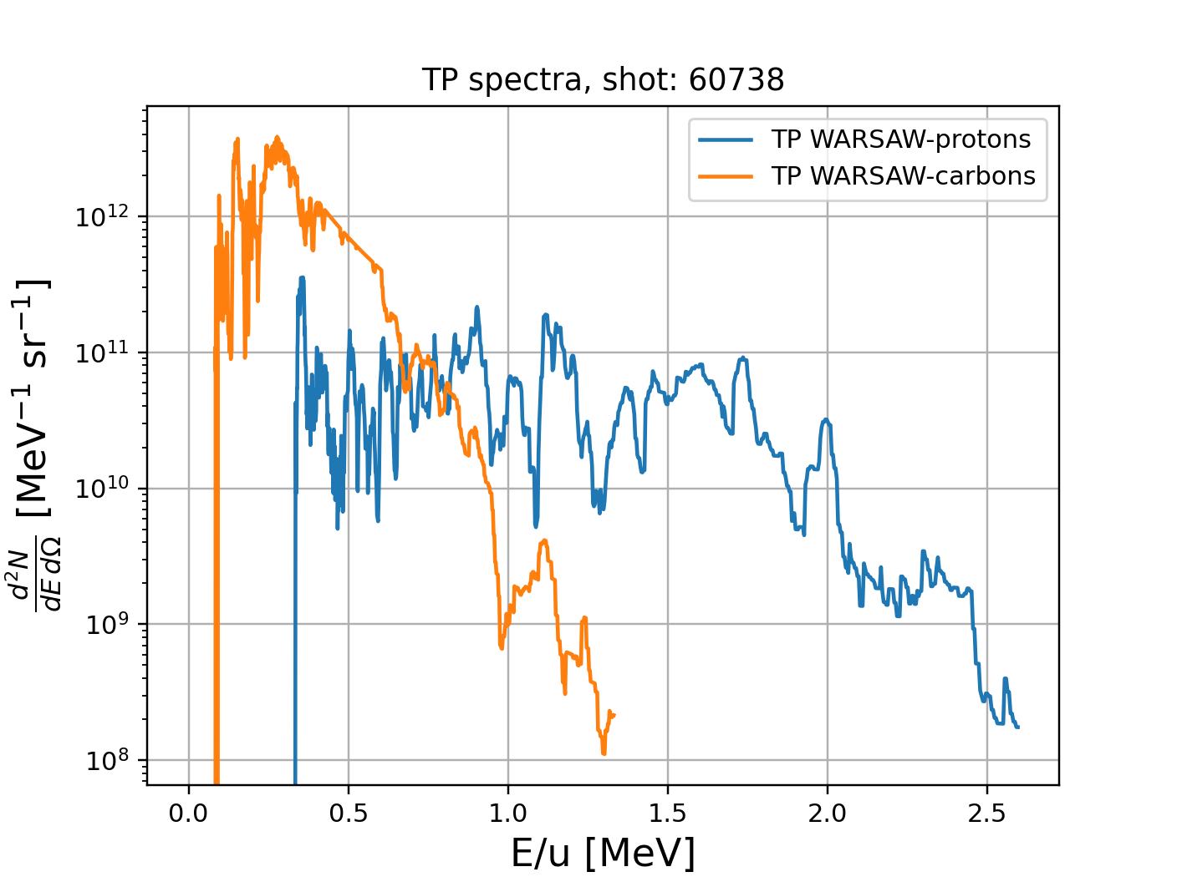
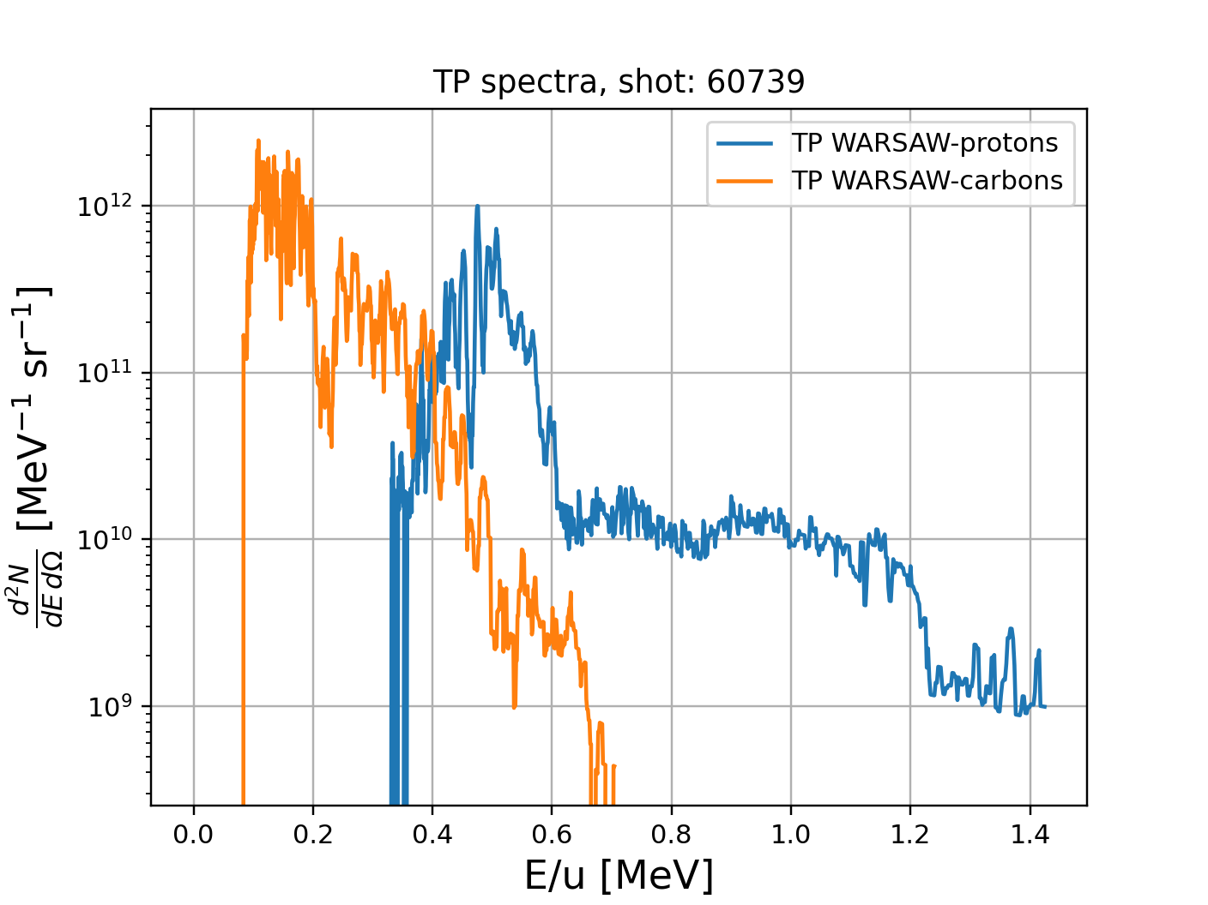
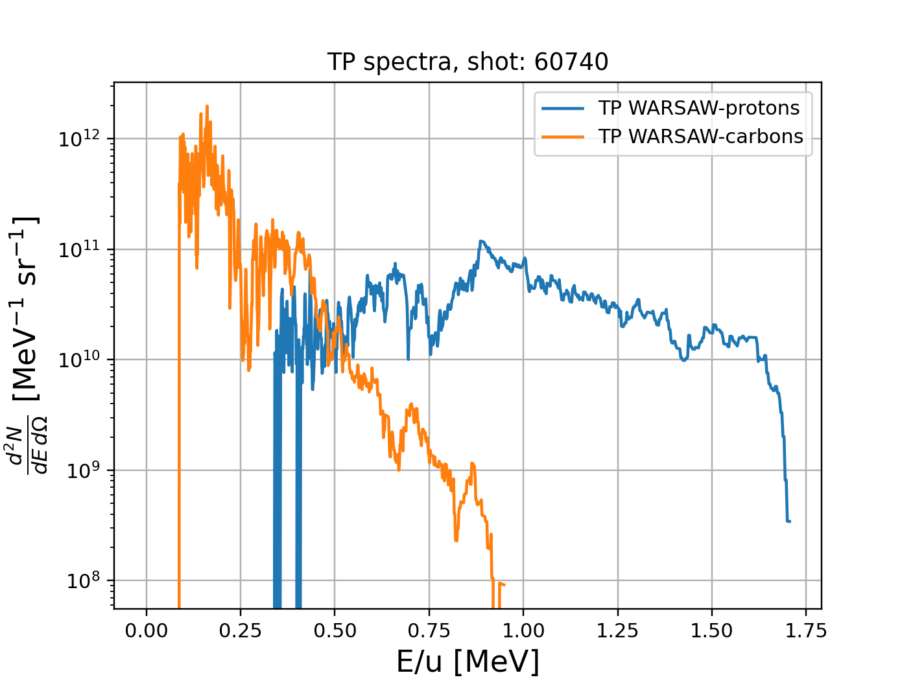
Shot: | Energy protons (MeV) | Fluence Protons (str^-1) | Energy C+6 (MeV/u) | Fluence C+6 (str^-1)
60735 | 1.4 | 6.82e+10 | 0.3 | 1.94e+11
60736 | 4.0 | 2.46e+10 | 2.0 | 2.99e+11
60738 | 2.6 | 9.41e+10 | 1.3 | 6.73e+11
60739 | 1.4 | 6.01e+10 | 0.7 | 1.62e+11
60740 | 1.7 | 4.61e+10 | 0.9 | 9.95e+10

Slide 6
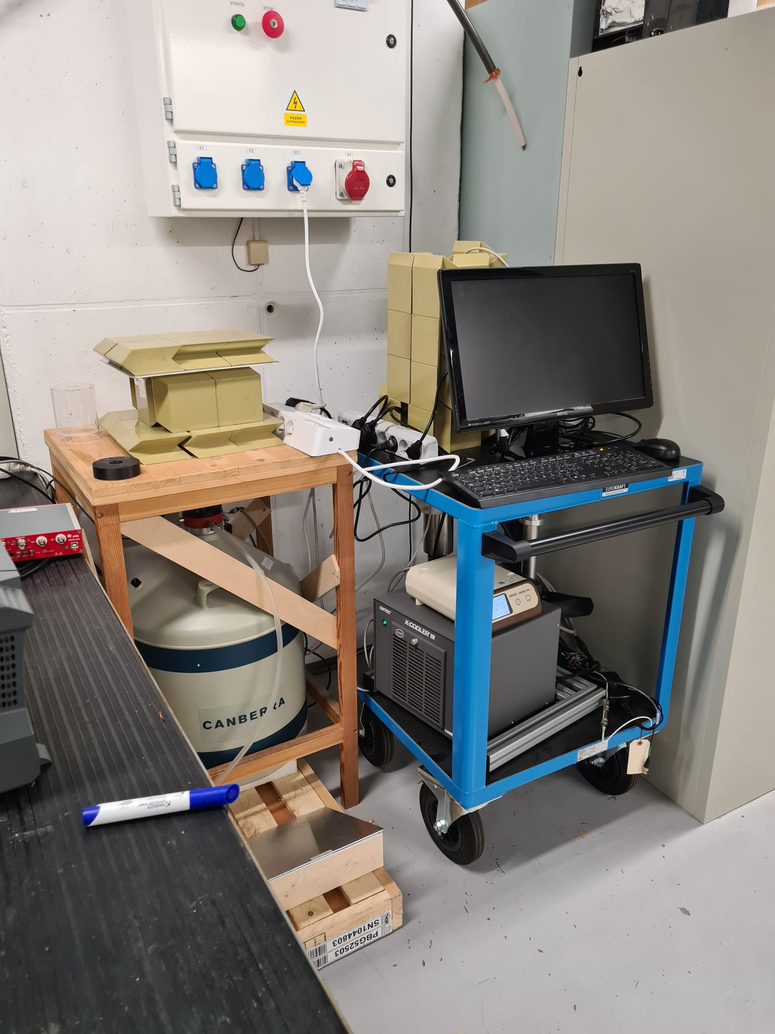
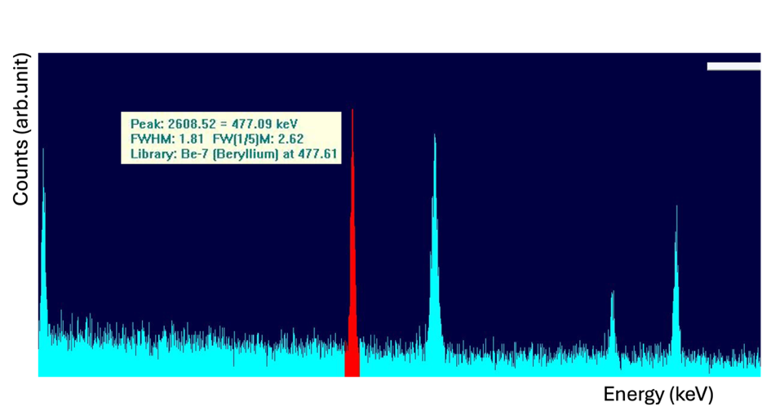
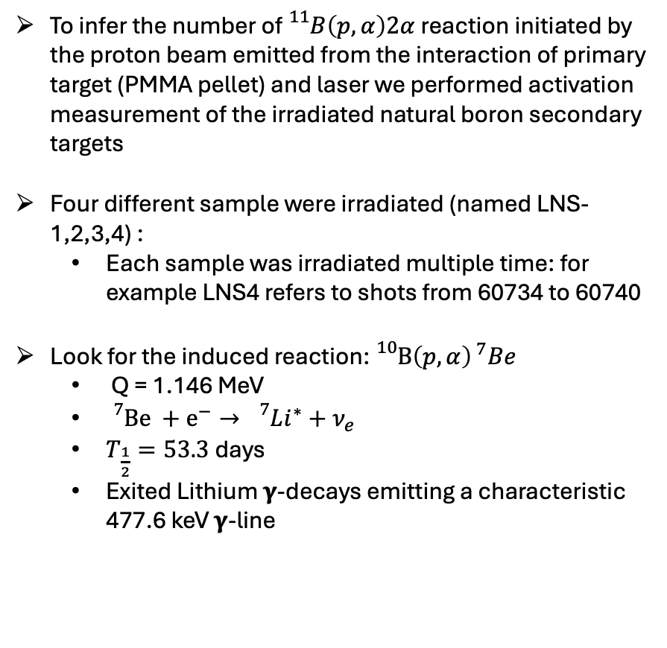
Activation Measurement:
To infer the number of ${}_{}^{11}B\left(p,α\right)2α$ reaction initiated by the proton beam emitted from the interaction of primary target (PMMA pellet) and laser we performed activation measurement of the irradiated natural boron secondary targets
Four different sample were irradiated (named LNS-1,2,3,4) :
Each sample was irradiated multiple time: for example LNS4 refers to shots from 60734 to 60740
Look for the induced reaction: ${}_{}^{10}B{\left(p,α\right)}^{ 7}Be$
Q = 1.146 MeV
${}_{}^{7}{Be +e^{−}→ {}_{}^{7}Li^{∗}+ν_{e} }$
$T_{\frac{1}{2}}=53.3$days
Exited Lithium 𝛄-decays emitting a characteristic 477.6 keV 𝛄-line

Slide 7
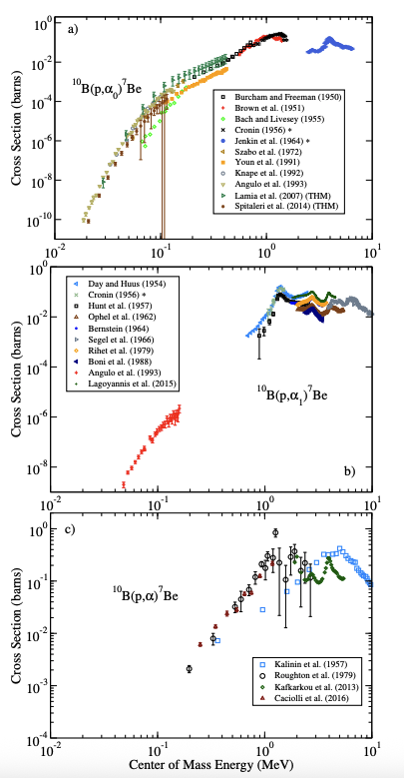
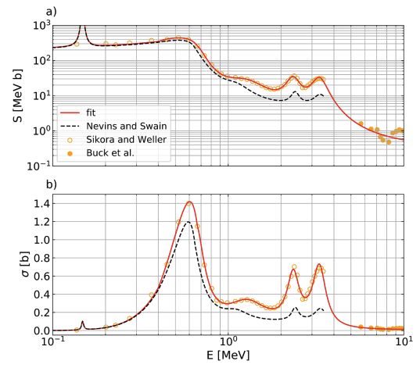
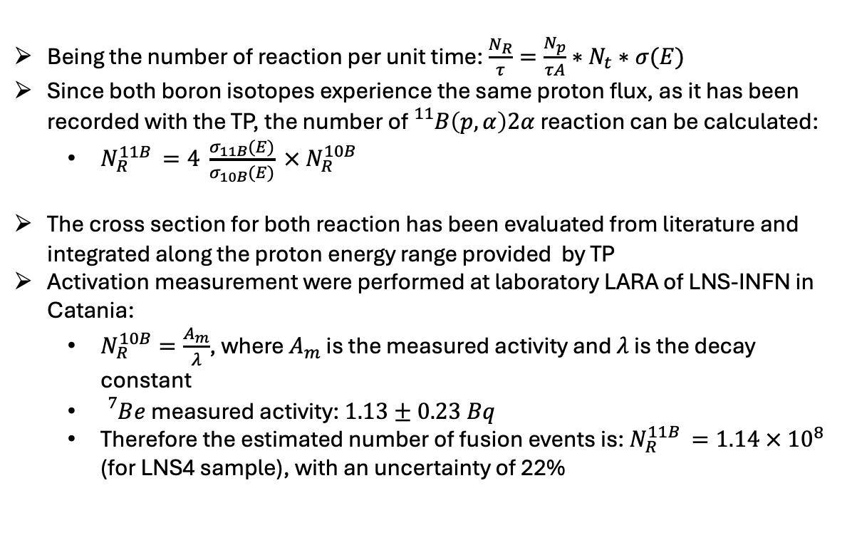
Activation Measurement:
Being the number of reaction per unit time: $\frac{N_{R}}{τ}=\frac{N_{p}}{τA}∗N_{t}∗σ(E)$
Since both boron isotopes experience the same proton flux, as it has been recorded with the TP, the number of ${}_{}^{11}B\left(p,α\right)2α$ reaction can be calculated:
$N_{R}^{11B }=4 \frac{σ_{11B}(E)}{σ_{10B}(E)} × N_{R}^{10B}$
The cross section for both reaction has been evaluated from literature and integrated along the proton energy range provided by TP
Activation measurement were performed at laboratory LARA of LNS-INFN in Catania:
$N_{R}^{10B}=\frac{A_{m}}{λ}$, where $A_{m}$ is the measured activity and $λ$ is the decay constant
${}_{}^{7}Be$ measured activity: $1.13±0.23 Bq$
Therefore the estimated number of fusion events is: $N_{R}^{11B }=1.14 × {10}^{8}$ (for LNS4 sample), with an uncertainty of 22%
Wiescher, M., et al. "Low energy measurements of the B 10 (p, α) Be 7 reaction." Physical Review C 95.4 (2017): 044617.
Tentori, Alessandro, and Fabio Belloni. "Revisiting p-11B fusion cross section and reactivity, and their analytic approximations." Nuclear Fusion 63.8 (2023): 086001.

Slide 8
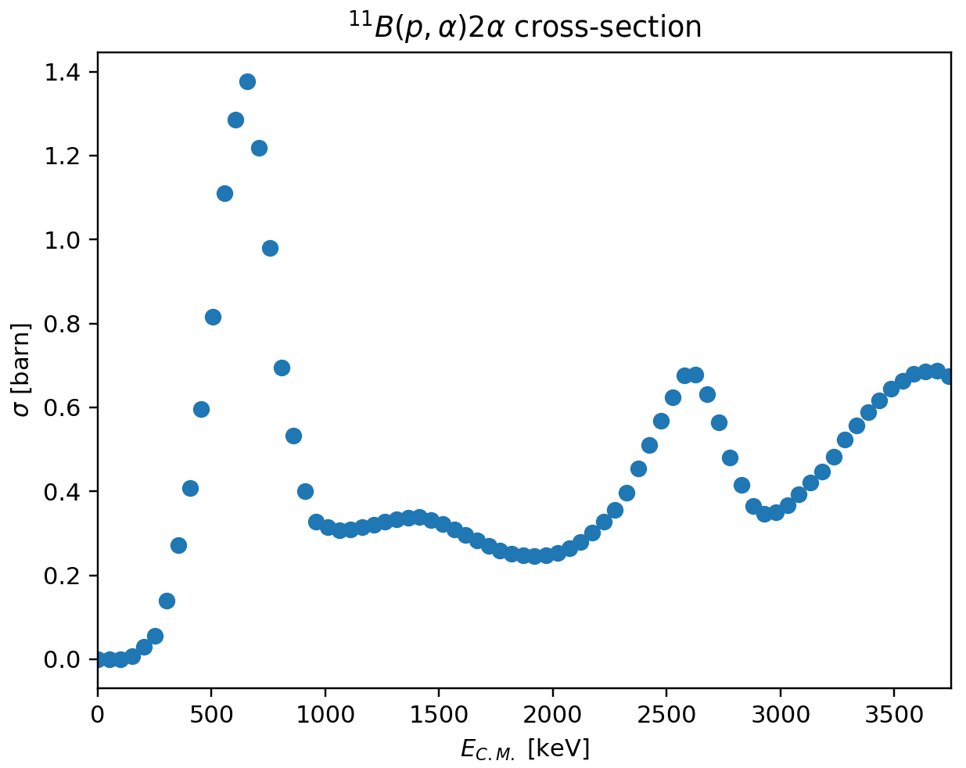
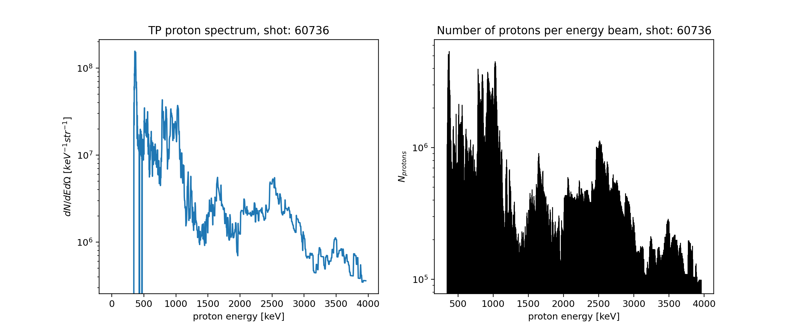
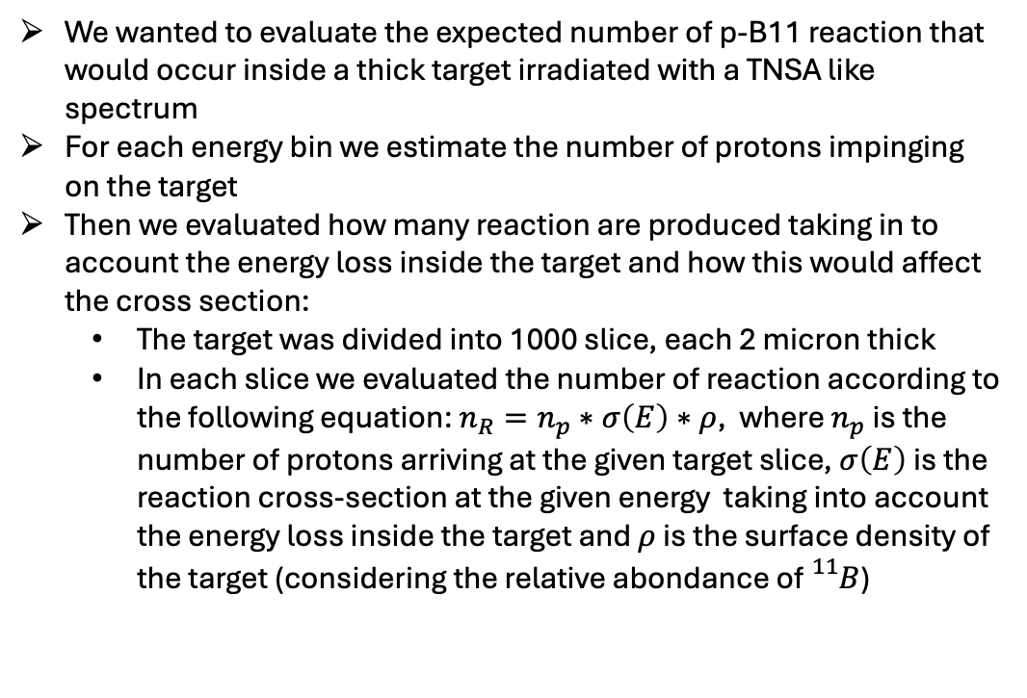
Analytical calculation of the Number of reaction produced in the secondary target:
We wanted to evaluate the expected number of p-B11 reaction that would occur inside a thick target irradiated with a TNSA like spectrum
For each energy bin we estimate the number of protons impinging on the target
Then we evaluated how many reaction are produced taking in to account the energy loss inside the target and how this would affect the cross section:
The target was divided into 1000 slice, each 2 micron thick
In each slice we evaluated the number of reaction according to the following equation: $n_{R}=n_{p}∗σ\left(E\right)∗ρ$, where $n_{p}$ is the number of protons arriving at the given target slice, $σ\left(E\right)$ is the reaction cross-section at the given energy taking into account the energy loss inside the target and $ρ$ is the surface density of the target (considering the relative abondance of ${}_{}^{11}B$)

Slide 9
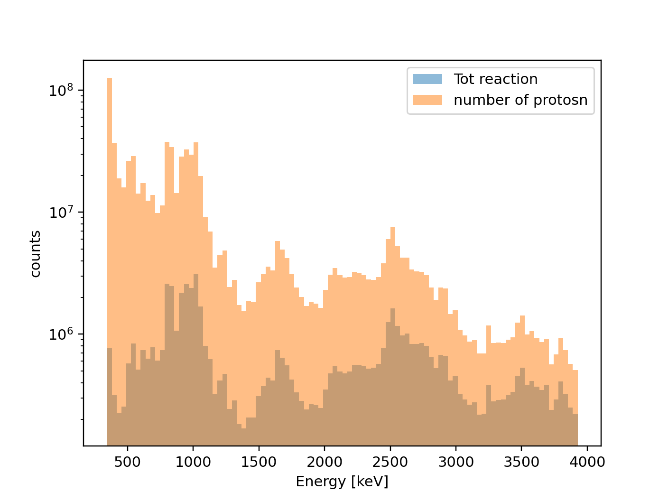
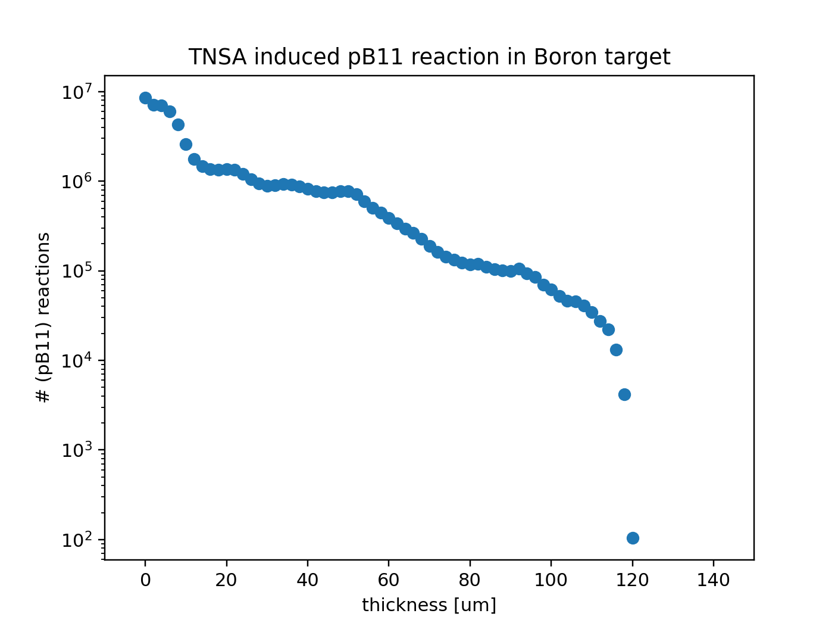
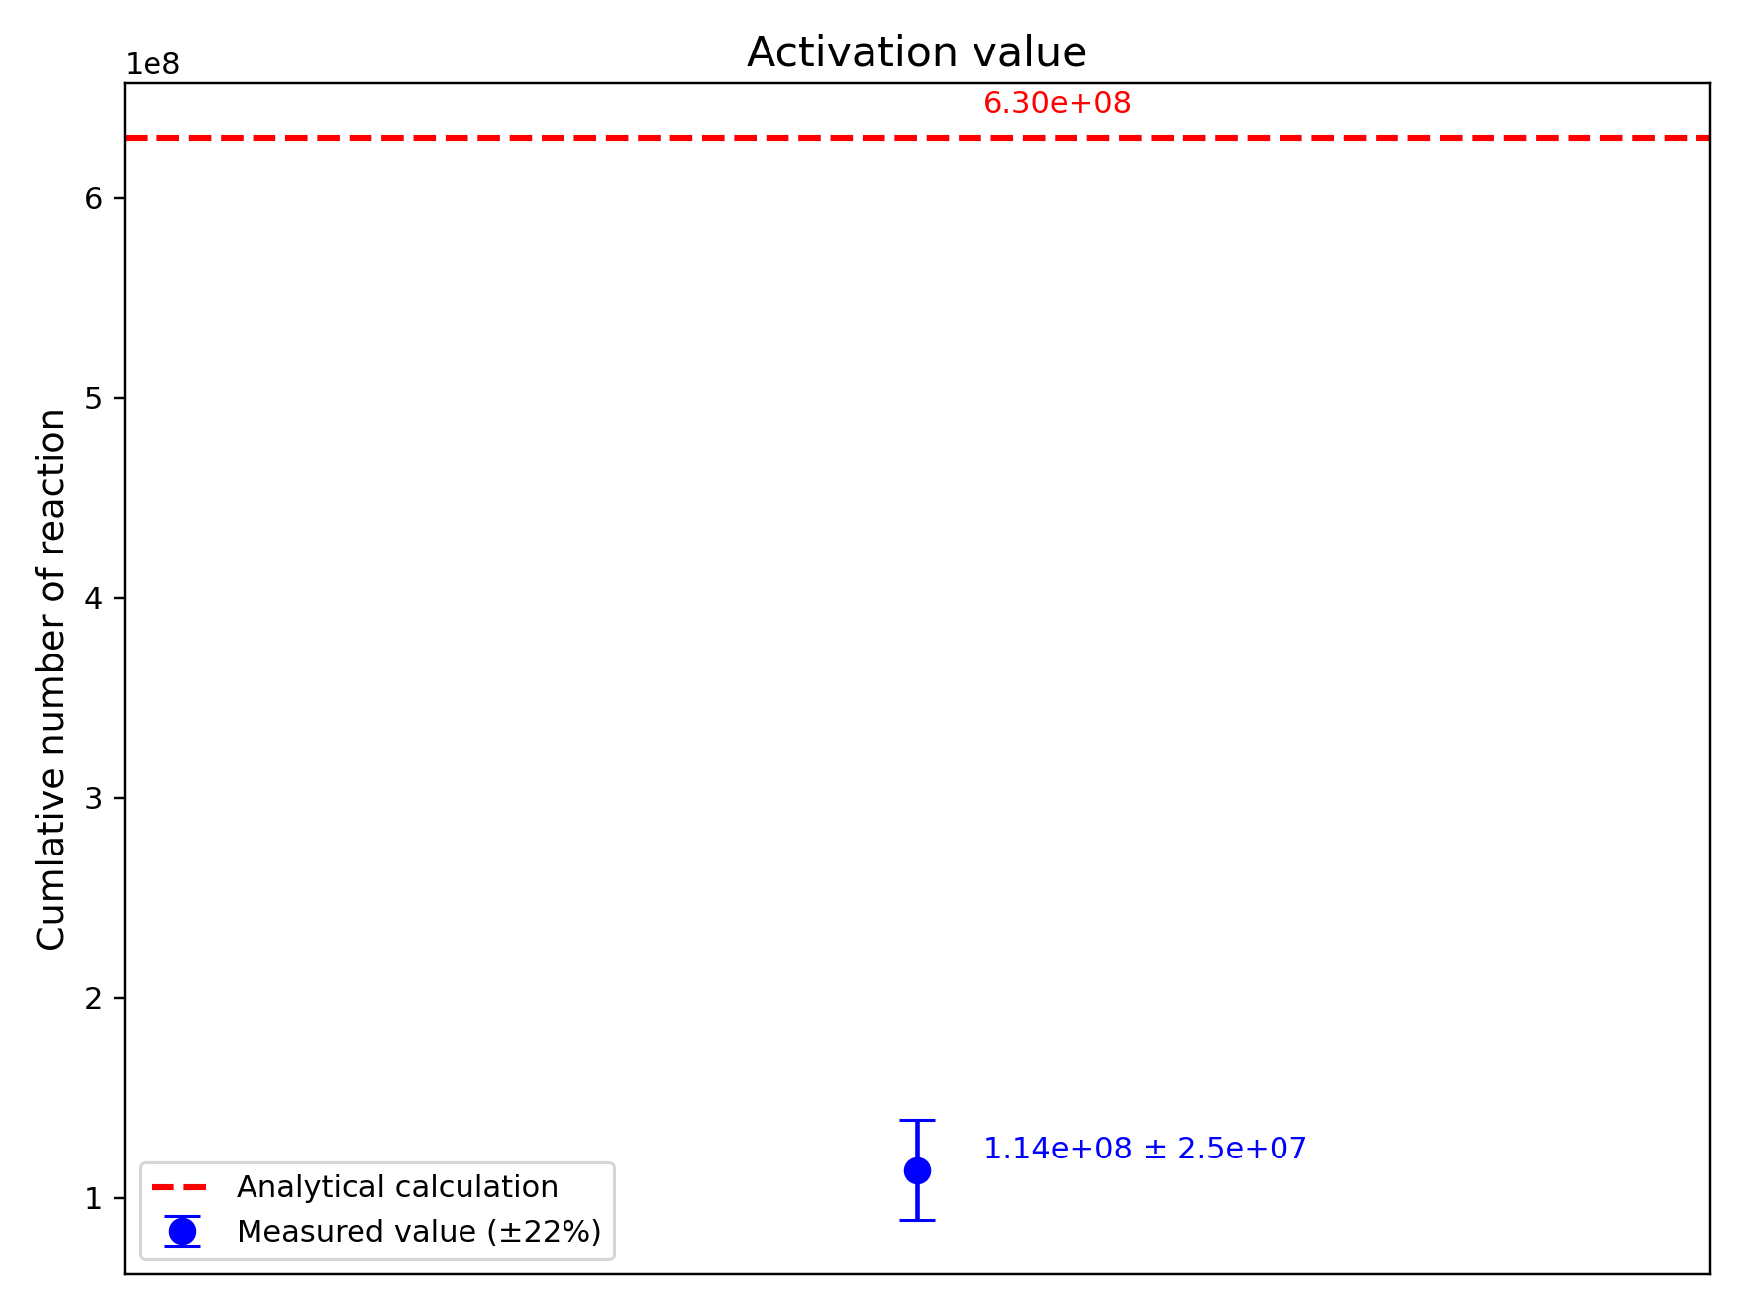
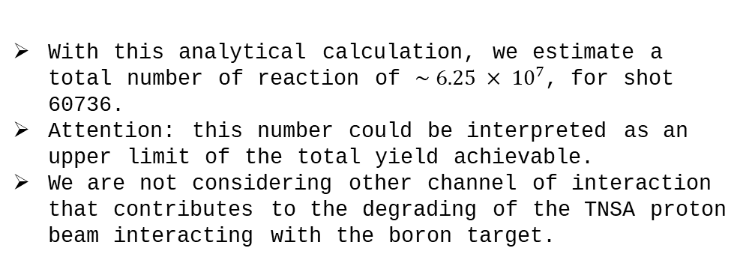
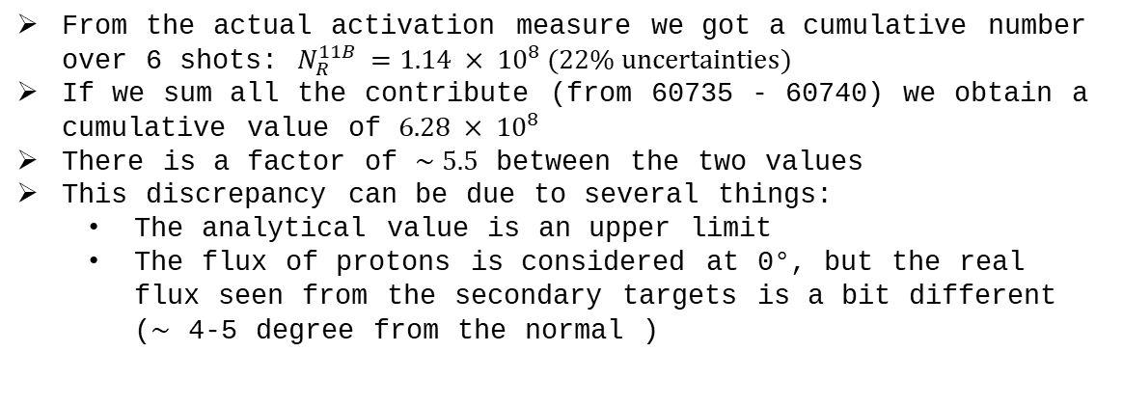
Analytical calculation of the Number of reaction produced in the secondary target:
Shot: 60736
With this analytical calculation, we estimate a total number of reaction of $\sim 6.25 × {10}^{7}$, for shot 60736.
Attention: this number could be interpreted as an upper limit of the total yield achievable.
We are not considering other channel of interaction that contributes to the degrading of the TNSA proton beam interacting with the boron target.
60735 | 60736 | 60738 | 60739 | 60740
1.01e+8 | 6.3e+7 | 2.8e+8 | 5.4e+7 | 1.3e+8
From the actual activation measure we got a cumulative number over 6 shots: $N_{R}^{11B }=1.14 × {10}^{8} (22\% uncertainties)$
If we sum all the contribute (from 60735 - 60740) we obtain a cumulative value of $6.28 × {10}^{8}$
There is a factor of $\sim 5.5$ between the two values
This discrepancy can be due to several things:
The analytical value is an upper limit
The flux of protons is considered at 0°, but the real flux seen from the secondary targets is a bit different ($\sim$ 4-5 degree from the normal )

Slide 10
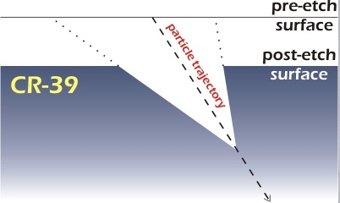
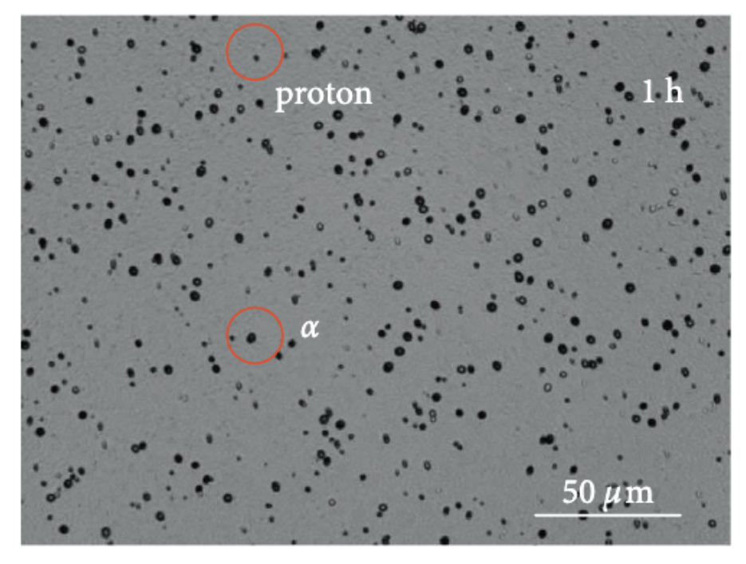
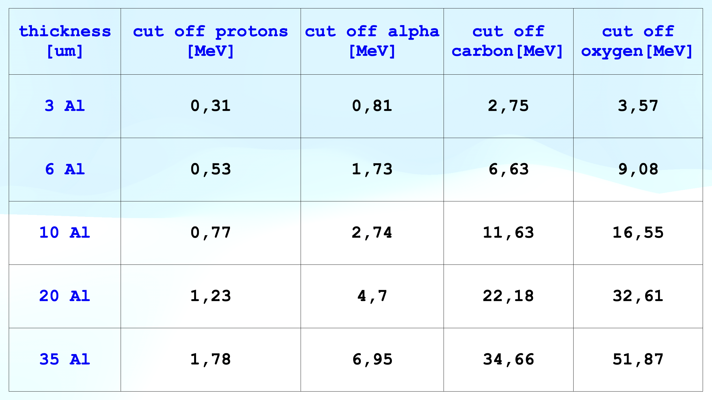
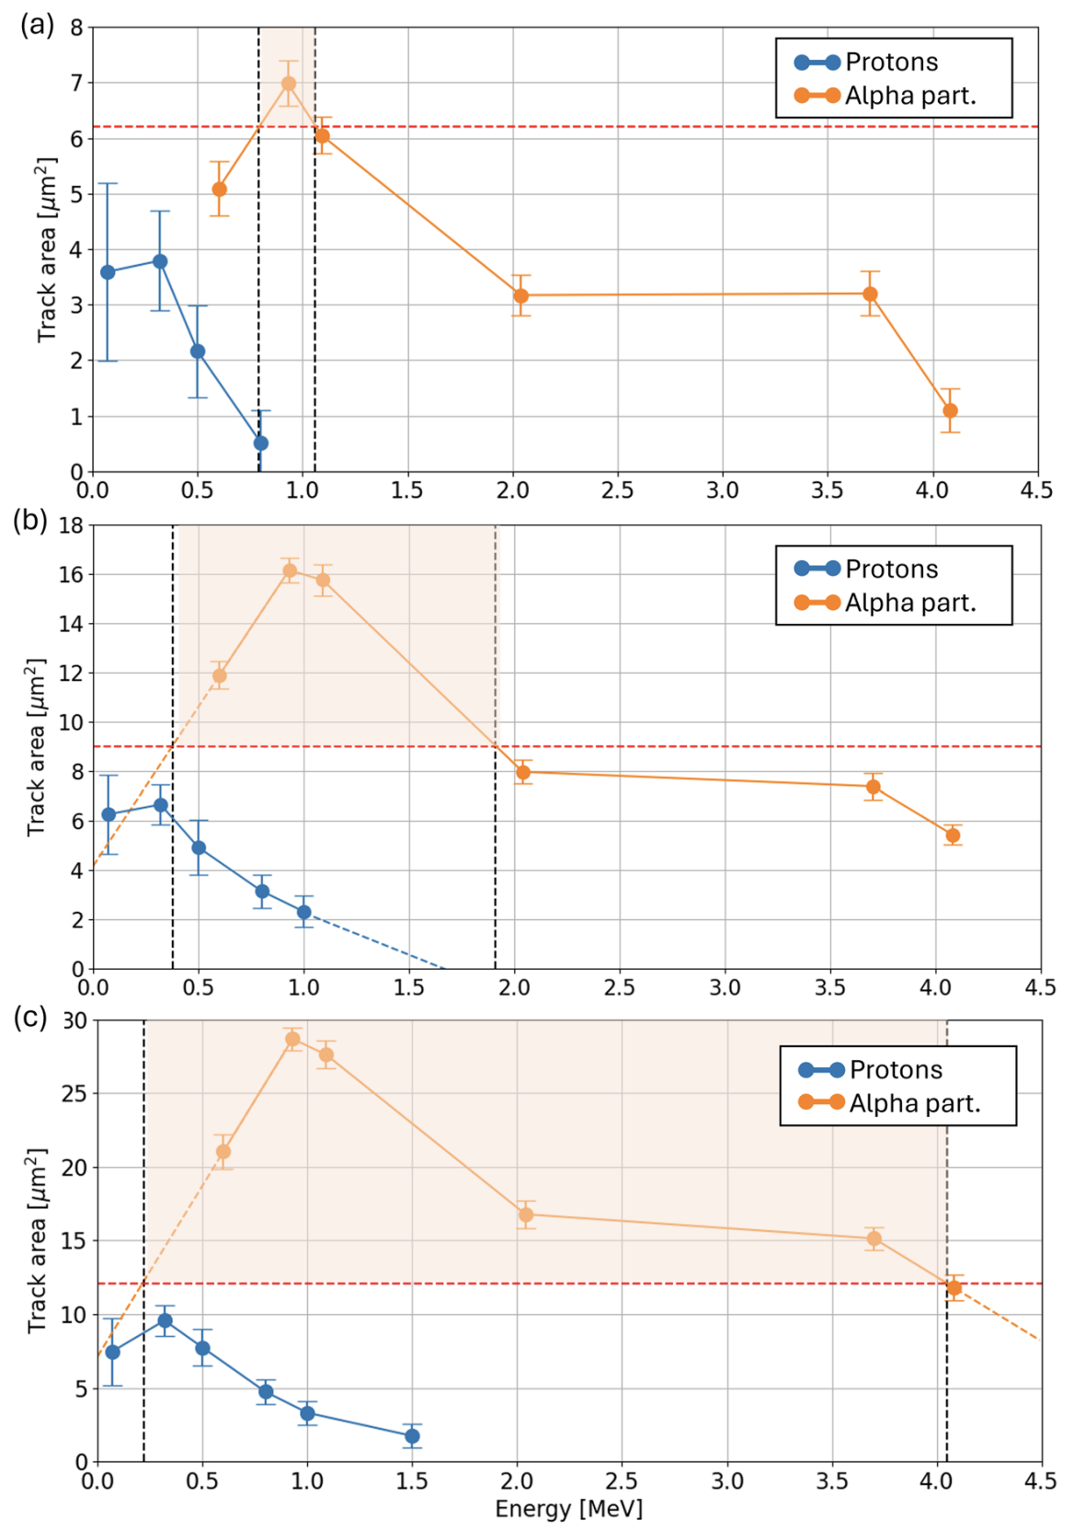
CR39 measurements:
Sold state passive detector
Particle discrimination based on the track area left by the particle interacting with the detector
Use of Al filters to stop the low energetic particle
Calibration with mono energetic sources of protons and alpha particles
Etching method with acid solution (NaOH), to increase the diameter of the particle track areas and be able to count them with optical microscope
Issues: the calibration curve doesn’t give an univocal discrimination between protons and alphas.
Solution: we refer only to a small region in which we are sure that we see only alpha particles
60 mins
90 mins
120 mins
Scisciò, M., et al. "Laser-initiated p–11B fusion reactions in petawatt high-repetition-rate laser facilities." Matter and Radiation at Extremes 10.3 (2025).

Slide 11
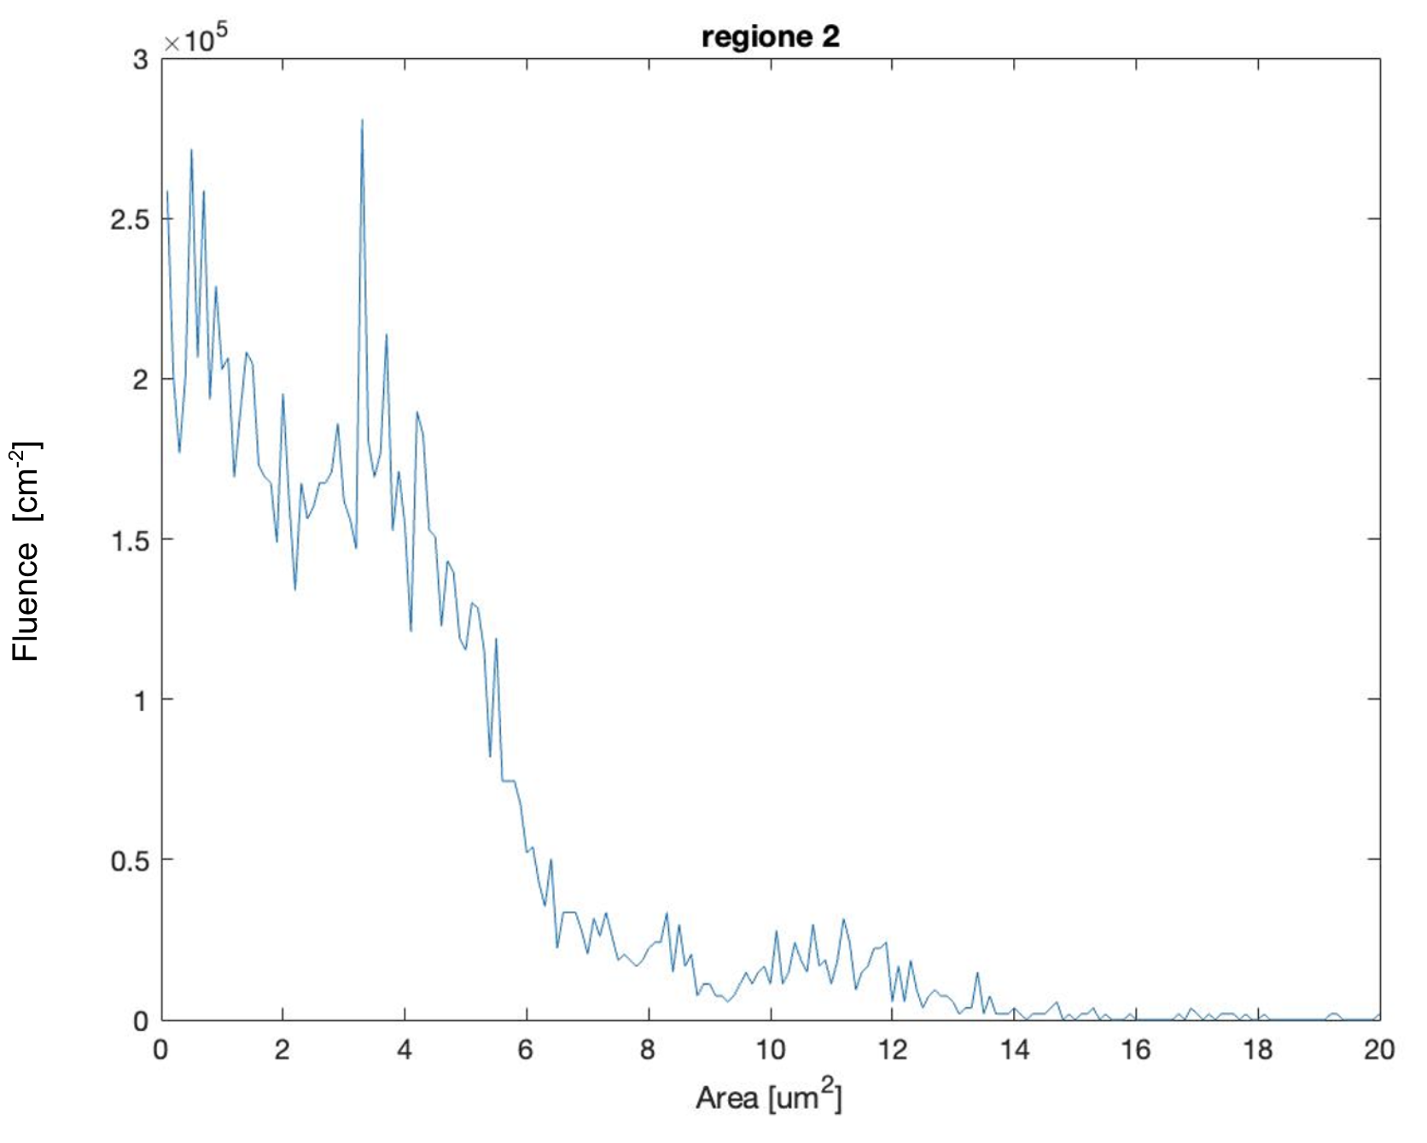
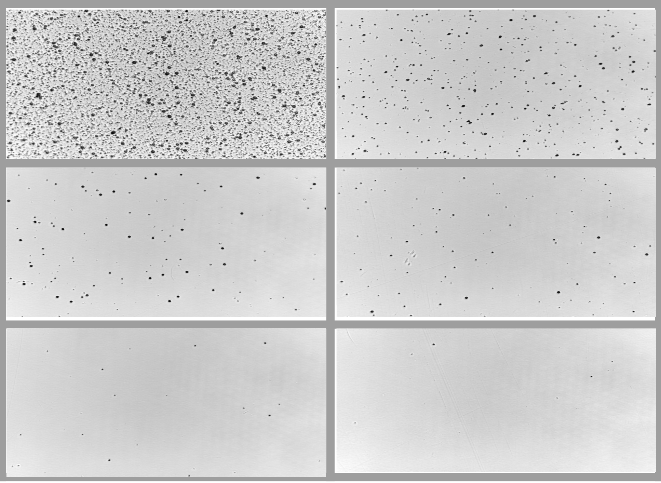
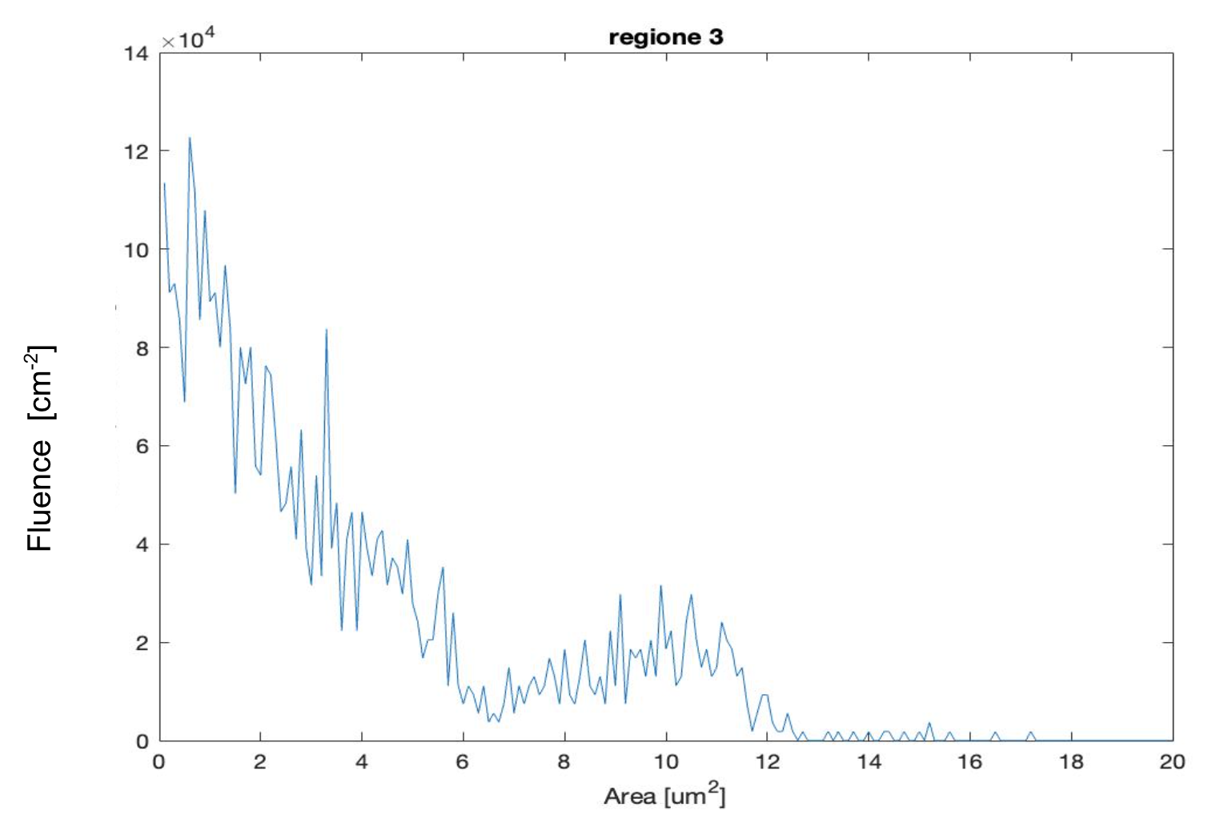
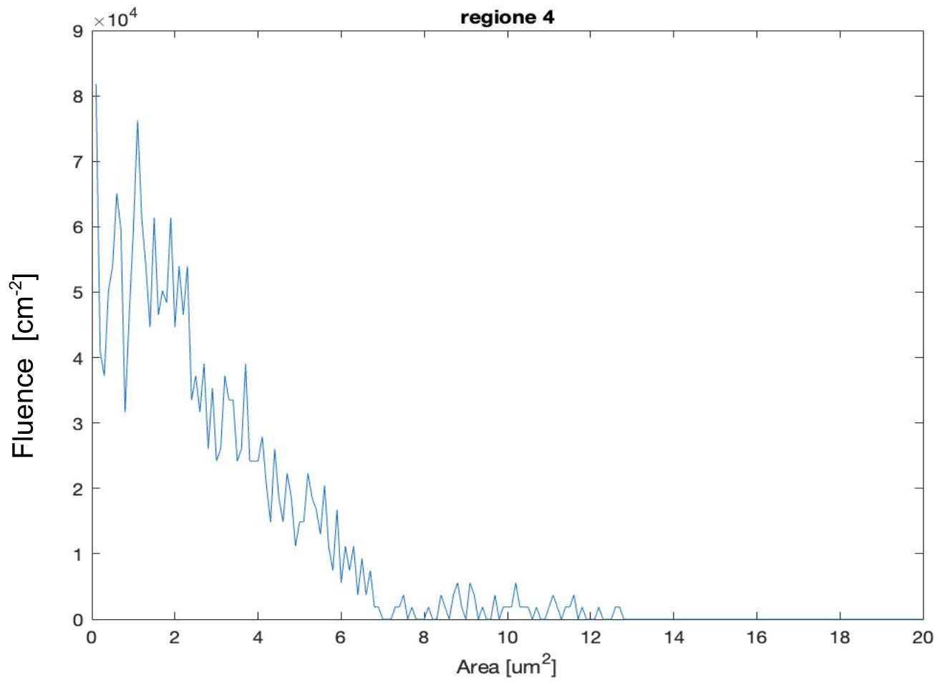
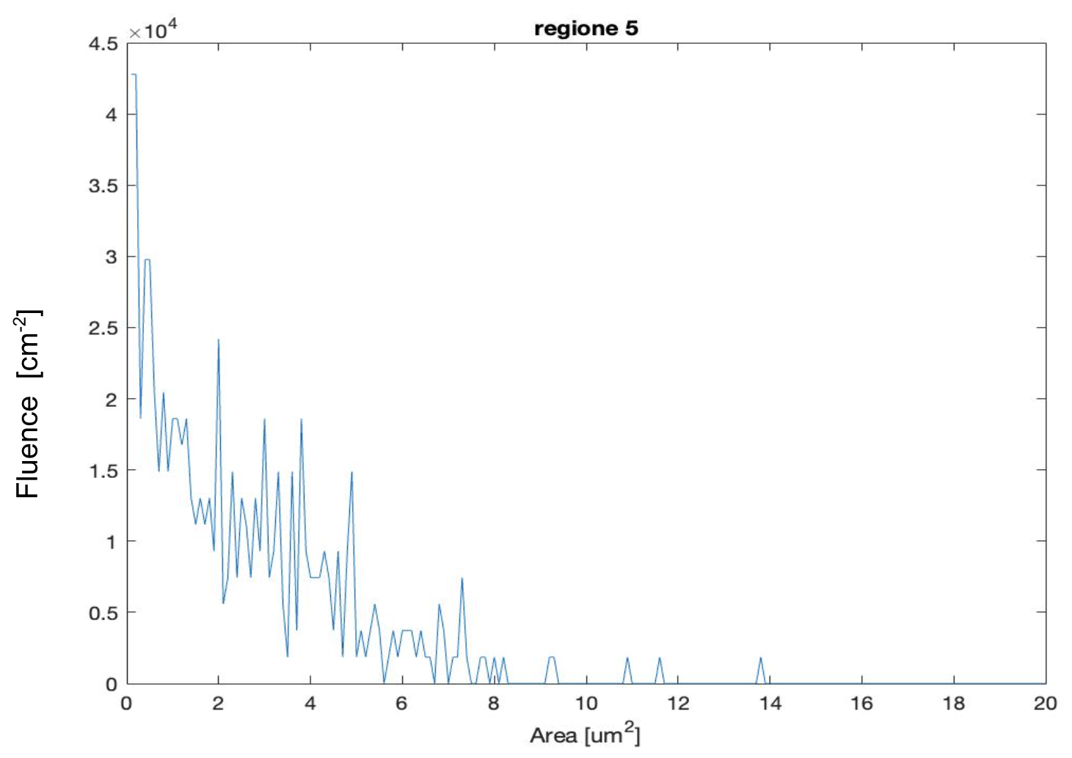
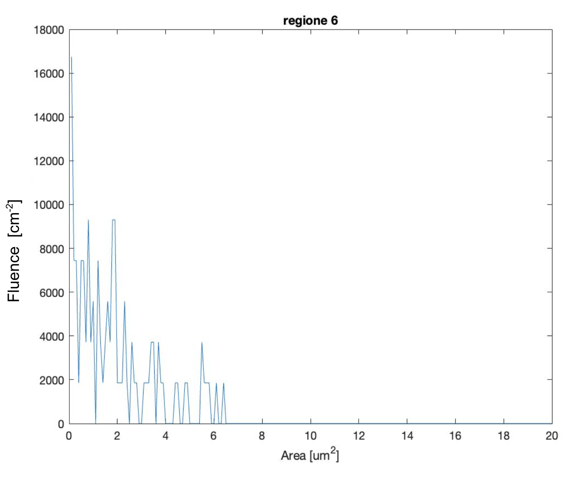
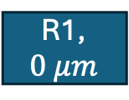
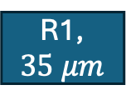




CR39 measurements, shot 60736: 60 mins etching, x40 magnification
R1, $0 μm$
R2, $3 μm$
SATURATED
R1, $6 μm$
R1, $10 μm$
R1, $20 μm$
R1, $35 μm$

Slide 12




CR39 measurements, shot 60736: Calibration curve applied
Based on the two calibration curve for protons and alphas, we selected a threshold area ($3.6 μm^{2}$) for which we are sure to find only alphas

Slide 13




CR39 measurements, shot 60736:
$$\frac{N_{all}}{cm^{2}}$$
R2 | R3 | R4 | R5 | R6
$$5.6721 × 10^5$$ | $$1.9616 × 10^5$$ | $$1.0628 × 10^5$$ | $$3.1744 × 10^4$$ | $$6.6279 × 10^3$$
Applying the mention discrimination we were able to to count the number of alpha particle in each CR39 detector
The number of alpha particle so calculated is underestimation of the real fluence seen from each detector since (especially in the region with thinner Al filter)
$$\frac{N_{α}}{cm^{2}} (Area>3.6 μm^2)$$
R2 | R3 | R4 | R5 | R6
$$1.3302 × 10^5$$ | $$3.2209 × 10^4$$ | $$1.8837 × 10^4$$ | $6. 9767× 10^$3 | $$9. 3023× 10^2$$

Slide 14





Monte Carlo simulation:
To better understand the measurement from CR39 detector array, we performed Monte Carlo simulations for two main reasons:
Calculate the effective geometrical efficiency of CR39 array detector
Evaluate the amount of backscatter events from protons and carbons ions
The simulations was done using TOPAS tool.
The CR39 detector geometrical efficiency was found to be very low. In principle this could help to lowering the amount of backscatter ions that contributes to the background noise seen in the CR39s.
For each CR39: $η \sim 0.059 \%$
For all the detector array: $η \sim 0.36 \%$

Slide 15



Monte Carlo simulation: backscatter evaluation
The simulation parameter were set using the experimental data from shot 60736
TNSA beam of protons and carbons:
Energy spectrum sampled from TP data
Conical shape of the beam, with angle aperture of 10°
The amount of generated event, was set to be of the same order of magnitude of the recorded events seen in the experiment
Two scorer for monitoring the generated beam and the BS events (right in front of the secondary target holder)

Slide 16









Monte Carlo simulation: backscatter evaluation
The amount of BS event generated from the secondary target, is extremely low: $\sim 0.003 \%$
With energy range of about $\sim 6 MeV/u$
Good News! The amount of backscatter event is very low
The amount of this event reaching the CR39 array is even smaller due to the low geometrical efficiency (not considering the filters):
CR39_1: $5.18 ×{10}^{3} cm^{−2}$
CR39_2: $3.87 ×{10}^{3} cm^{−2}$
CR39_3: $3.41 ×{10}^{3} cm^{−2}$
CR39_4: $3.35 ×{10}^{3} cm^{−2}$
CR39_5: $3.61 ×{10}^{3} cm^{−2}$
CR39_6: $2.95 ×{10}^{3} cm^{−2}$
(accounting for the filters)
CR39_1: $5.18 ×{10}^{3} cm^{−2}$
CR39_2: $1.94 ×{10}^{3} cm^{−2}$
CR39_3: $1.54 ×{10}^{3} cm^{−2}$
CR39_4: $1.17 ×{10}^{3} cm^{−2}$
CR39_5: $5.4 ×{10}^{2} cm^{−2}$
CR39_6: $1.5 ×{10}^{2} cm^{−2}$
$$0 μm$$
$$3 μm$$
$$6 μm$$
$$10 μm$$
$$20 μm$$
$$35 μm$$

Slide 17






Monte Carlo simulation: subtraction of the estimated background from the data
CR_2 | CR_3 | CR_4 | CR_5 | CR_6
$$5.6721 × 10^5$$ | $$1.9616 × 10^5$$ | $$1.0628 × 10^5$$ | $$3.1744 × 10^4$$ | $$6.6279 × 10^3$$
$$\frac{N_{all}}{cm^{2}}$$
$$\frac{N_{α}}{cm^{2}}$$
CR_2 | CR_3 | CR_4 | CR_5 | CR_6
$$5.6334 × {10}^{5}(99\%)$$ | $$1.9275 × {10}^{5}(98\%)$$ | $$1.0293 × {10}^{5}(96\%)$$ | $$2.8135 × {10}^{4}(88\%)$$ | $$3.675 × {10}^{3}(55\%)$$

Slide 18





Monte Carlo simulation: $p11B$ emission from thick target
We performed another simulation, trying to mimic the $α$ emission due to the fusion reaction induced into the born target irradiated with a TNSA like proton beam
We construct a composite boron target: 10 layers, $2 μm$ thick
Each layer emits alphas with the typical $α$ spectrum (the spectrum was sampled from data found in literature)
In this way we account on the fact that the actual spectrum coming from the thick target would change shape due to the boron thickness
The amount of $α$ sources in each layer was computed from the analytical calculation did before
We counted the alphas reaching our detectors (taking in account the filters):
CR_1: $5.34 ×{10}^{5}cm^{−2}$
CR_2: $4.42 ×{10}^{5}cm^{−2}$
CR_3: $3.38 ×{10}^{5}cm^{−2}$
CR_4: $4.42 ×{10}^{4}cm^{−2}$
CR_5: $6.22 ×{10}^{3}cm^{−2}$
CR_6: $0 cm^{−2}$

Slide 19

Conclusions:
Calibration: more conservative (look for alpha safe window)
BG subtraction: more aggressive, strongly dependent on how you model the background
Comparison:
High-fluence: BG subtraction
Mid/Low-Fluence: Calibration method
BG-evaluation indicates that, in the considered geometry, the non-alpha background is not dominant: high signa to noise ratio for alphas
Expand this analysis to other shots to see if we observe similar behavior shot to shot

Slide 20
Thank you for you attention!

