Slide 1
Potential of Low Gain Avalanche Detectors (LGAD) for Plasma Diagnostics in pB Fusion Experiments
5th International Workshop on Proton-Boron Fusion
September 8-11, 2025, Belgrade, Serbia
Milos Manojlovic, Neil Moffat, Gordana Lastovicka-Medin, Martin Perez, Pablo Fernández-Martínez, Enric Cabruja, Salvador Hidalgo, Giulio Pellegrini
Contact e-mail: milos.manojlovic@imb-cnm.csic.es

Slide 2
Outline
Motivation
History & Why detectors with multiplication?
State of the art
Low Gain Avalanche Diodes (LGAD)
Ultra-fast silicon detectors (UFSD)
4D tracking
Gain response (chosen examples)
MIPs, protons, neutrons, X-rays, ions, photons …
Future
LGADs in pB fusion experiments?

Slide 3
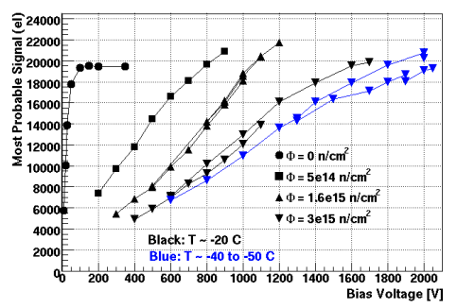
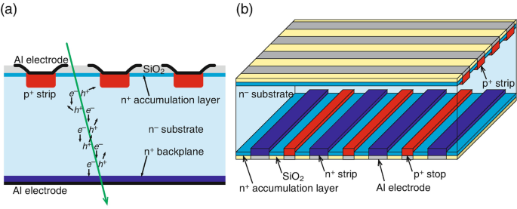
How it all started? …
Silicon detectors
Severe radiation
Charge
MULTIPLICATION
Question was (<2010):
Can we then build Si-based detectors with multiplication mechanism & could they be used as fast timing detectors?

Slide 4
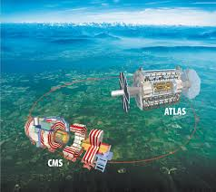
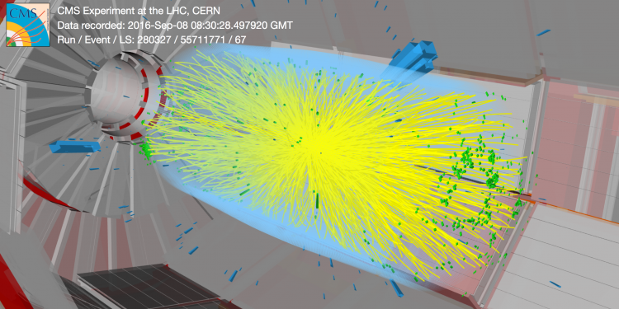

ATLAS, LHC & HL-LHC (CERN) context …
PROBLEM…
√s = 13.6 TeV
Signal
Pile-up!
About 1.1 × 10¹¹ protons per bunch
40 million bunch crossings per second
Up to 10¹⁶ particles per cm² over HL-LHC lifetime hitting the innermost detectors

Slide 5
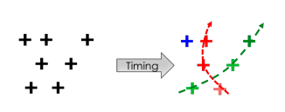


Ultra-fast silicon detectors for 4D tracking (x, y, z, t)
SOLUTION…
Track particles in space coordinates
Good spatial resolution (10 um for example)
Track particles in time (10s of picosecond)
Low Gain Avalanche Detectors technology …
Thin
We also use Boron ;)
E-profile
E-profile
n++
n++
p+
+
+
PiN diode
LGAD
p-
p-
p++
p++

Slide 6
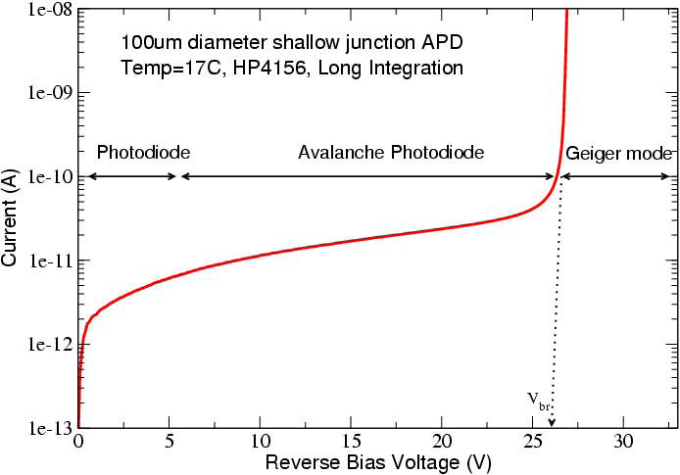
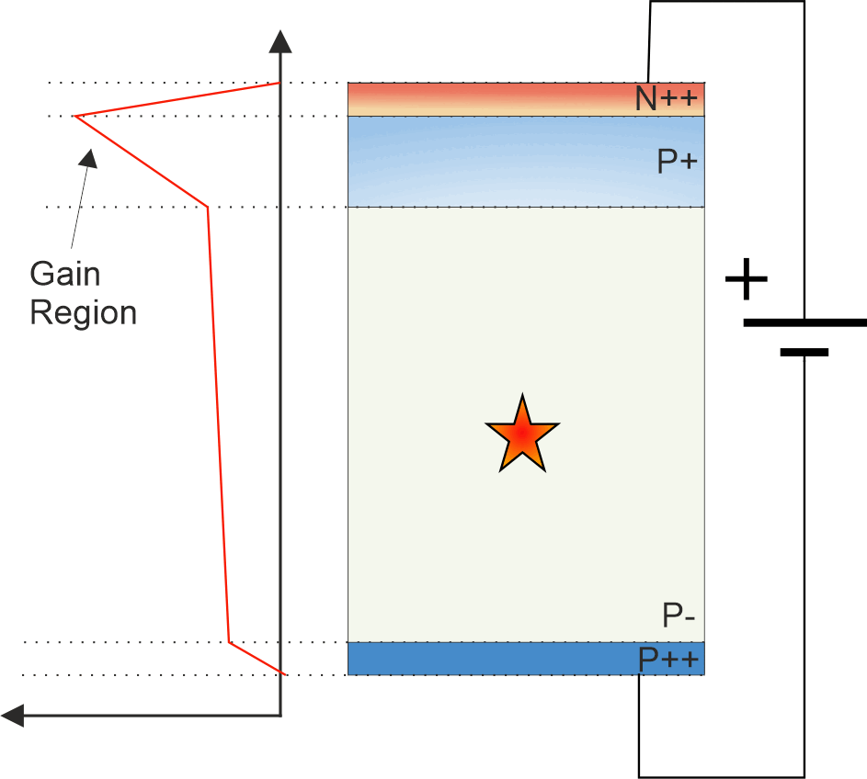
Low Gain Avalanche Detector
Proposed by IMB-CNM in 2014
Proportional response (linear mode operation)
Better sensitivity (Gain)
S/N ratio increased
Excellent timing resolution (~ 30 ps)
MIP detection for HEP
Thin detector integration with the same signal and higher collection efficiency
Linear mode
No Gain
Gain > 10⁴
Digital response
Moderate Gain
&
Proportional response
[1] A.G. Stewart et al. in Proc. of SPIE, Vol. 6119, 2006
Original paper
G. Pellegrini, et al., Technology developments and first measurements of Low Gain Avalanche Detectors (LGAD) for high energy physics applications, Nucl. Instrum. Methods A 765 (2014) 12.

Slide 7
State-of-the-art…
Low Gain Avalanche Diodes (LGAD)

Slide 8
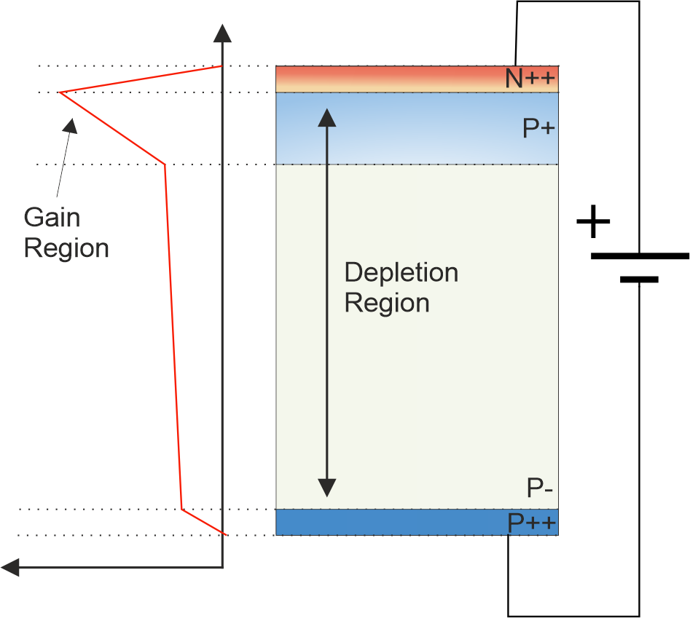
P-type LGAD
When a reverse bias is applied:
Detector depletes (Free of charge carriers)
Electric field present which attracts electrons to the N++ contact (TOP)
Holes move to P++
High field region at junction between P++ and N+ region

Slide 9
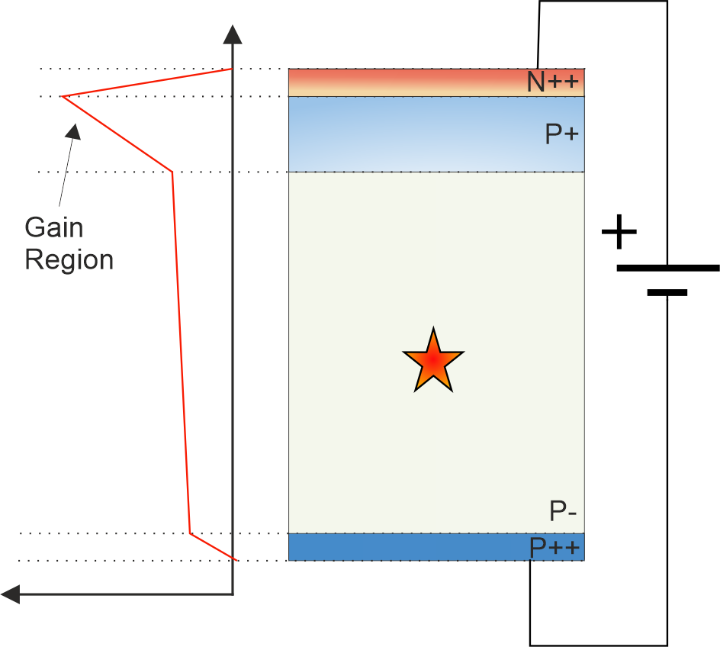
P-type LGAD
Charge particle interaction in device
(By photons, electrons, protons, X-rays….)
From fusion, why not?

Slide 10
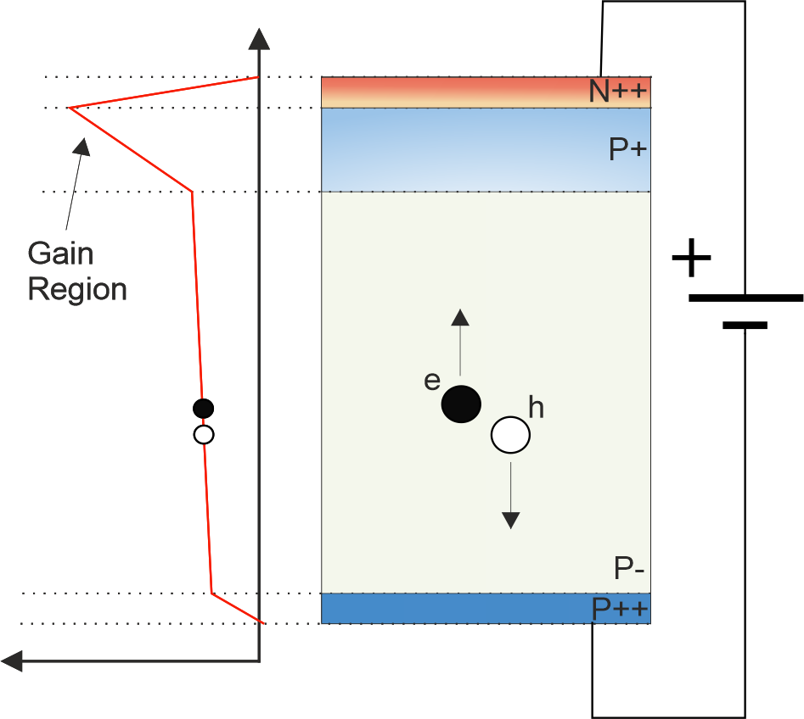
P-type LGAD
Electron-hole pair generated due to interaction

Slide 11
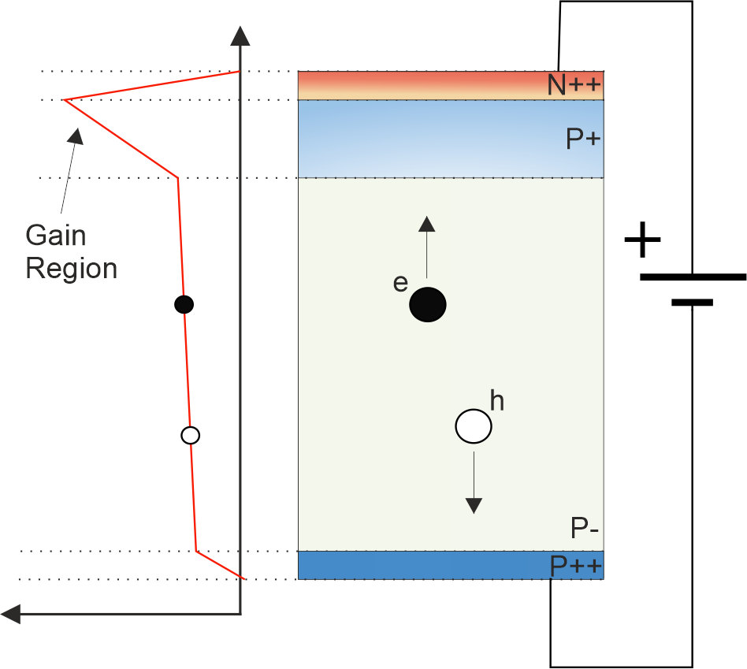
P-type LGAD
Electrons move up
Holes move down

Slide 12
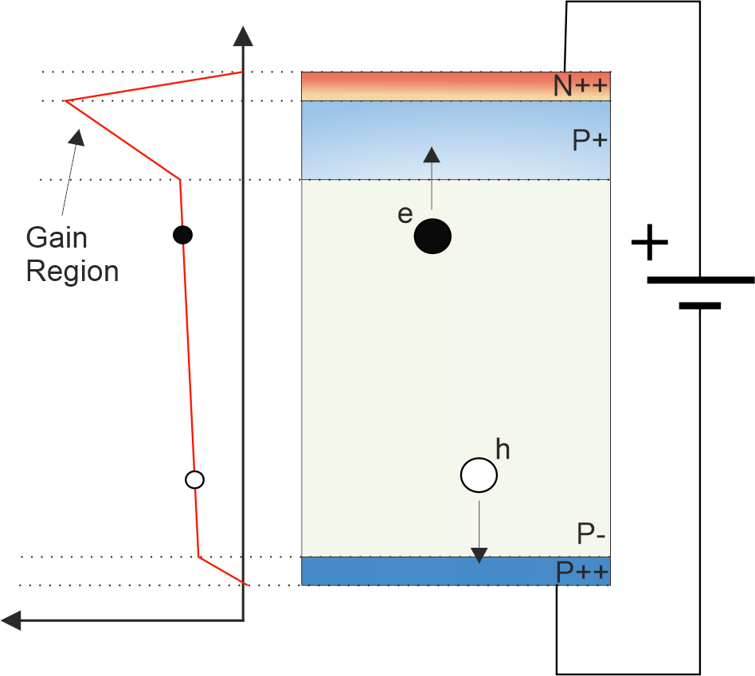
P-type LGAD
Electrons move up
Holes move down

Slide 13
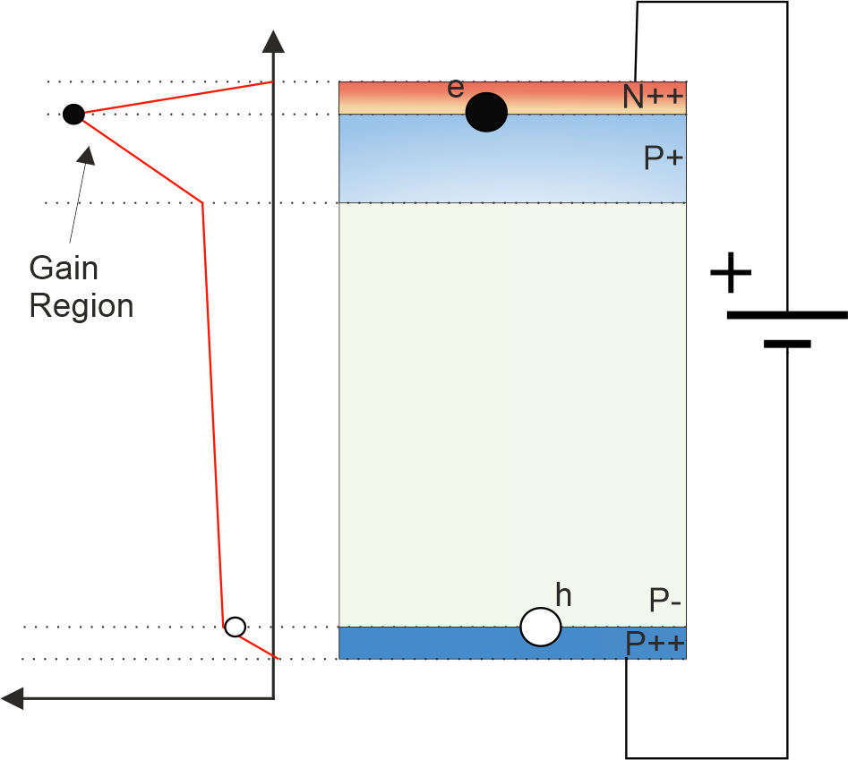
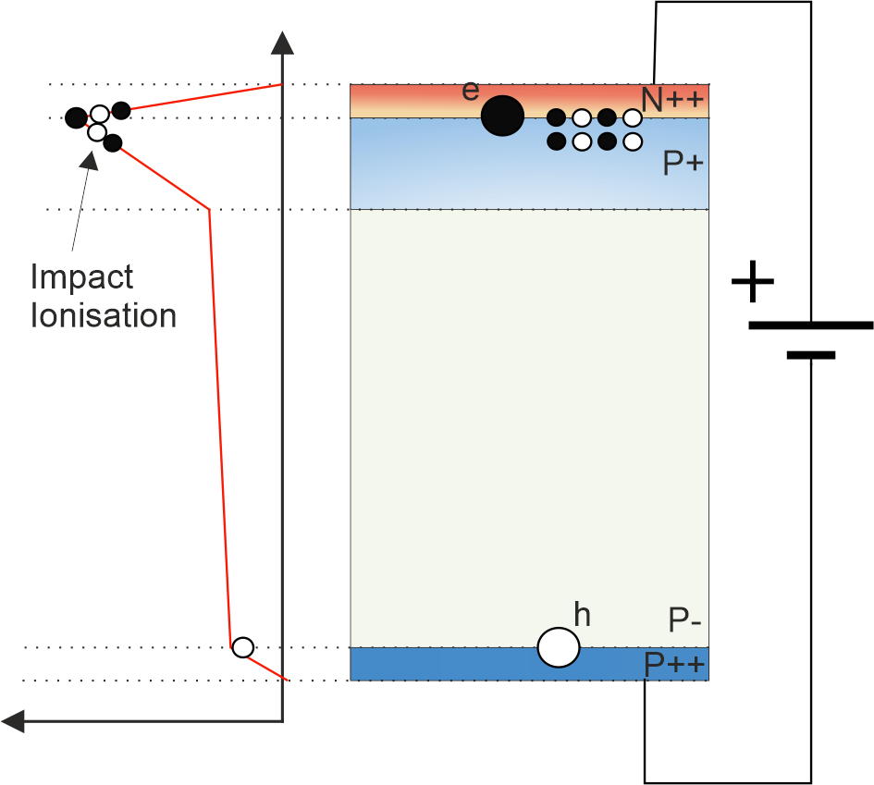
P-type LGAD
When electron reaches high field (Gain Region) it is accelerated and undergoes impact ionisation

Slide 14
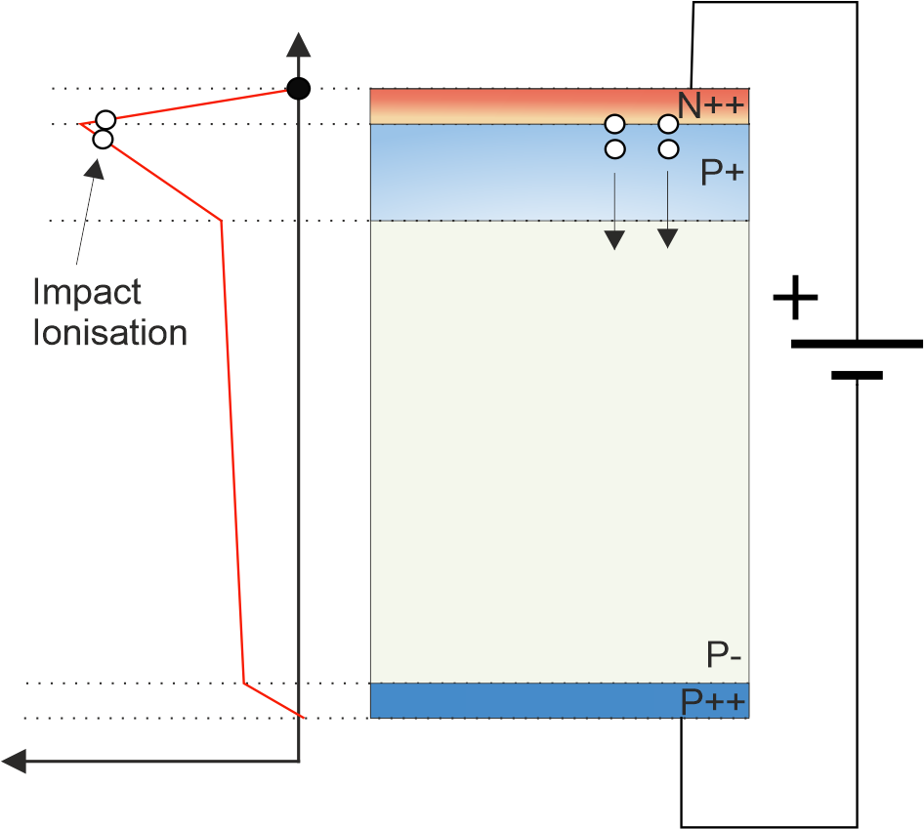
P-type LGAD
Electrons are collected (almost) instantaneously
Holes drift to bottom side

Slide 15
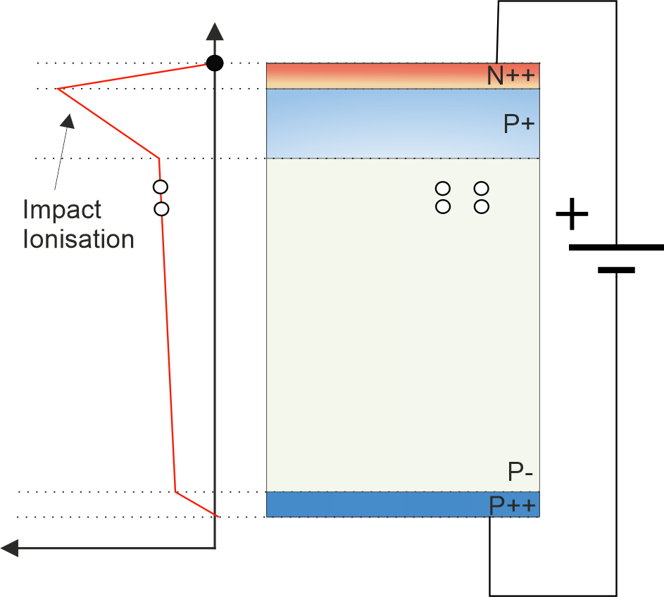
P-type LGAD
Electrons are collected (almost) instantaneously
Holes drift to bottom side

Slide 16
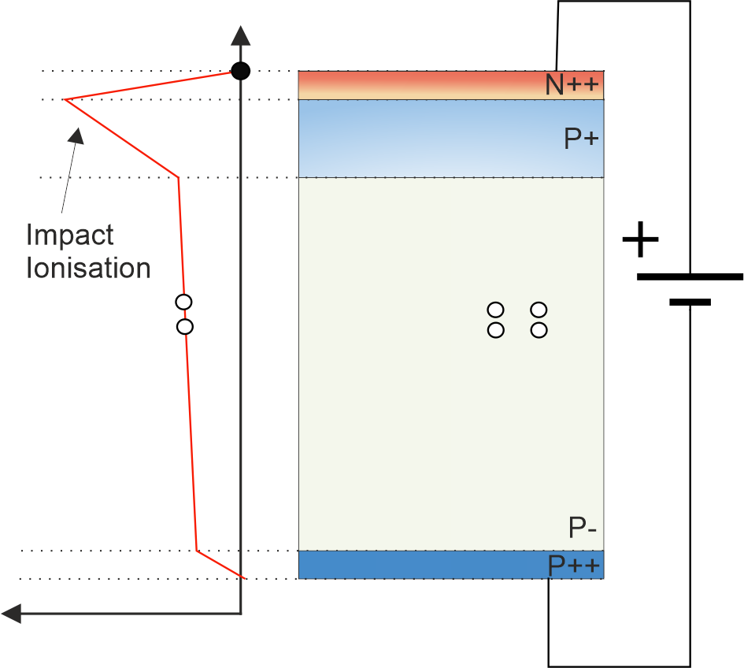
P-type LGAD
Electrons are collected (almost) instantaneously
Holes drift to bottom side

Slide 17
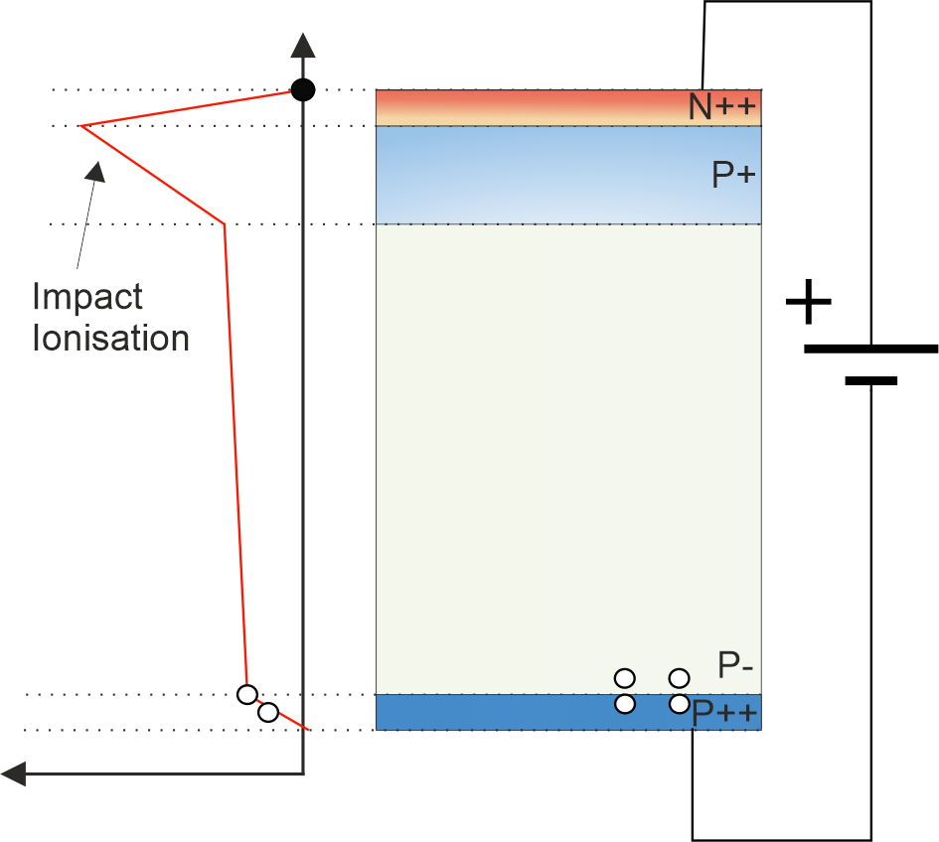
P-type LGAD
Electrons are collected (almost) instantaneously
Holes drift to bottom side

Slide 18

P-type LGAD
Electrons are collected (almost) instantaneously
Holes drift to bottom side

Slide 19
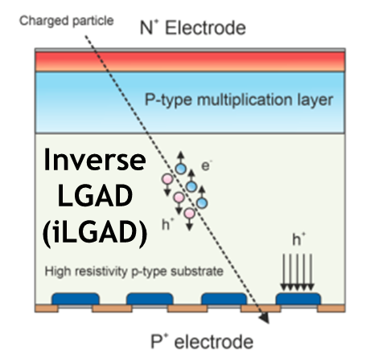
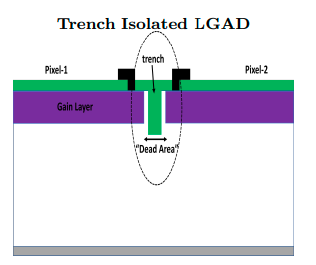
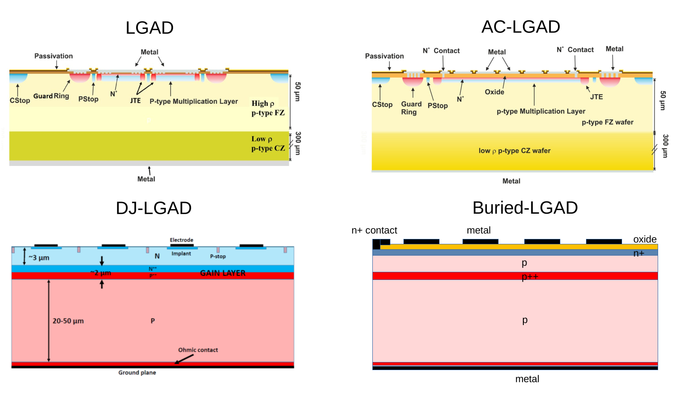

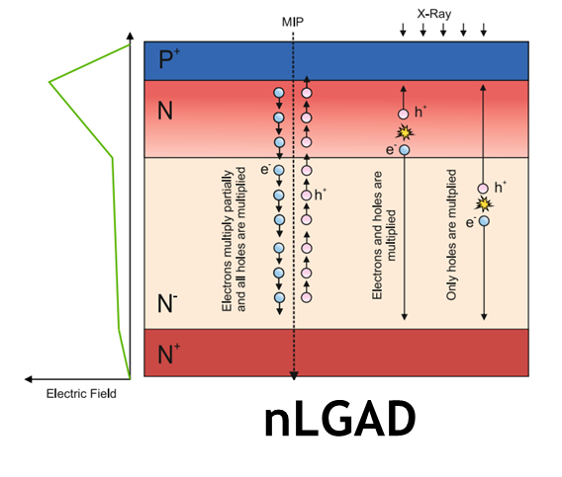
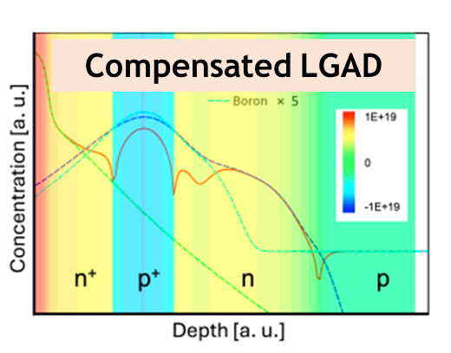
In LGAD …
Many LGAD ”flavours” are emerging depending on the application

Slide 20
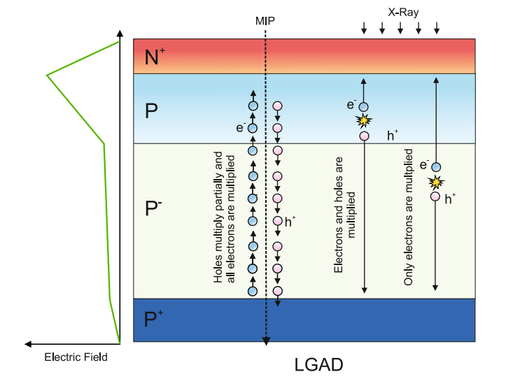
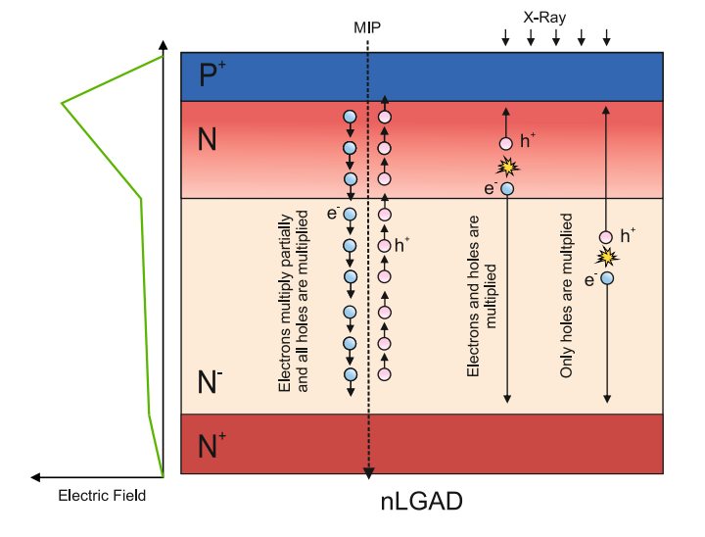
LGAD vs nLGAD
Gain of LGAD is penetration depth-dependant
Electron-driven multiplication
Pellegrini et al, European patent EP 3 971 997 B1
Villegas et al, TREDI 2024
Villegas et al, https://doi.org/10.1016/j.nima.2025.170208
Pellegrini et al, https://doi.org/10.1016/j.nima.2014.06.008

Slide 21
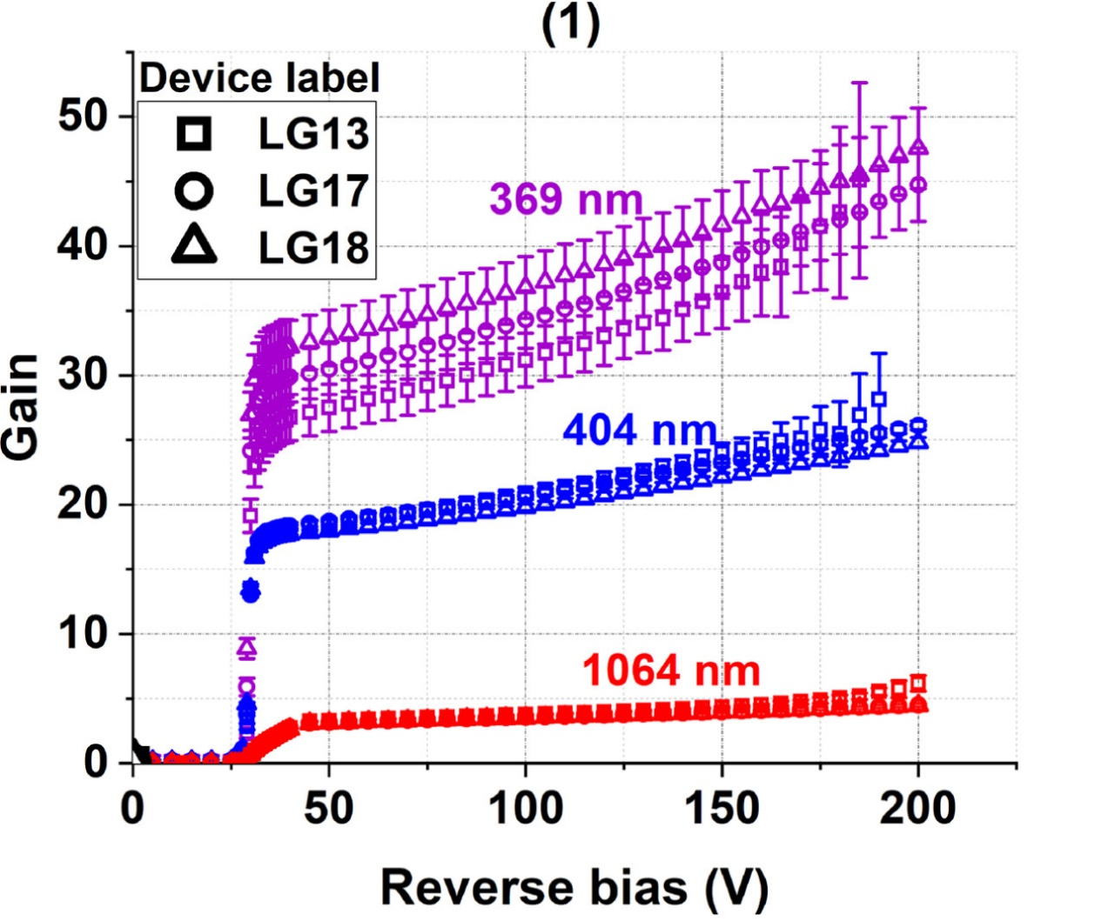
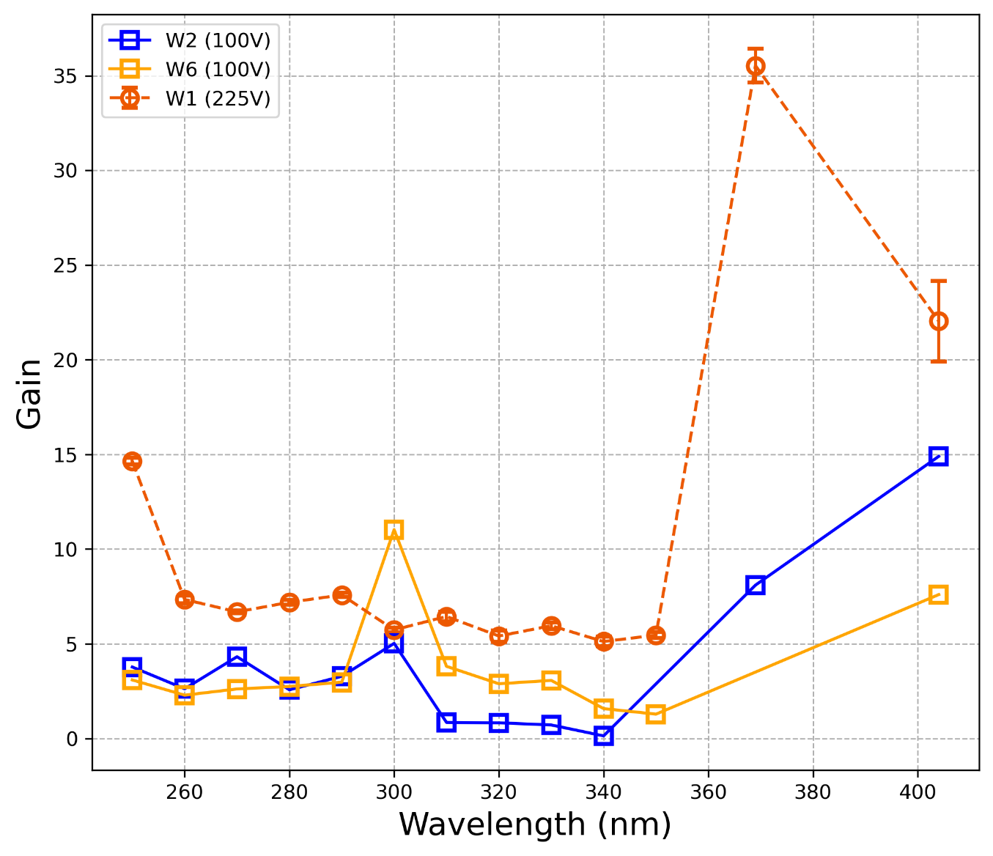
Some results on nLGAD (photon detection)
Ultra-shallow junction nLGAD (USJ-nLGAD)
Medical Imaging Application
280 < E < 530 eV
Water window range
Submitted…
X
│
R
A
Y
SOFT X-RAY
A – Absorptance coefficient T – Transmittance coefficient
- Carbon
- Oxygen
Deep-UV light
(250 nm)
Gain
A ~ 1
T ~ 1
15
H₂O
5
250
404
21
Wavelength [nm]
[1] Villegas, J., Torres, C., Manojlovic, M., Jimenez-Ramos, M. C., Moffat, N., Lopez, J. G., & Hidalgo, S. (2025). NLGAD gain response to low-penetrating particles. Nuclear Instruments and Methods in Physics Research Section A: Accelerators, Spectrometers, Detectors and Associated Equipment, 1072, 170208. https://doi.org/10.1016/j.nima.2025.170208
[2] Manojlović, M., Moffat, N., Fernandez-Martínez, P., Villegas, J., Cabruja, E., Rebarz, M., Pellegrini, G., & Hidalgo, S. (2025). nLGAD detector gain response to deep and near-ultraviolet (UV) light. [Manuscript submitted for publication]

Slide 22
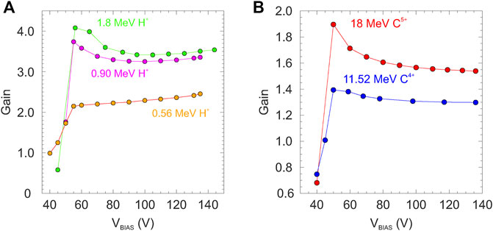
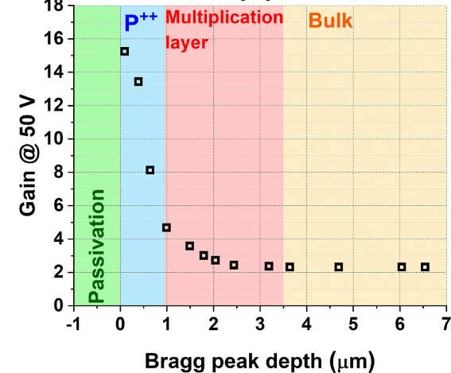
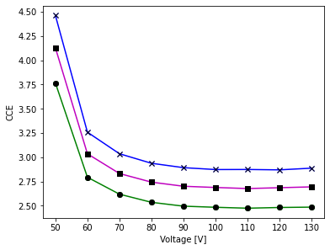
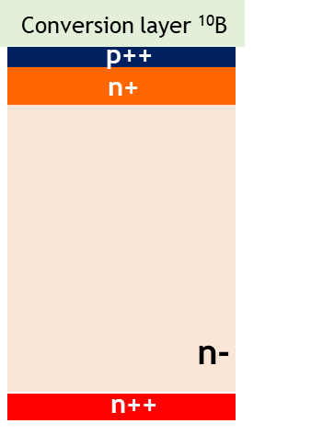
Examples (LGADs & nLGAD)… what we know…
What we want to test…
Could have implications in pB fusion experiment
Angular measurements (600 keV protons)
Gain
Can LGADs be used for neutron detection in pB fusion?
Gain
Proton detection
α-particle in fusion experiments
n
Alpha particle detection (source)
α
¹⁰B+n→⁷Li+α+Q
Q = 2.79 MeV
Gain
Gain
Ion detection
Voltage [V]

Slide 23
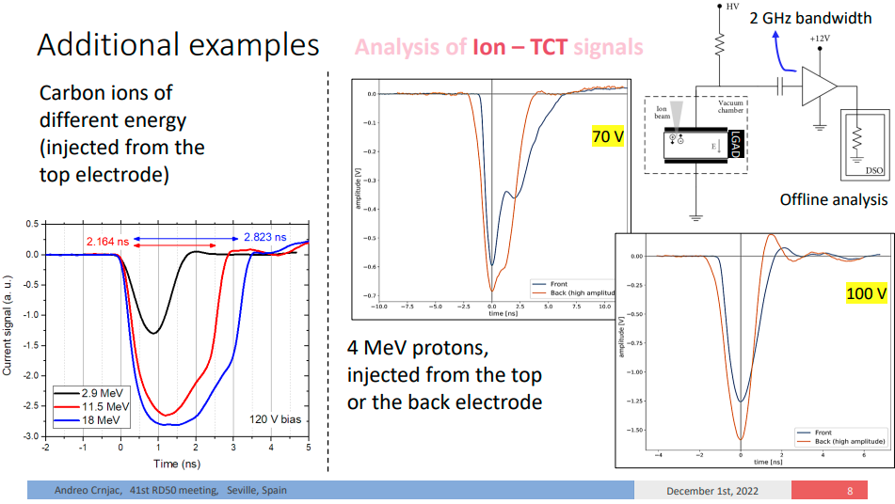
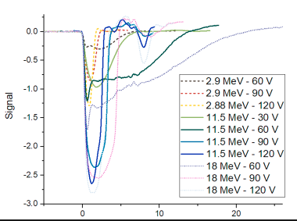
Andreo Crnjac et. al.

Slide 24
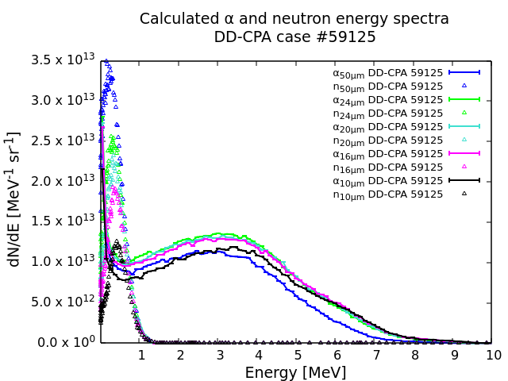
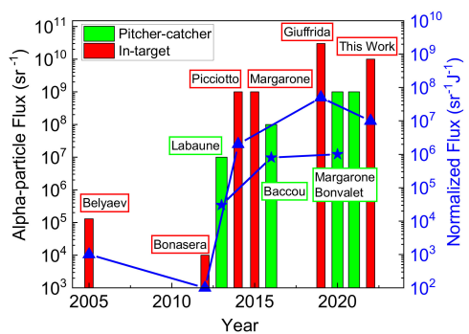
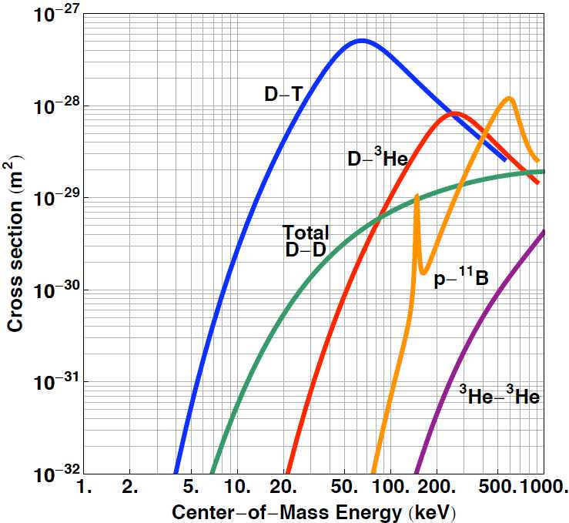
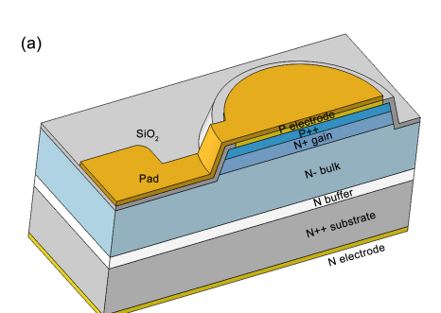

pB fusion context…
LGAD is radiation resistant with this neutron flux
maximum of 10¹¹ α/sr/shot^{[2]}
¹p +¹¹B →3⁴He +8.7MeV
The community working on
4H-SiC LGAD
Aneutronic (almost no neutrons)
Direct energy conversion (charged particles)
[1] Margarone, D. et al. (2022) ‘In-target proton–boron nuclear fusion using a PW-class laser’, Applied Sciences, 12(3), p. 1444. doi:10.3390/app12031444.
[1] Sen Zhao, Keqi Wang, Kaibo Xie, Chenxi Fu, Chengwei Wang, Xin Shi and Congcong Wang, Charge Collection Performance of 4H-SiC LGAD, IEEE TRANSACTIONS ON NUCLEAR SCIENCE, VOL. XX, NO. XX, XXXX 2020
[2] McKenzie, Warren, et al. “HB11—Understanding Hydrogen-Boron Fusion as a New Clean Energy Source.” Journal of Fusion Energy, vol. 42, no. 1, 13 May 2023, https://doi.org/10.1007/s10894-023-00349-9. Accessed 24 Aug. 2023.

Slide 25
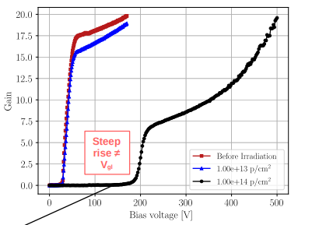
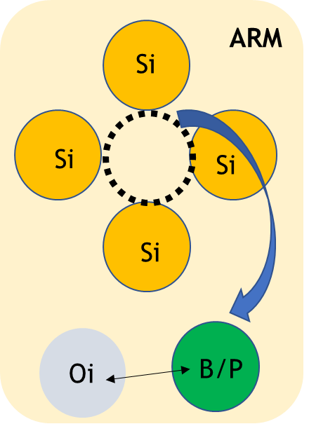
Nothing is perfect…
LGADs suffer from gain loss under severe radiation environments
Acceptor removal mechanism (ARM) (well studied)
Donor removal mechanism (we are investigating it…) ^{[1]}
N(ф) = N(0) exp(−C_{A} ф)
10¹⁵ neq/cm² (1 MeV neutron equivalent fluence)
Mitigation teckniques: Carbon co-implantation, compensation design etc.
Margarita Biveinytė, Marcos Fernandez Garcia, Salvador Hidalgo, Veronika Kraus, Michael Moll, Jairo Villegas, Moritz Wiehe, Characterization and Irradiation Studies of the Novel nLGAD Concept, VCI2025
[1] Milos Manojlovic, Andreo Crnjac, Neil Moffat, et al. Gain Response and Ion Beam-Induced Donor Removal in nLGAD Detector: Global Gain Quenching. TechRxiv. September 04, 2025. DOI: 10.36227/techrxiv.175699542.28031525/v1

Slide 26
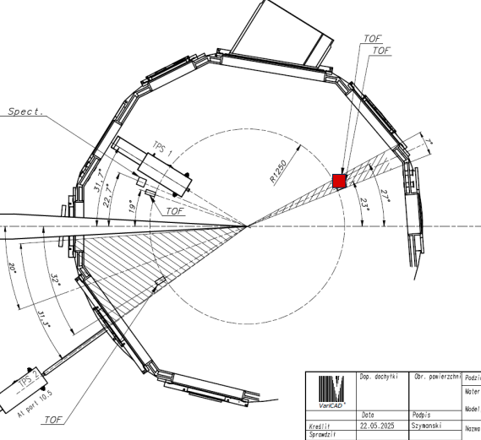
Experiment in October
"PROton BOron Nuclear fusion: from energy production to medical applications" (PROBONO - CA21128) (Dr. Przemysław Tchórz)
LGAD detector systems for neutrons and charged particles: isntallation, opetration, and data analysis (Dr. Gordana Lastovicka-Medin)
Feasibility study…

Slide 27
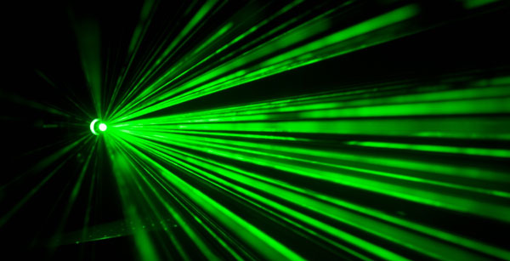
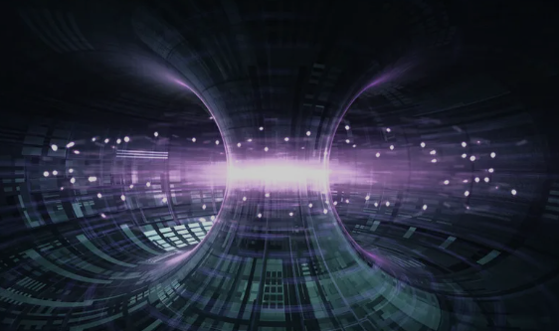


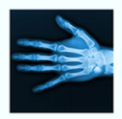
Applications
Deep-UV detection
In nuclear fusión experiments
UV-light detection
in space research
Femtosecond-scale dynamics Attosecond laser experiments?
Gamma radiation detection
In October at ELI The feasibiluty study
HL-LHC phase CERN
Soft X-ray imaging
Collaboration & Ideas ☺

Slide 28
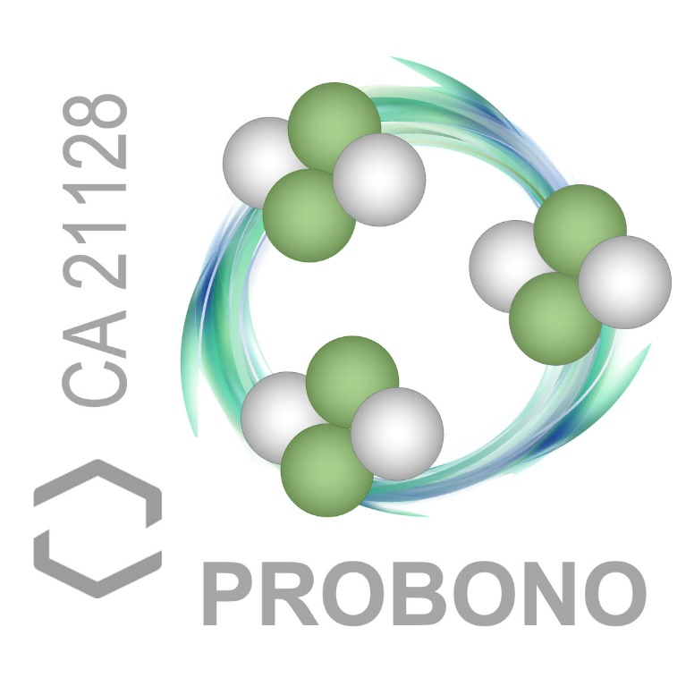


Acknowledgements
Thank you!
Acknowledgements
This work has been funded by the Spanish Ministry of Science and Innovation (MCIN/AEI/10.13039/501100011033/) and by the European Union’s ERDF program “A way of making Europe”. Grant references: PID2020-113705RB-C32 and PID2021-124660OB-C22. Also, it was funded by the European Union’s Horizon 2020 Research and Innovation funding program, under Grant Agreement No. 101004761 (AIDAInnova).

