Slide 1
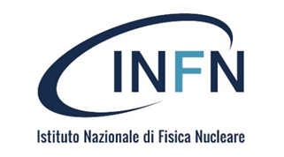


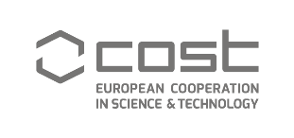
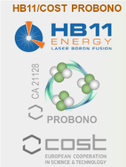

The proton-boron fusion reaction enhances in-vitro cancer cell death
Lorenzo Manti
Department of Mathematics and Physics, University of Campania “L. Vanvitelli”, Caserta
& INFN, Naples Section, Naples, Italy
lorenzo.manti@unicampania.it, manti@na.infn.it
5th International Workshop on Proton-Boron Fusion
Belgrade-September 11th, 2025

Slide 2
Outline
Protontherapy
Proton-Boron Capture Therapy (PBCT)
Radiobiological rationale
Experimental data
Conclusions
Future perspectives

Slide 3
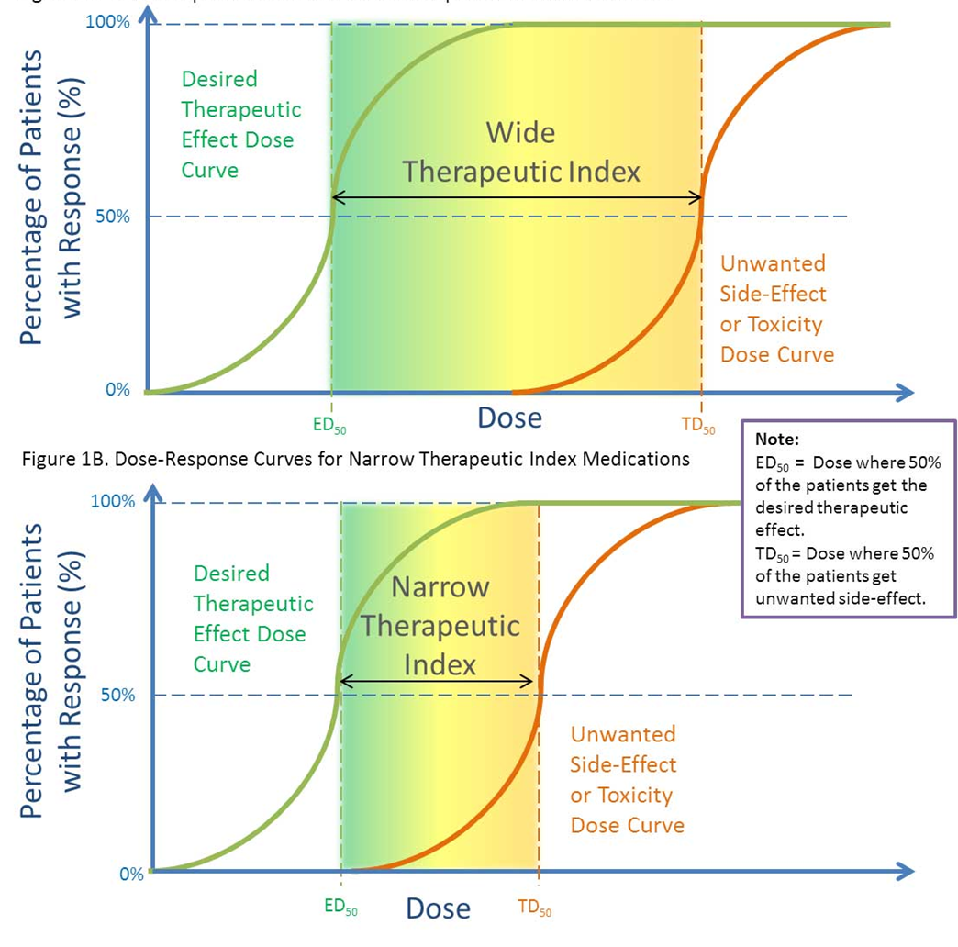
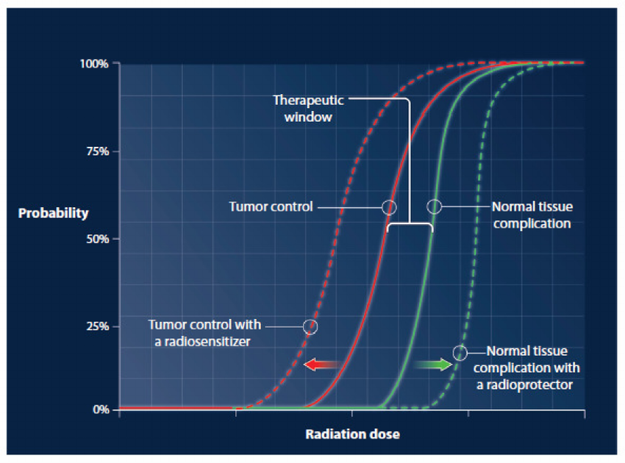
Cancer radiotherapy (RT)
The aim of RT is Tumour Local Control (TLC)
The curative dose is limited by the Normal-Tissue Complication Probability (NTCP)
Hence the concept of Therapeutic Index (TI)
Also called Therapeutic Window
Radiobiology seeks strategies to widen the TI/TW in RT

Slide 4
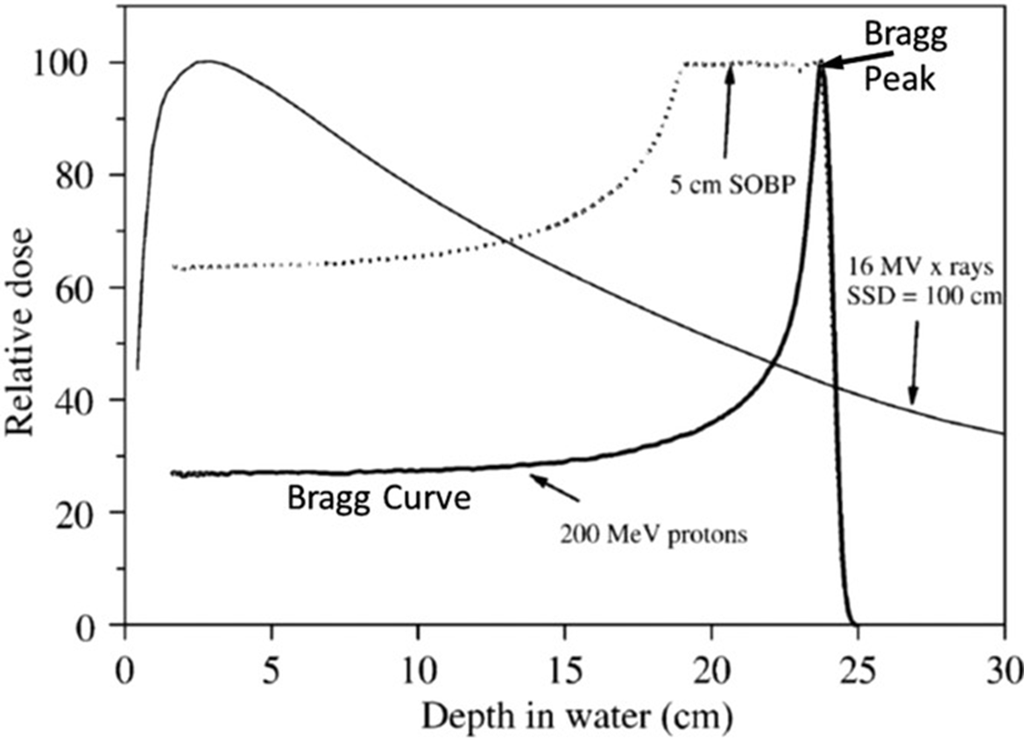
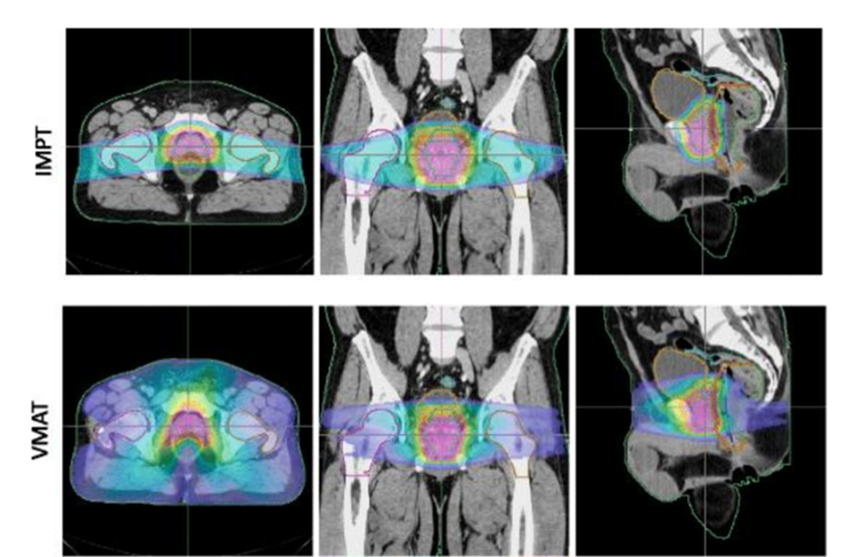
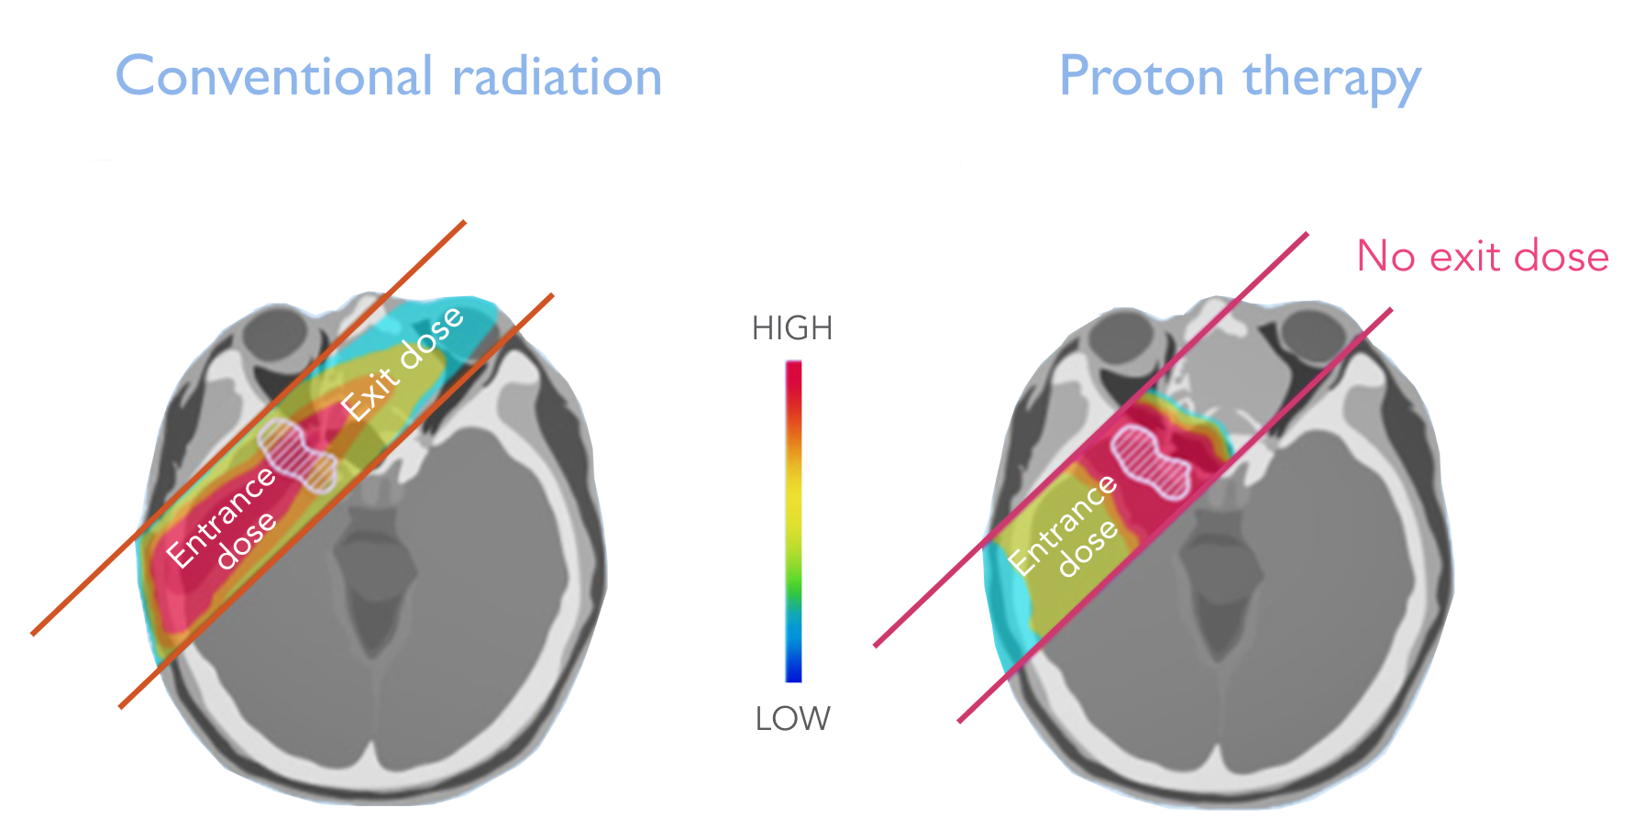
Protontherapy
Notes:
Volumetric Modulated Arc Therapy, a type of external beam radiation therapy (EBRT) that uses a continuously rotating linear accelerator to deliver radiation. IMPT precise form of proton therapy that uses narrow, scanning "pencil beams" of protons to deliver a radiation dose to a tumor. It achieves superior dose-sparing of healthy organs compared to traditional X-ray treatments like IMRT by modulating the intensity and energy of these beams, allowing for more complex tumor targeting, especially in anatomically challenging areas

Slide 5
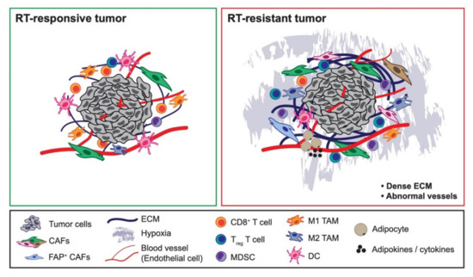
Cancer radioresistance

Slide 6
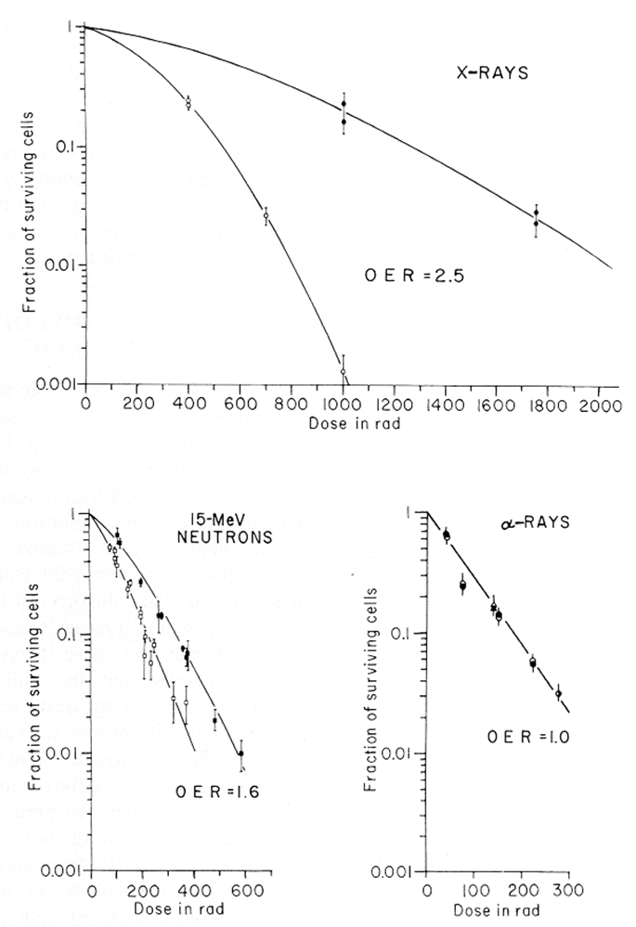
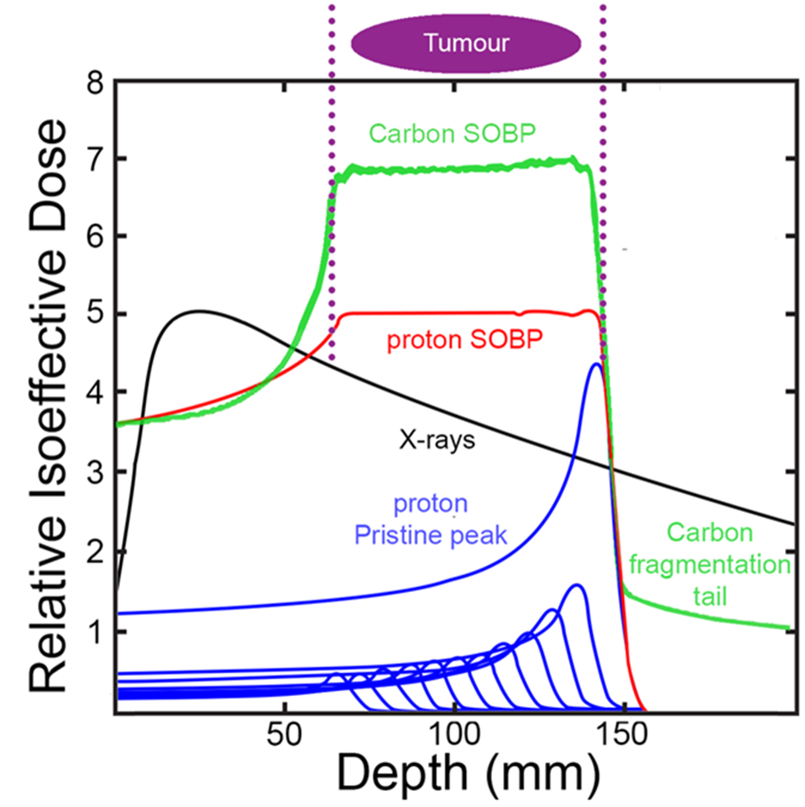
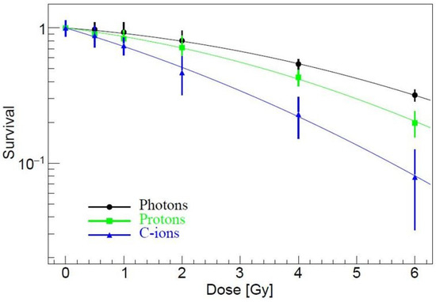
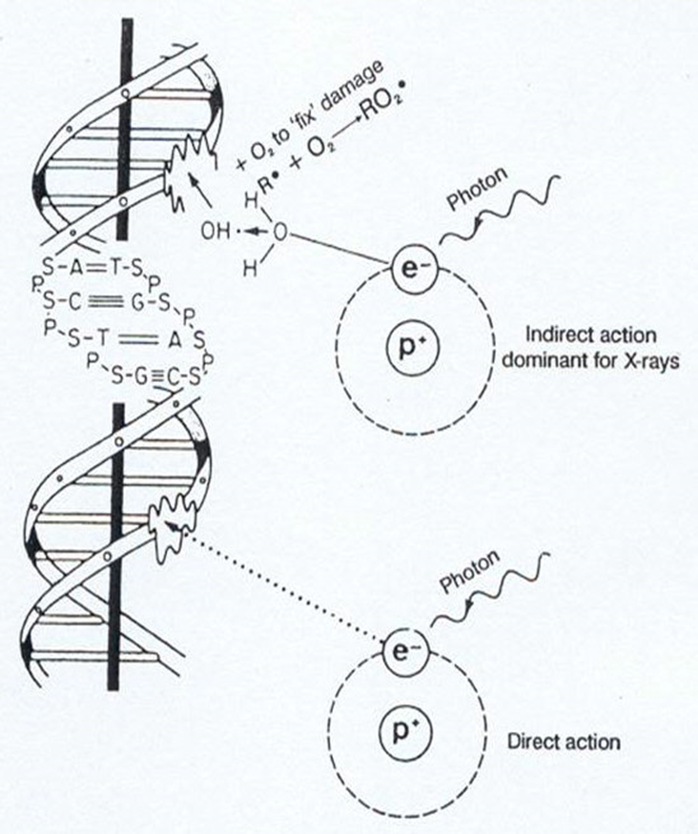
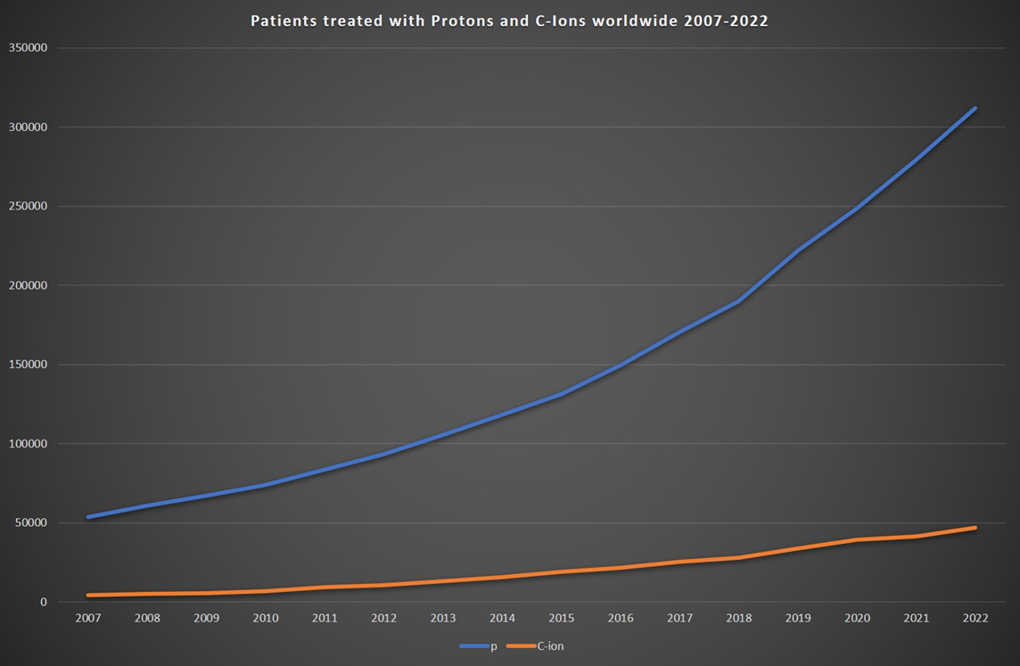
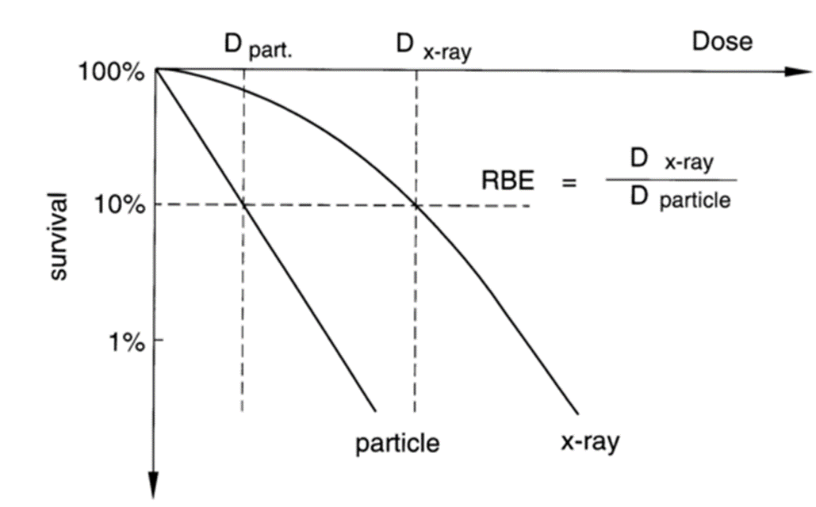
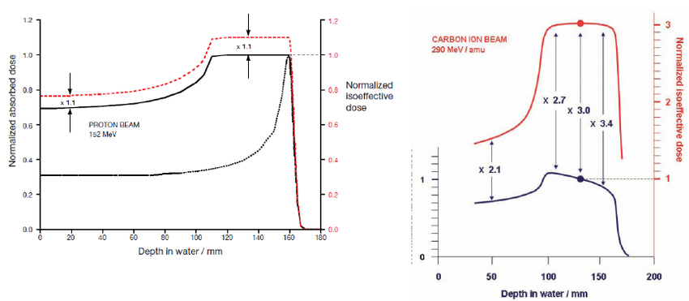
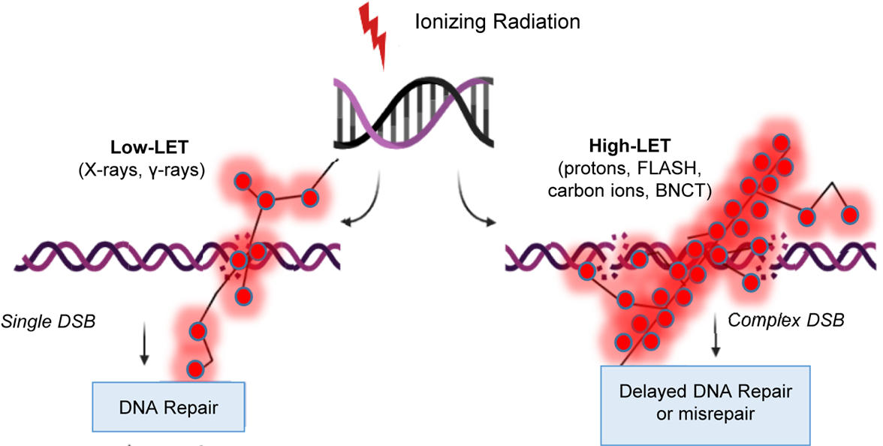
Radiation biological effectiveness
Physics plays a fundamental role (radiation quality)
Notes:
The biological effects of ionising radiation are critically driven by the initial spatio-temporal energy deposition patterns at the nanometer scale influencing how the ensuing biochemical processes are dealt with at the cellular level and leading to a diversity of tissue/systemic responses

Slide 7
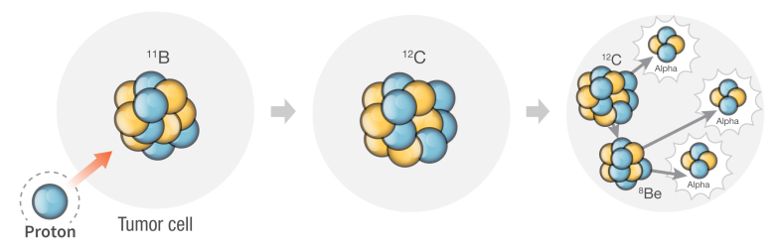
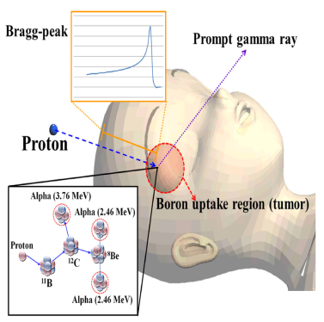
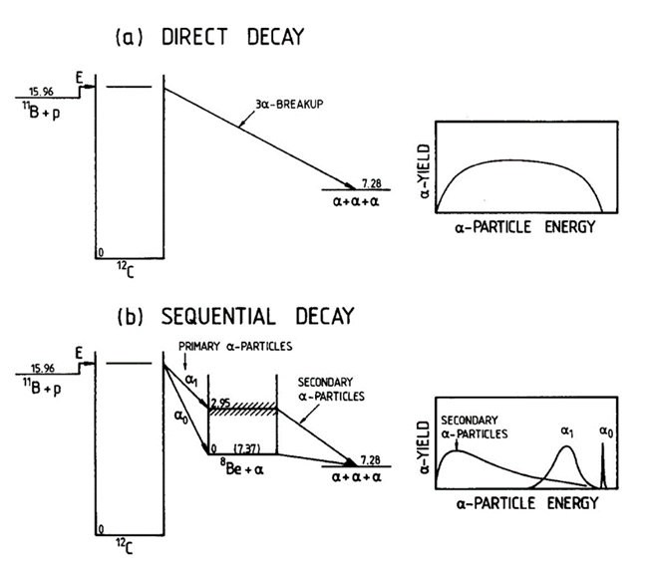
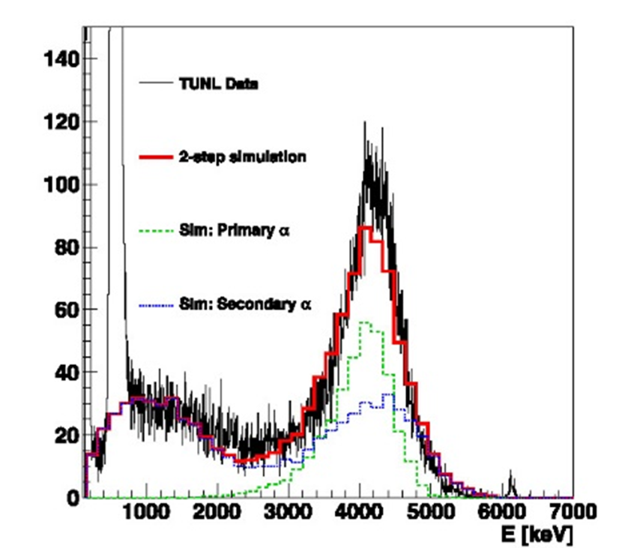
Enhancing clinical proton effectiveness:
Approach based on the pB fusion reaction (Yoon et al., 2014)
Locally deploying complex DNA damage to cancer cells
p + ¹¹B → 3α + 8.7 MeV

Slide 8
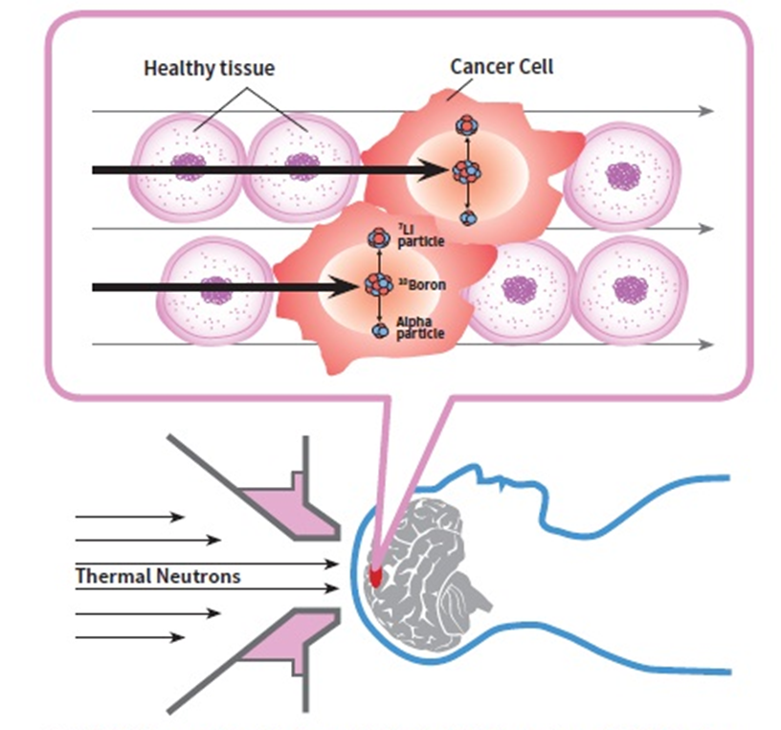
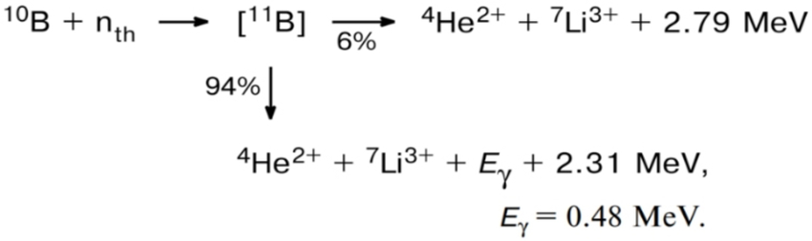
PBCT vs. BNCT

Slide 9
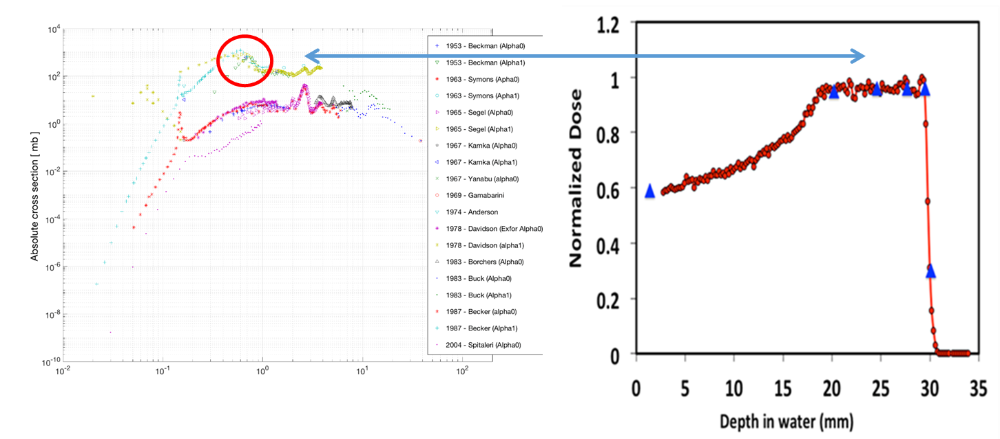
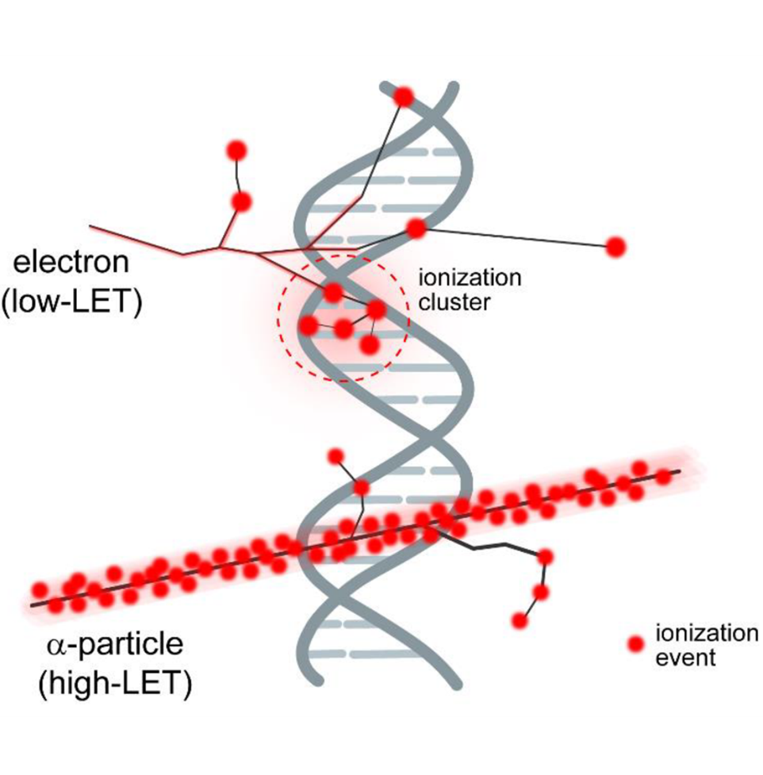
Proton-Boron Capture Therapy (PBCT)
Physics ensures no reaction occurring in healthy tissues but confined within the tumour
Radiobiology predicts greater DNA-damaging action by the reaction products than that by the primary proton beam
Incident proton energy
Notes:
Do-Kun, Y. et al.,, Joo-Young, J. & Tae S.S. Application of proton boron fusion reaction to radiation therapy: A Monte Carlo simulation study. Appl. Phys. Lett. 105, 223507 (2014).
The 11B(p, α)αα reaction at the 0.675 MeV resonance

Slide 10
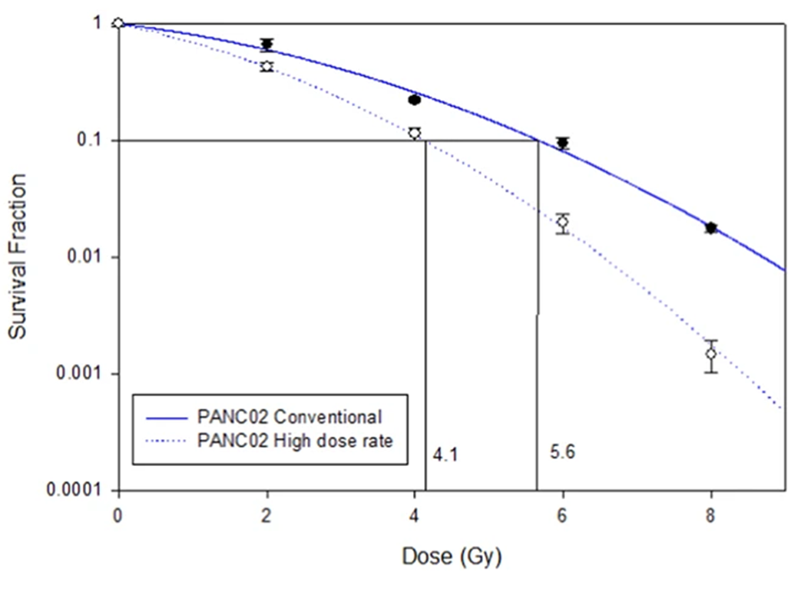
Definition of DMF
Dose-Modifying Factor (DMF) = (5.6/4.1) ~ 1.36
Notes:
- Standard clonogenic – colony foming - assay
No effect (cytotoxicity) of BSH itself

Slide 11
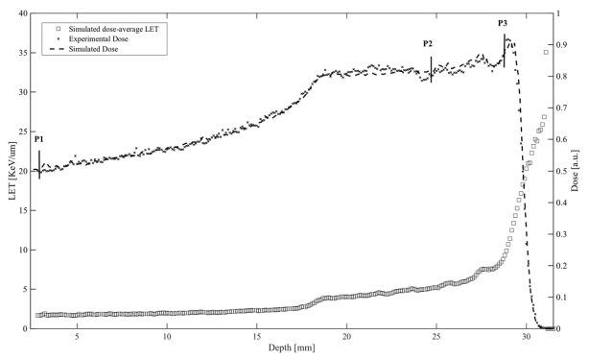
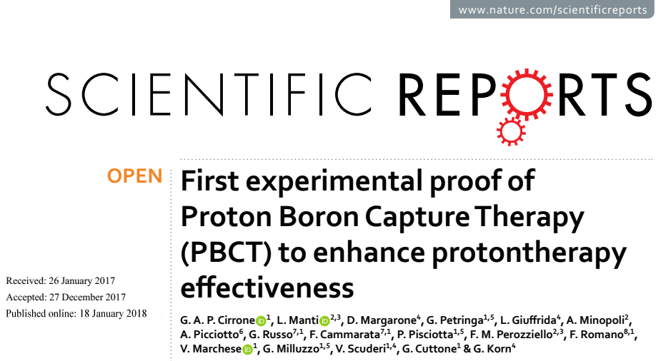
PBCT – first experimental proof
LNS-INFN, Catania
E_{p} = 62 MeV
DU145 (prostate cancer)
Boron carrier – “BSH” (Na₂B₁₂H₁₁SH)
sodium mercaptododecaborate
BSH
DMF₁₀ =1.46 ± 0.12
Notes:
- Standard clonogenic – colony foming - assay
No effect (cytotoxicity) of BSH itself

Slide 12
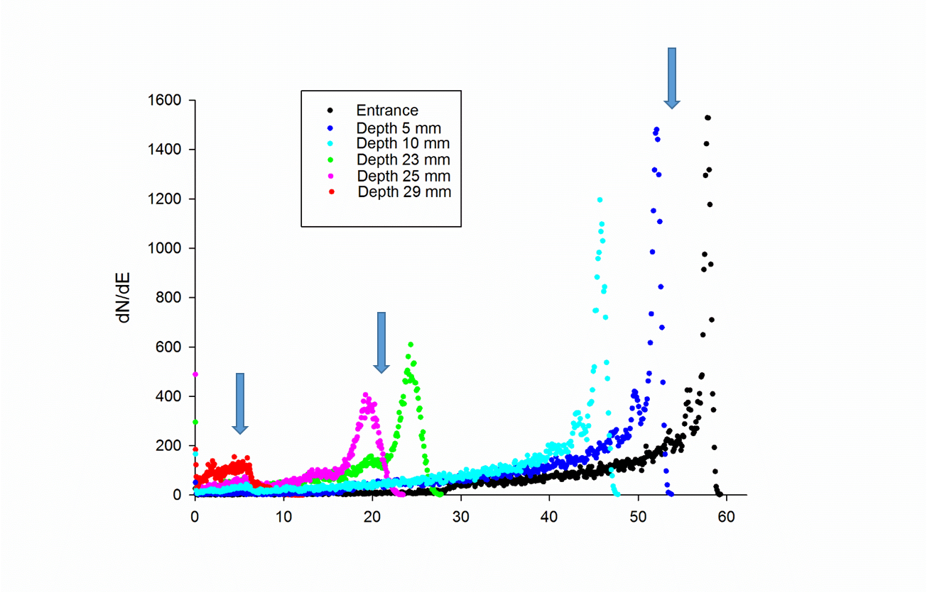
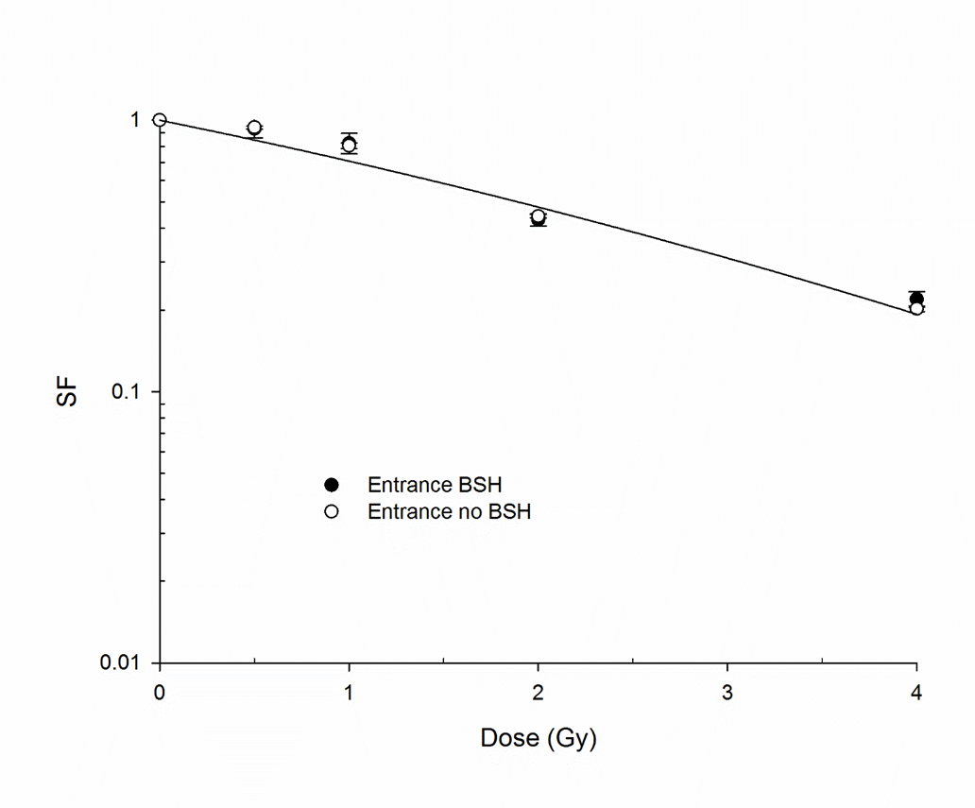
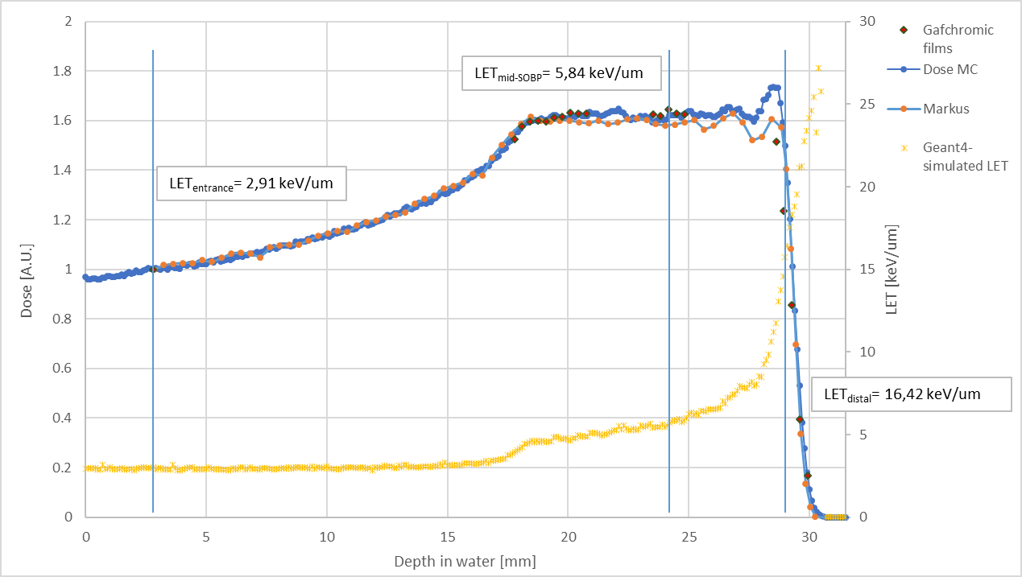
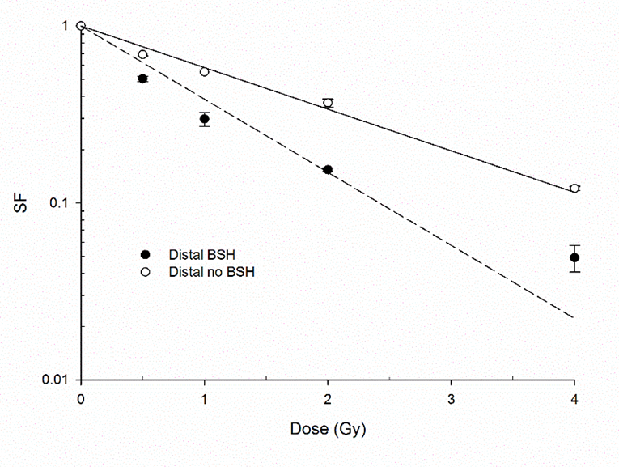

PBCT: Dependence upon incident proton energy

Slide 13
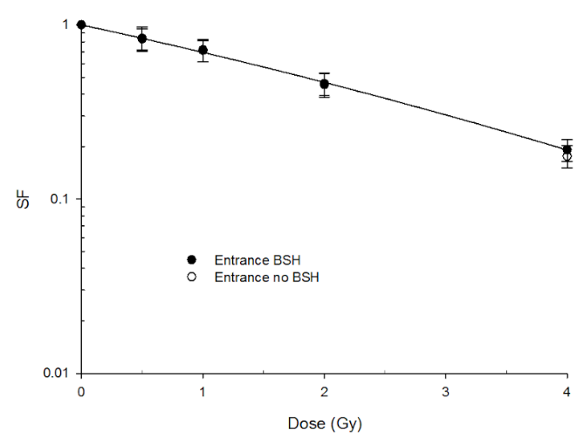
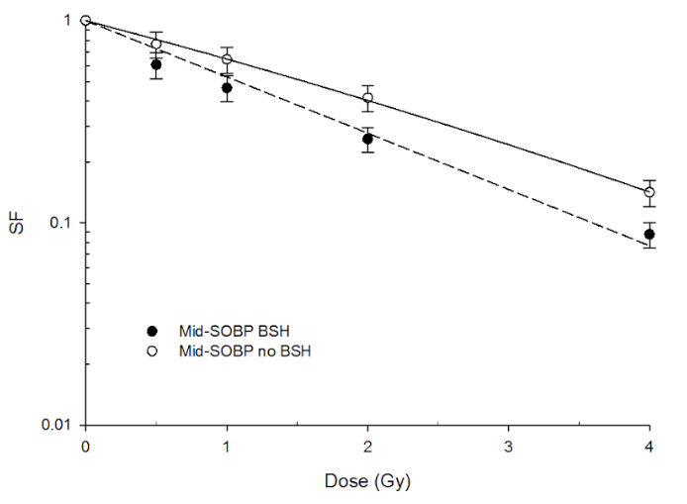
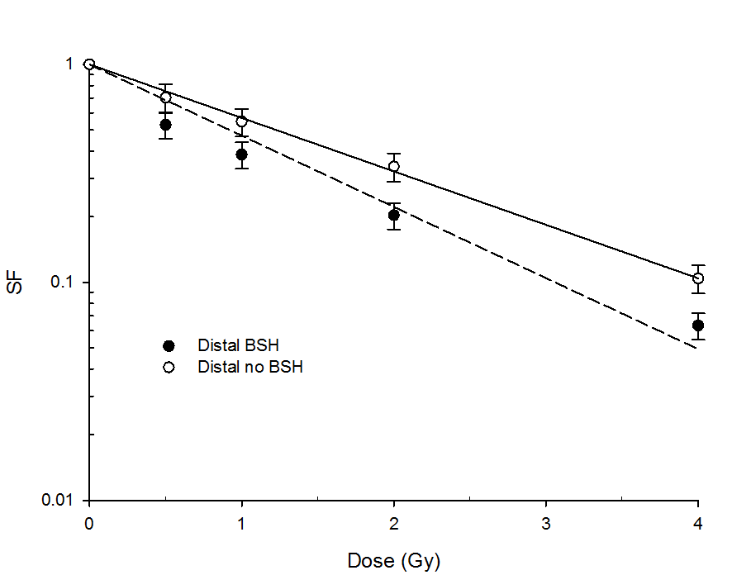
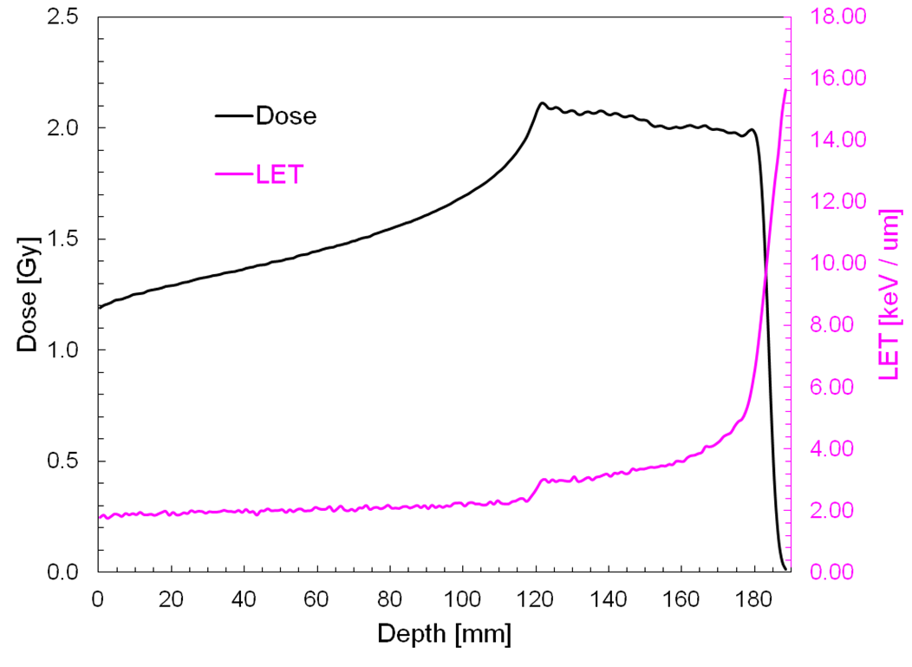

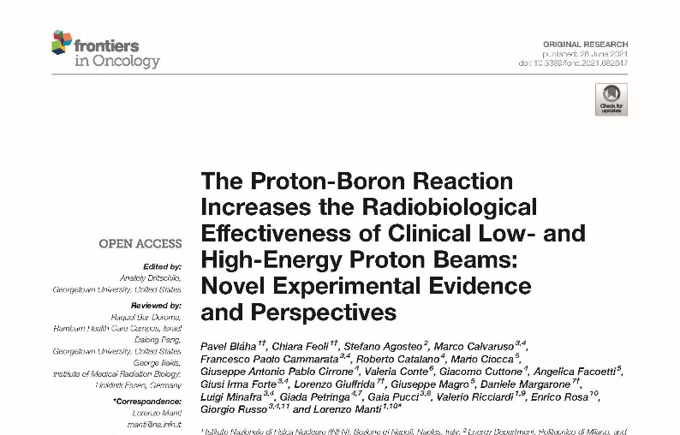
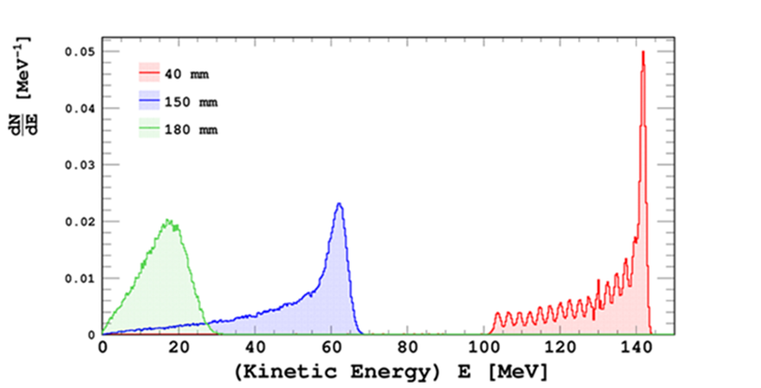
PBCT: High-energy clinical proton beams
Courtesy of A. Mairani and G. Magro
E_{p+} = 131.5-164.8 MeV
DU145 (prostate cancer)
Boron carrier – “BSH” (Na₂B₁₂H₁₁SH)
sodium mercaptododecaborate
natural isotopic composition
80 ppm

Slide 14
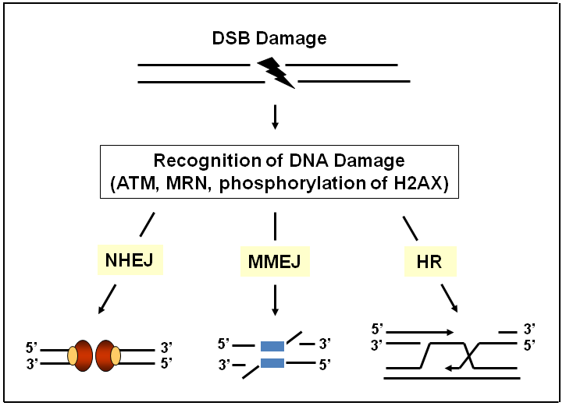
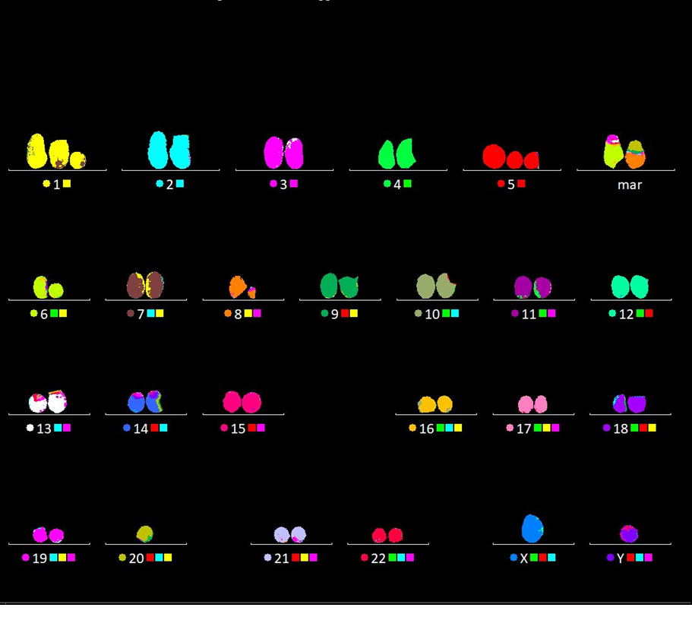
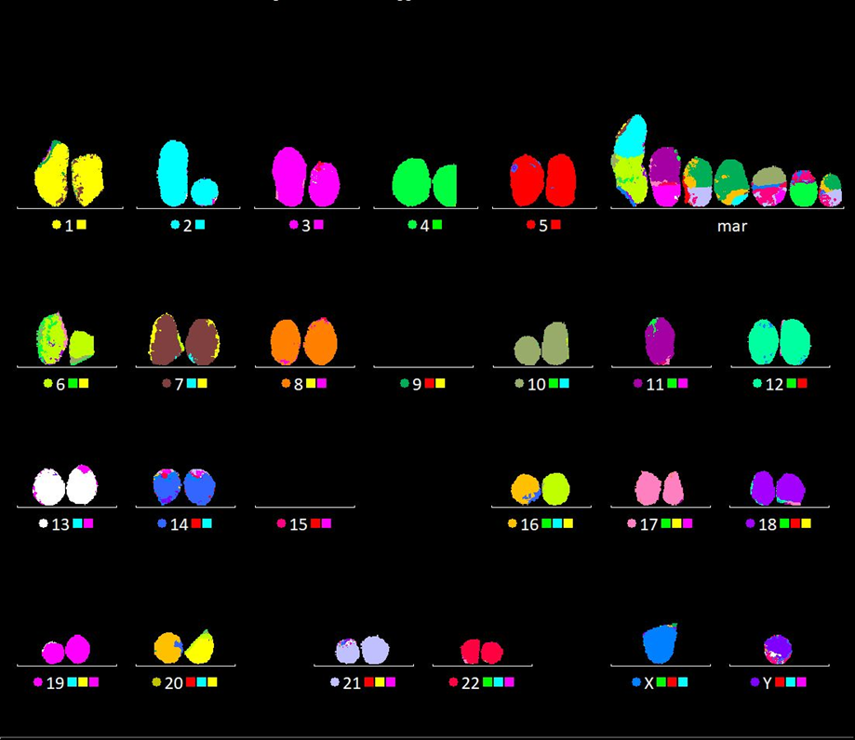
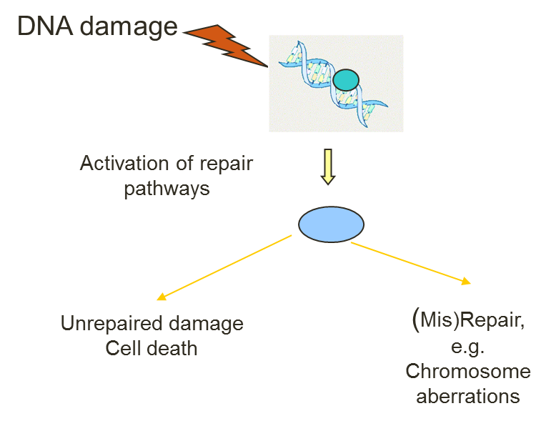
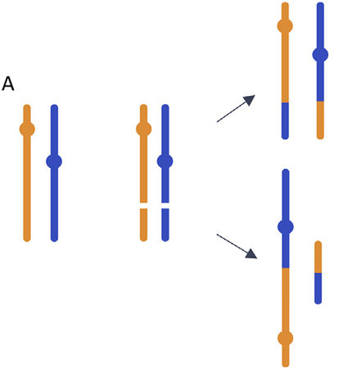
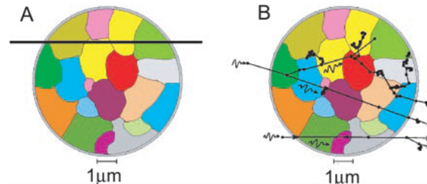
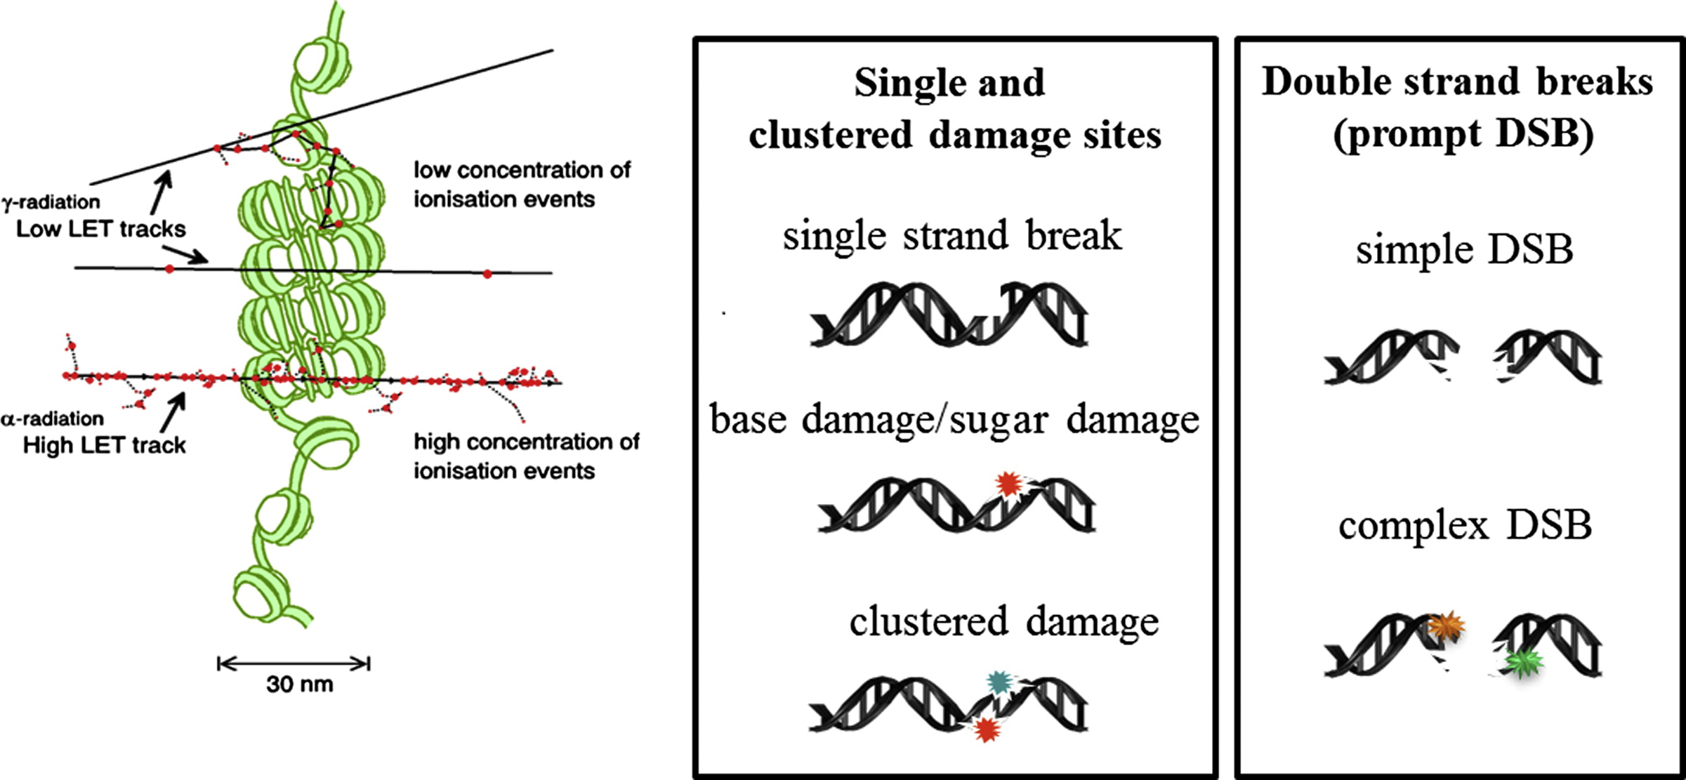
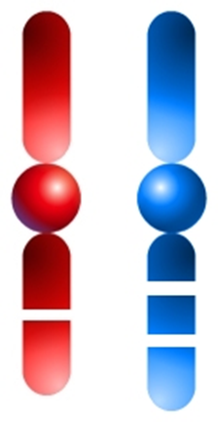
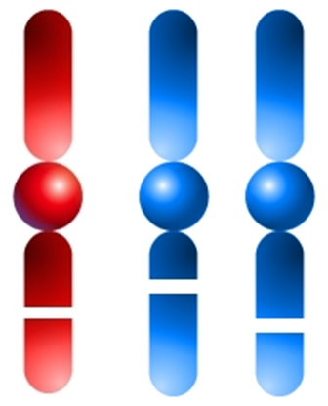
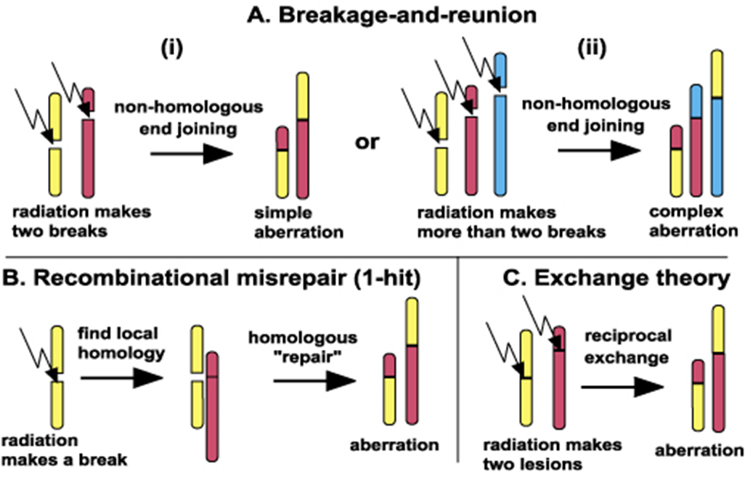
Looking for mechanisms… Chromosome aberrations are the smoking gun!
Proton-irradiated cell: No boron
Proton-irradiated cell: With boron

Slide 15
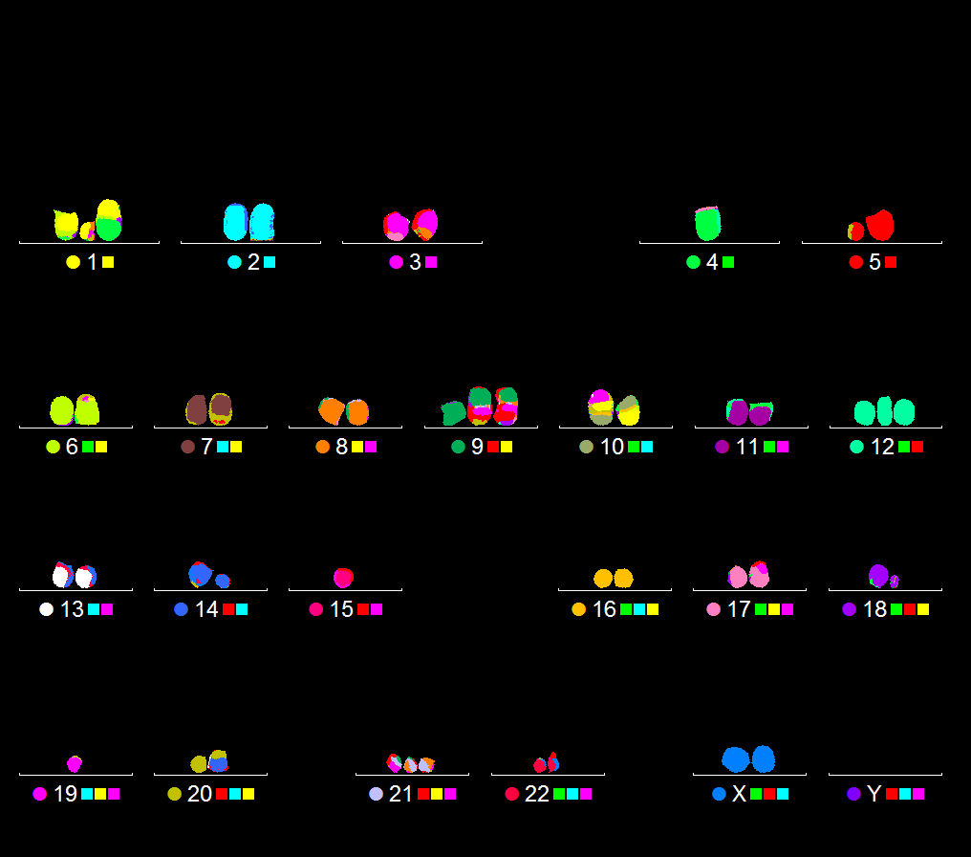
Radiobiological detection of pB-generated α-particles Chromosome aberration studies
2Gy-irradiated cell in the presence of BSH

Slide 16
Chromosome aberrations CNAO
BSH
Bláha et al., Front Oncol. 2021

Slide 17
Damage complexity along the clinical CNAO proton SOBP
Bláha et al., Front Oncol. 2021

Slide 18
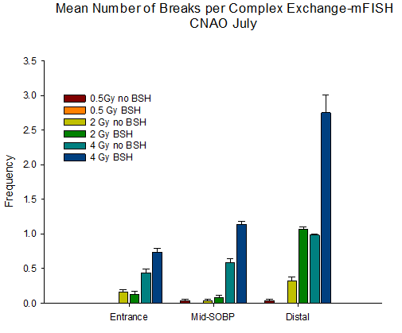

Extent of chromosome aberration complexity
Chromosome aberrations-CNAO
Bláha et al., Front. Oncol.2021

Slide 19


From BSH to BPA: Enhancement of clinical proton effectiveness in cancer radioresistant cells
Entrance
DMF₁₀=1
Mid-SOBP
Distal
DMF₁₀=1.15
DMF₁₀=1.32

Slide 20


Chromosome aberrations-CNAO
BPA
CNAO
Unpublished data

Slide 21








DNA damage complexity- Foci assay
Automated analysis by ImageJ Macro with FP-3D plugin-MCF-10 cells CNAO

Slide 22



CIRCE: the Biophysics beamline

Slide 23



Low-energy monochromatic proton beam irradiations
DU 145
PANC-1
DU 145 | α (Gy⁻¹) | DMF₁₀
NO BSH | 0.52 ± 0.03
BSH | 0.96 ± 0.08 | ∼ 1.85
PANC-1 | α (Gy⁻¹) | DMF₁₀
NO BSH | 0.212± 0.006
BSH | 0.330± 0.012 | ~1.56

Slide 24


Premature senescence induced by the pB reaction
CNAO
Unpublished data

Slide 25
Synopsis of DMF₁₀ values
Facility | Cell line | Carrier & ¹¹B concentration | SOBP position | DMF₁₀
CNAO | DU-145 | BPA-120 ppm | Mid-SOBP | 1.10
CNAO | DU-145 | BPA-120 ppm | Distal | 1.28
CNAO | PANC-1 | BPA-120 ppm | Mid-SOBP | 1.15
CNAO | PANC-1 | BPA-120 ppm | Distal | 1.32
CIRCE | DU-145 | BSH-80 ppm | Pristine (∼700 keV) | 1.85
CIRCE | PANC-1 | BSH-80 ppm | Pristine (∼700 keV) | 1.56

Slide 26



Some open questions

Slide 27



The bystander effect

Slide 28



Evidence of a bystander effect in PBCT-1
CNAO therapeutic beamline-Clonogenic survival
PANC-1 cells; MidSOBP and Distal; 120 ppm of ¹¹B from BPA
Medium transfer experiments

Slide 29


Evidence of a bystander effect in PBCT-2
Micronuclei (MN)
MCF10A cells; MidSOBP; 120 ppm of ¹¹B from BPA
Medium transfer experiments
MN dose response – directly irradiated cells
Bystander effect experiment – not directly irradiated cells
Notes:
MN induction in MCF10A cells irradiated at the mid-SOBP of CNAO therapeutic beamline:
dose-response in directly irradiated cells showing DNA damage enhancement by BPA;
evidence for a bystander effect from medium-transfer experiment

Slide 30







PBCT in-vivo studies
In-vivo studies
Multimodal imaging techniques and Radiomics
Courtesy of Dr. G.A. P. Cirrone

Slide 31
Conclusions
The Proton-Boron reaction enhances the effectiveness of protontherapy
The complexity of DNA damage induced by the reaction products are key radiobiological mechanism
However, the increase in effectiveness is not simply related to an increase in macroscopic dose and untargeted effects must be taken into account

Slide 32
The future

Slide 33


Spatio-temporal radiobiology

Slide 34

The time factor: the «traditional» dose-rate effect

Slide 35




Novel temporal regimes
Very-High Dose Rates > 40 Gy/s (conventional accelerators) → Ultra-High Dose Rate up to ~ 10⁹ Gy/s (laser-driven accelerations)
“Rediscovered”: early studies found a biphasic (“hockey –stick”) type of response.
Pioneering study from Favaudon et al., 2014
Above 40 Gy/s, radiation does not trigger lung fibrosis, but has the same local tumor control, named the “FLASH effect”
Main benefits:
Sparing of the healthy tissue
Maintaining the same killing effect on tumor
Town, 1967

Slide 36



Towards FLASH RT
Some of the recent results:
Sparing of brain tissue and cognitive functions
Lack of sking fibronecrosis at mini pigs
No late toxicity in cat patients
First human treatment
Buonanno M. et al, 2019
Buonanno M. et al.,2019
Mostly electrons and X-rays – limited data with protons!
In general with protons:
No difference in cell killing
Differences in late arising effects
Senescence
TGF-β
Buonanno M., Radiotherapy and Oncology, 139, 2019

Slide 37



What about UDHR regimes?

Slide 38


Therapeutic window in radiotherapy

Slide 39


PROTOINDEX: Using laser-accelerated PROtons and nuclear fusion reactions for widening the proTOntherapy therapeutic INDEX
Unique combination of novel approaches
Potential clinical impact on clinical application
PBCT
+
FLASH
Very high dose rate
Conventional and laser driven proton acceleration
Decrease in the late adverse effects in normal tissue
Nuclear fusion reaction
Enhanced cancer eradication
Number of biological endpoints studied
Modest increment in cell lethality mediated by BPA-assisted PBCT in A549 lung cancer cells following laser-driven proton irradiation at ELIMAIA-ELIMED (courtesy of Dr. P. Blaha)
Notes:
Unique combination
New valuable scientific knowledge
Clinical app. – widening of therapeutic window; better local tumor control (radioresistant cancer); lower doses and/or less fractions – lower radiation „burden“; potential to develop more compact and cheaper proton accelerators with the use of laser driven acceleration
- IN THEORY this all could lead to a vast positive socio-economical impact.
Binary fusion reaction between proton and boron-11 atom, which produces highly damaging alpha particles

Slide 40




Laser-driven PBCT and FLASH in Breast Cancer

Slide 41


PROTOINDEX at ELIMAIA
Courtesy of F. Fede
The main objective of this proposal is the in-vitro study PBCT to enhance BC PT coupled with FLASH effects due to the UHDR protons at the ELIBEAM-ELIMAIA beamline
Increase effectiveness at cancer cell killing while further increasing the already proton favourable sparing of cardiac normal cells in the entrance channel.
Two established cell lines will be used: aggressive MDA-MB-231 breast cancer cells and normal Human Cardiac Microvascular Endothelial Cells (HMVEC-C).
The methodology employed for these experiments envisages dosimetry and radiobiology measurements both in 2D and 3D.

Slide 42








Acknowledgments
Radiation Biophysics Laboratory, UNINA, Naples
P. Blaha, F. Fede, C. Feoli, V. Ricciardi, E. Formicola,V.C. Elia
Medical Physics group, INFN-LNS, Catania
G. Cuttone, G.A.P. Cirrone, Giada Petringa
Dept. of Ion Acceleration and Applications of High-Energy Particles
D. Margarone, L. Giuffrida, F. Schillaci
Medical Physics and Radiobiology Unit ,CNAO, Pavia
M. Ciocca, M.Pullia, A. Facoetti,
CIRCE laboratory, UNICAMPANIA, Caserta
L. Gialanella, R. Buompane, G. Porzio
Call Gr. V INFN NEPTUNE: Nuclear process-driven Enhancement of
Proton Therapy UNravEled. (2019-22); MIUR PRIN: PBCT (2019-22)
CA21128 PROBONO

Slide 43
Backup slides

Slide 44

The clonogenic assay

Slide 45

More on the dose rate effect

Slide 46




Some literature on PBCT
Do-Kun Yoon, Joo-Young Jung, Tae Suk Suh; Application of proton boron fusion reaction to radiation therapy: A Monte Carlo simulation study. Appl. Phys. Lett. 1 December 2014; 105 (22): 223507. https://doi.org/10.1063/1.4903345
P.Kundràat, K.P.Brabcova et al, BORON-ENHANCED BIOLOGICAL EFFECTIVENESS OF PROTON IRRADIATION: STRATEGY TO ASSESS THE UNDERPINNING MECHANISM
Radiat Prot Dosimetry, 2022 Aug 22;198(9-11):527-531. doi: 10.1093/rpd/ncac093
A.J.Michaelidesova, P.Kundrat et al. First independent validation of the proton-boron capture therapy concept
Sci Rep. 2024 Aug 20;14(1):19264. doi: 10.1038/s41598-024-69370-y.
M Nuez-Martinez et al. Boron clusters (ferrabisdicarbollides) shaping the future as radiosensitizers for multimodal (chemo/radio/PBFR) therapy of glioblastoma J. Mater. Chem. B, 2022,10, 9794-9815
M. Shahmohammadi Beni et al. On the effectiveness of proton boron fusion therapy (PBFT) at cellular level Scientific Reports volume 12, Article number: 18098 (2022)
p11B publication in medical applications
We believe that the relative biological effectiveness (RBE) weighted
doses by attributing maximum potential RBEs to the dose of alphas would be incapable of explaining the significance of the biological effect observed in PBFT, therefore more investigations would be needed in this regard
The fraction of deposited energy from alpha particles compared to incident protons is not entirely negligible, despite the previously reported results
The results obtained for the cellular damage suggest that proton boron fusion radiation therapy, when combined with boron-rich compounds, is a promising modality to fight against resistant tumors.
Courtesy of Dr. GAP Cirrone

Slide 47

No action of BSH per se

Slide 48




Slide 49
Long standing collaboration beyond the clinical applications
Istokskaia, V et al. A multi-MeV alpha particle source via proton-boron fusion driven by a 10-GW tabletop laser Communications Physics, 2023, 6(1), 27
Milluzzo, G. et al Extended characterization of alpha particles via laser-induced p-11B fusion reaction in silicon hydrogenated boron-doped thin targets Journal of Instrumentation, 2023, 18(7), C07022
M. Tosca et al, Plasma polymers as targets for laser-driven proton-boron fusion Frontiers in Physics, 2023, 11, 1227140
Kantarelou V et al, A Methodology for the Discrimination of Alpha Particles from Other Ions in Laser-Driven Proton-Boron Reactions Using CR-39 Detectors Coupled in a Thomson Parabola Spectrometer Laser and Particle Beams, 2023, 2023, 3125787
Margarone D, et al In-Target Proton–Boron Nuclear Fusion Using a PW-Class Laser Applied Sciences (Switzerland), 2022, 12(3), 1444
Bonvalet J, et al Energetic α -particle sources produced through proton-boron reactions by high-energy high-intensity laser beams Physical Review E, 2021,103(5), 053202
Margarone D, et al Generation of alpha particle beams with a multi-kJ, Peta Watt Class Laser System Frontiers in Physics 2020, 8, 343
Giuffrida, L et al, High-current stream of energetic alpha particles from laser-driven proton-boron fusion Physical Review E, 2020, 10(1), 013204
Belloni. F, et al
On the enhancement of p-11B fusion reaction rate in laser-driven plasma by alpha – proton collisional energy transfer
Physics of Plasmas, 2018, 25(2), 020701
Picciotto, A et al
Fabrication of advanced targets for laser driven nuclear fusion reactions through standard microelectronics technology approaches
Journal of Instrumentation 2017, 12(10),P10001
A Picciotto et al., Boron-Proton Nuclear-Fusion Enhancement Induced in Boron-Doped Silicon Targets by Low-Contrast Pulsed Laser” Phys. Rev. X 4, 031030 (2014) A .Picciotto et al. Ammonia borane-based targets for new developments in laser-driven proton boron fusion Applied Surface Science 672, 01/11/2024, 160797 I.C.E Turcu et al, Borane (B𝒎H𝒏), Hydrogen rich, Proton Boron fusion fuel materials for high yield laser-driven Alpha sources, Journal of Instrumentation, 2nd International Workshop on Proton-Boron Fusion, Catania, Italy 5–8 September 2022, published 2024. Istokskaia, V et al. A multi-MeV alpha particle source via proton-boron fusion driven by a 10-GW tabletop laser Communications Physics, 2023, 6(1), 27
Milluzzo, G. et al Extended characterization of alpha particles via laser-induced p-11B fusion reaction in silicon hydrogenated boron-doped thin targets Journal of Instrumentation, 2023, 18(7), C07022
M. Tosca et al, Plasma polymers as targets for laser-driven proton-boron fusion Frontiers in Physics, 2023, 11, 1227140
Kantarelou V et al, A Methodology for the Discrimination of Alpha Particles from Other Ions in Laser-Driven Proton-Boron Reactions Using CR-39 Detectors Coupled in a Thomson Parabola Spectrometer Laser and Particle Beams, 2023, 2023, 3125787
Margarone D, et al In-Target Proton–Boron Nuclear Fusion Using a PW-Class Laser Applied Sciences (Switzerland), 2022, 12(3), 1444
Bonvalet J, et al Energetic α -particle sources produced through proton-boron reactions by high-energy high-intensity laser beams Physical Review E, 2021,103(5), 053202
Margarone D, et al Generation of alpha particle beams with a multi-kJ, Peta Watt Class Laser System Frontiers in Physics 2020, 8, 343 Giuffrida, L et al, High-current stream of energetic alpha particles from laser-driven proton-boron fusion Physical Review E, 2020, 10(1), 013204
Belloni. F, et al
On the enhancement of p-11B fusion reaction rate in laser-driven plasma by alpha – proton collisional energy transfer
Physics of Plasmas, 2018, 25(2), 020701
Picciotto, A et al
Fabrication of advanced targets for laser driven nuclear fusion reactions through standard microelectronics technology approaches
Journal of Instrumentation 2017, 12(10),P10001
A Picciotto et al., Boron-Proton Nuclear-Fusion Enhancement Induced in Boron-Doped Silicon Targets by Low-Contrast Pulsed Laser” Phys. Rev. X 4, 031030 (2014)
A .Picciotto et al. Ammonia borane-based targets for new developments in laser-driven proton boron fusion Applied Surface Science 672, 01/11/2024, 160797 I.C.E Turcu et al, Borane (B𝒎H𝒏), Hydrogen rich, Proton Boron fusion fuel materials for high yield laser-driven Alpha sources, Journal of Instrumentation, 2nd International Workshop on Proton-Boron Fusion, Catania, Italy 5–8 September 2022, published 2024.

Slide 50


Accelerator-based BNCT

