Slide 1
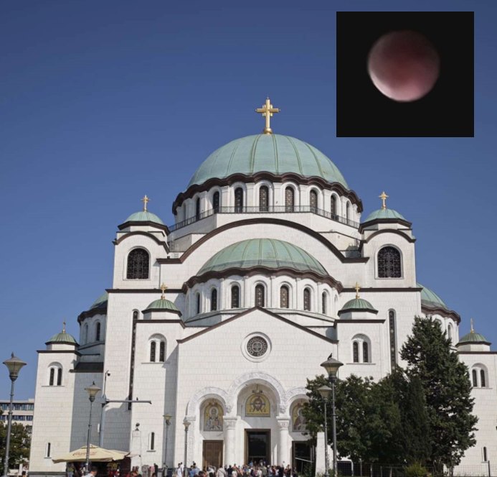

Slide 2

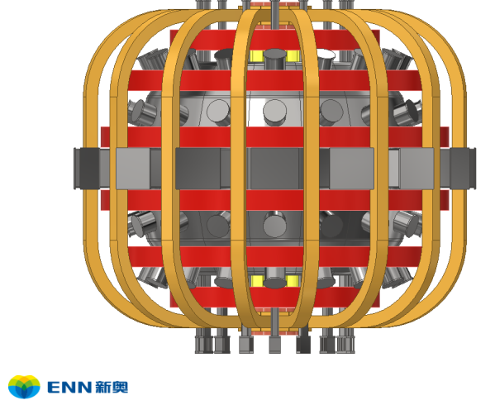
Fusion Energy at the Cross Roads and
Proton-Boron Fusion: A Path to Aneutronic Energy or a Scientific Mirage?
Dieter H.H. Hoffmann
a collaborative effort of
¹Xi’An Jiaotong University, Xi’An, Shaanxi, P.R. China
² Hebei Key Laboratory of Compact Fusion, Langfang 065001, China
³ENN Science and Technology Development Co., Ltd., Langfang 065001, China ⁴Institute of Modern Physics, CAS, Lanzhou 730000, China

Slide 3

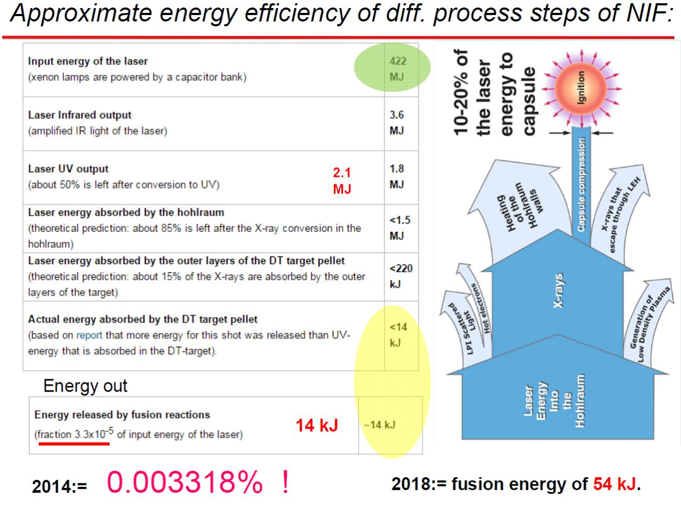

Inertial Fusion Breakthrough at NIF, Livermore
Exceeded Lawson criterion for ignition in 2021 (1.37 MJ
2.8 MJ in 2022 Now more than 8 MJ
2021/22 fusion energy $≈$ 1.8 MJ/2.8MJ/> 8MJ
Notes:
Very little of the original 422 MJ arrives at the target

Slide 4
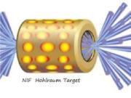
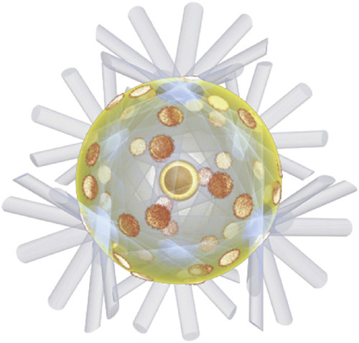
Workshop on spherical Hohlraums: October 9-11 in Xi‘An, China
Why did NIF start with an unfavorable geometry?
courtesy Lan Ke

Slide 5
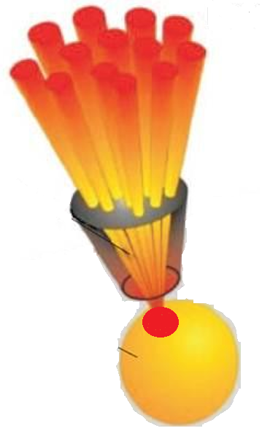

Fast ignition with Laser Generated Particle Beams
e, p,$α$, or even more heavy ions
(not yet successfully demonstrated!!!)
Laser beam(s)
Precompressed fusion fuel

Slide 6
Upcoming: New amplifier scheme: Lan Ke (POP submitted) Double Cone ignition: see talk on IFSA by Zhang Jie

Slide 7
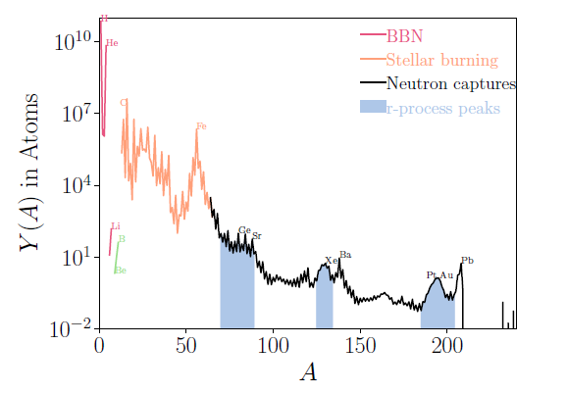
Abundance pattern of Nuclei in the solar system
. Courtesy B. Jiang XJTU

Slide 8
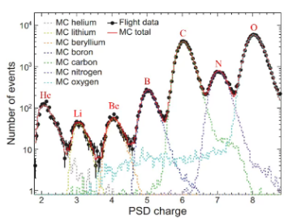
Spectral Hardening in Cosmic Ray Boron Spectrum.
Courtesy DAMPE coll. PRL 134 191991 May 13, 2025

Slide 9
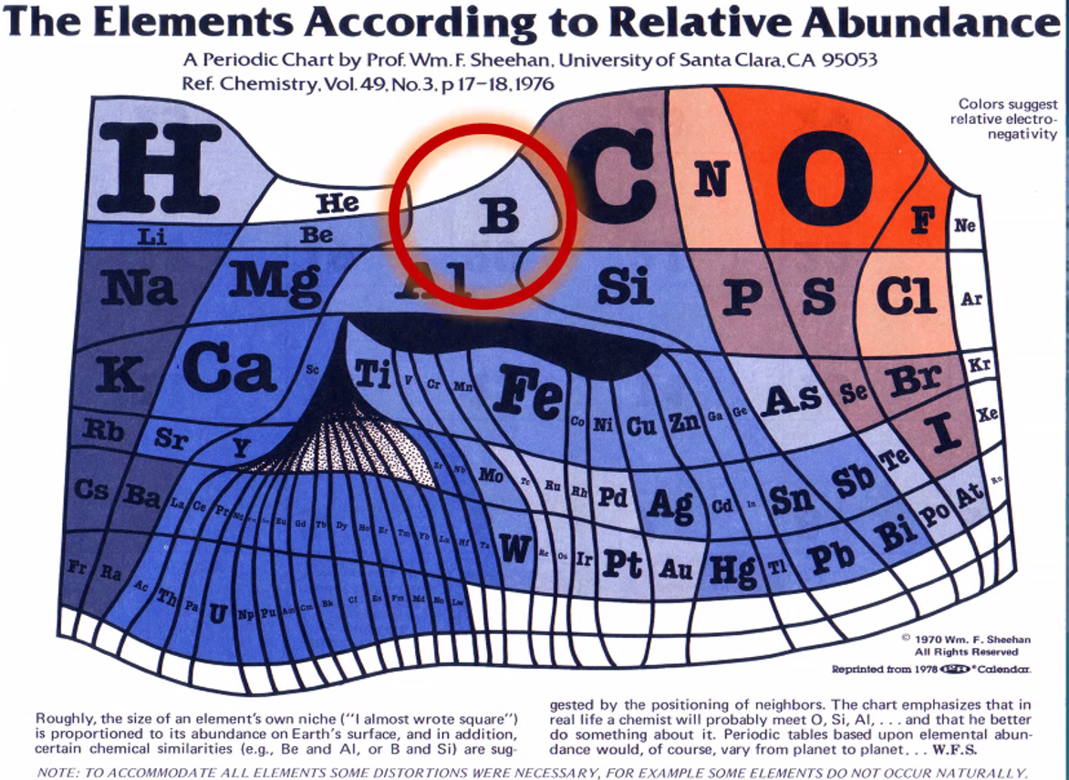

Slide 10
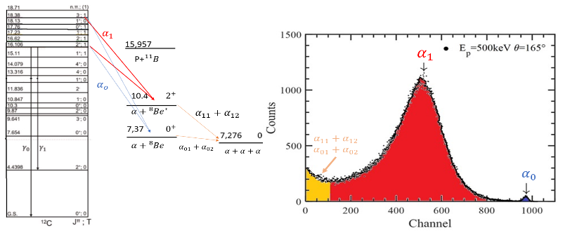

Level Diagram of ${}_{ }^{12}C$ and Decay Modes

Slide 11
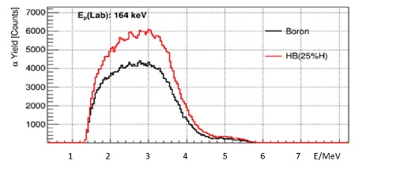
. Increased alpha particle yield for hydrogen doped boron Target.
ENN Experiment at IMP Lanzhou

Slide 12
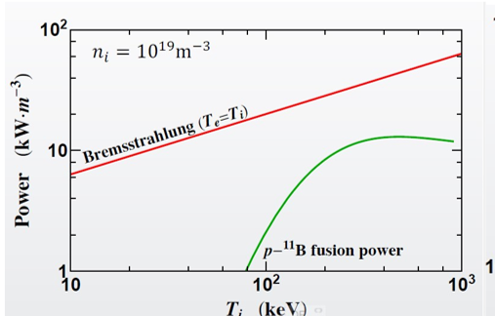

Slide 13
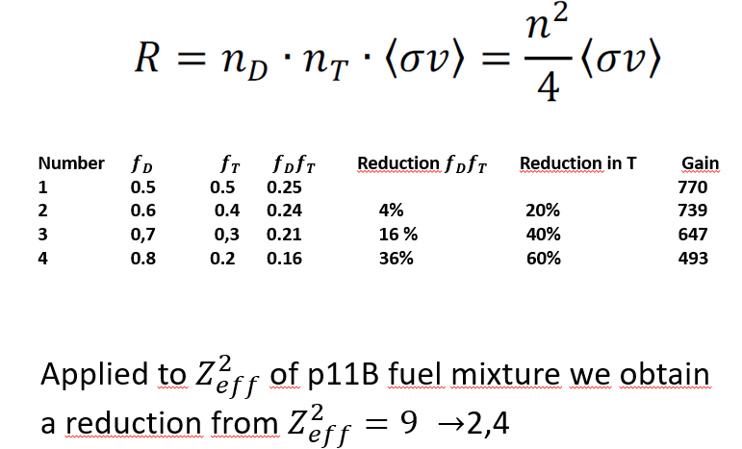
How to decrease the effective charge

Slide 14
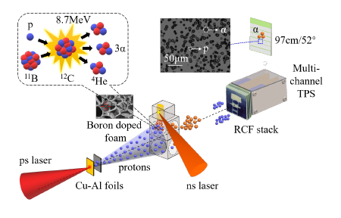

Slide 15
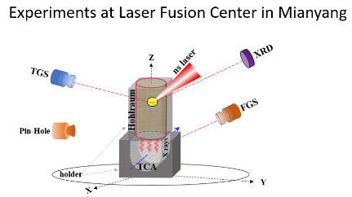
we used laser-accelerated protons and observed orders of magnitude more alphas than expected from pure beam-target interaction

Slide 16
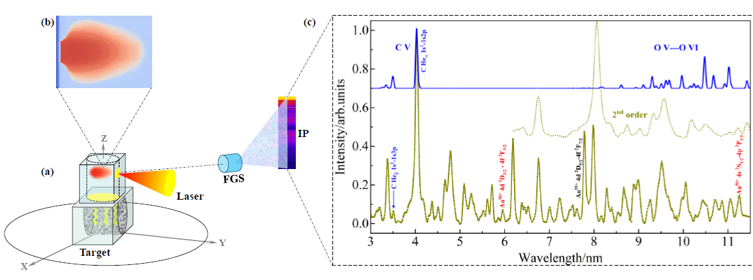
High Resolution Spectroscopy

Slide 17
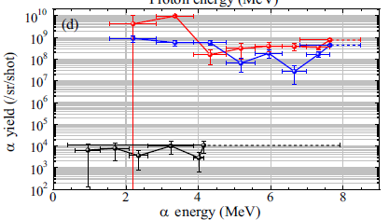
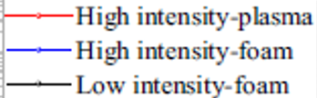
Alpha Particle Yield

Slide 18
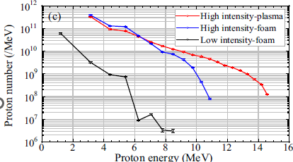

Slide 19
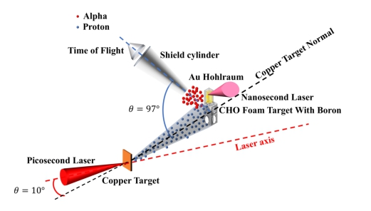
Set Up with Time-of-Flight detector
Set Up with Time-of-Flight detector

Slide 20
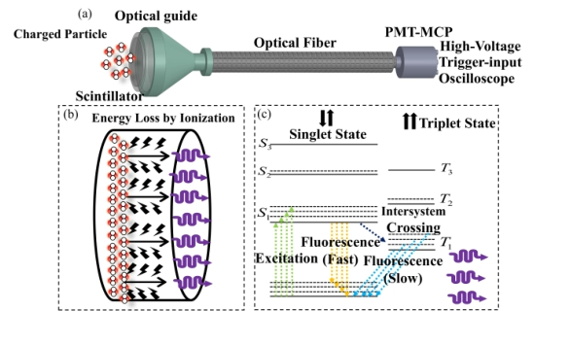

Slide 21
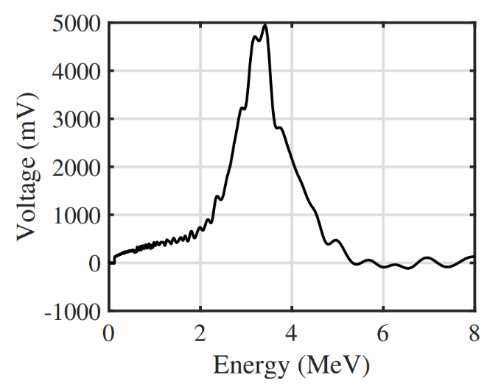
Energy spectrum of α-particles from proton-boron fusion reactions.

Slide 22
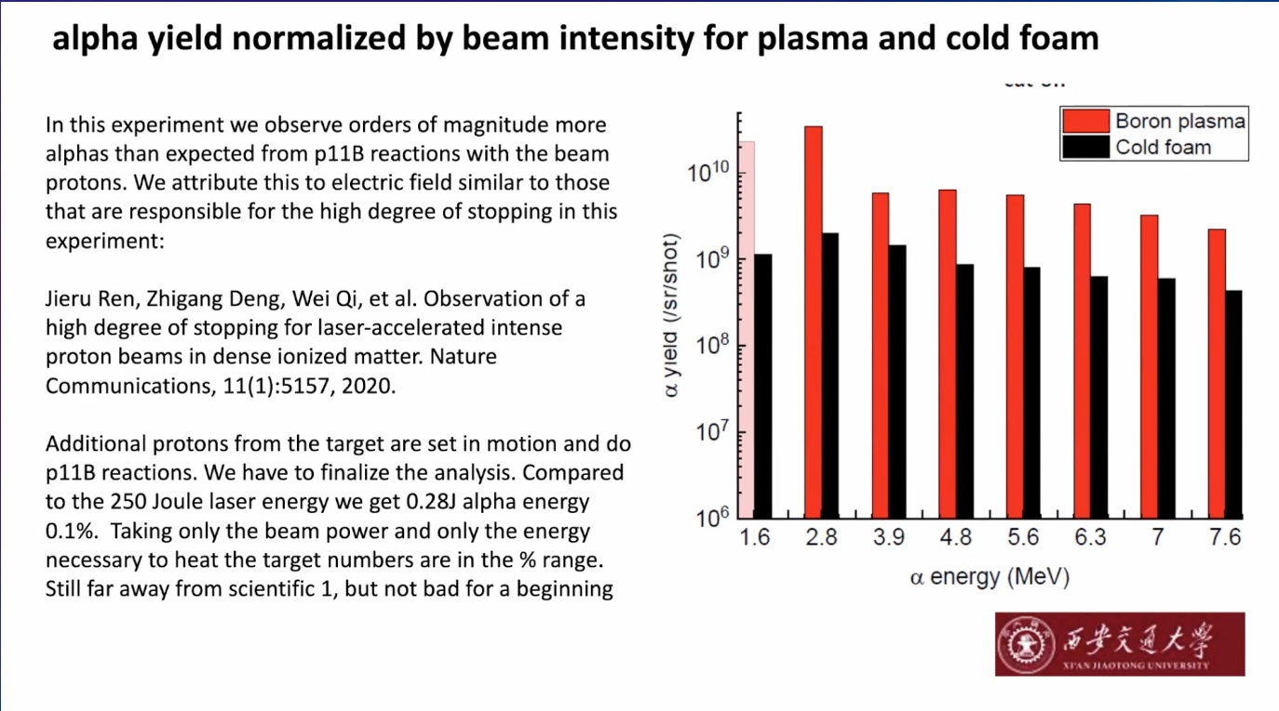

Slide 23
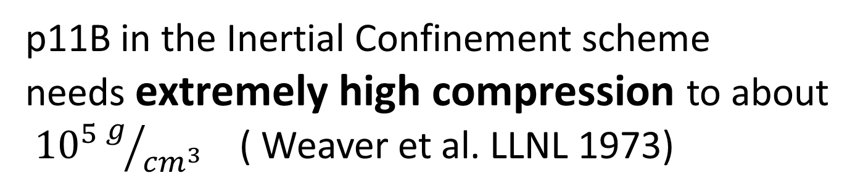
Problems for p11B energy production
p11B in the Inertial Confinement scheme needs extremely high compression to about
${10}^{5}g/{{cm}^{3}}$ ( Weaver et al. LLNL 1973)
We need an efficient driver to do the compression work
Notes:
Due to my experience with Boron targets it needs a huge effeort to produce Boron inertial fusion targets with the required surface roughness. It seems to be a technical problem but is probably not easy to achieve

Slide 24
The amount of problems and the effort it takes to solve them is a conserved quantity. (applies also for MCF and ICF)
Science
Technological Issues
Fusion Energy
DT
Science
Fusion Energy
p11B
Technological Issues
Time x funding x ideas x young fusion enthusiasts
(arb. Units, maybe even logarithmic scale)

Slide 25
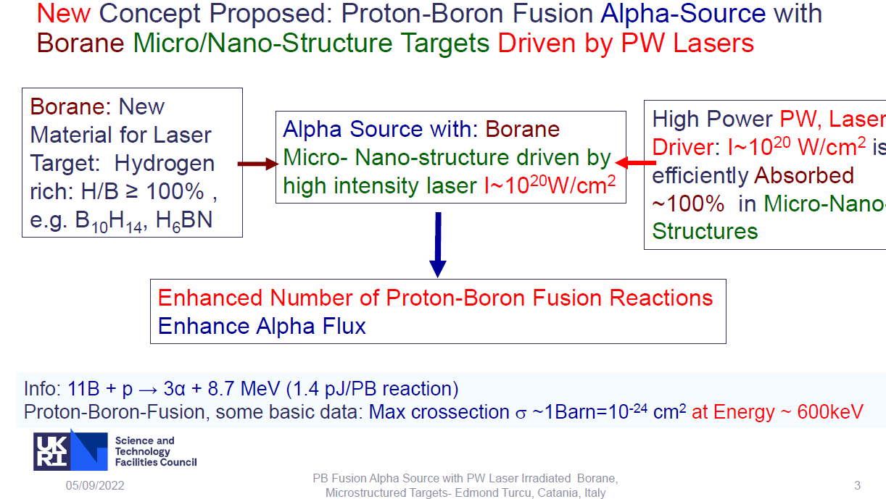

Slide 26
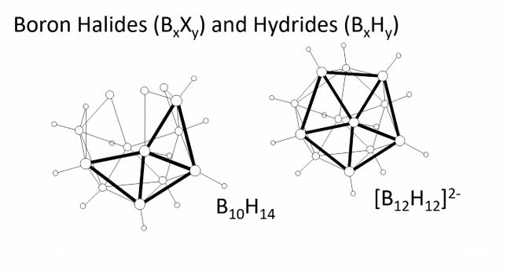

Slide 27


Slide 28
Conclusion:

